Slide 1
NON-CODE USE CASES FOR GIT AND GITHUB
Elizabeth Miraglia
Assistant Program Director, Metadata Services
Head, Books & Serials Metadata
UC San Diego Library
Notes:
The presenter is still very much a beginner user of git and github. Most of the content represents significant trial and error (or the work of much more skilled colleagues). Anyone who is an intermediate or advanced user is free to leave now, no questions asked.

Slide 2
DIGITAL OBJECT METADATA AT UCSD
What does the Digital Object Metadata Unit do?
  Perform mapping, normalization, clean up and reconciliation for metadata created by data providers and researchers for ingest into our digital repository
  Clean up and manage existing repository metadata
  Primarily work with excel files
Notes:
Excel is most common file submitted and is the format for ingest
limited file level collaboration - one metadata analyst works per project

Slide 3
DIGITAL OBJECT METADATA AT UCSD
How the unit uses git:
  Versioning of metadata file during munging
  Documentation & work tracking
  Shared access to project files
  Issues for tasks and discussions
Notes:
Documentation - useful for projects with long dormant periods or for projects with multiple batches
Shared access to project files (facilitate project hand off between staff, access to past project files)

Slide 4
DIGITAL OBJECT METADATA AT UCSD
Git features in use:
  3 admin level contributors commit to the “code”
  Push and pull data to and from master branch only
  Commit messages for documentation and tracking
  Other users have more limited access
Features the unit does not use:
Branching and merging
Diffs
Notes:
UCSD git repo is private due to content that is not publicly accessible in the DAMS
Using diffs on excel files is difficult/impossible and with only 3 users there’s no real need for branching
“other users” have access for discussion of issues and work, but do not commit code/metadata files

Slide 5
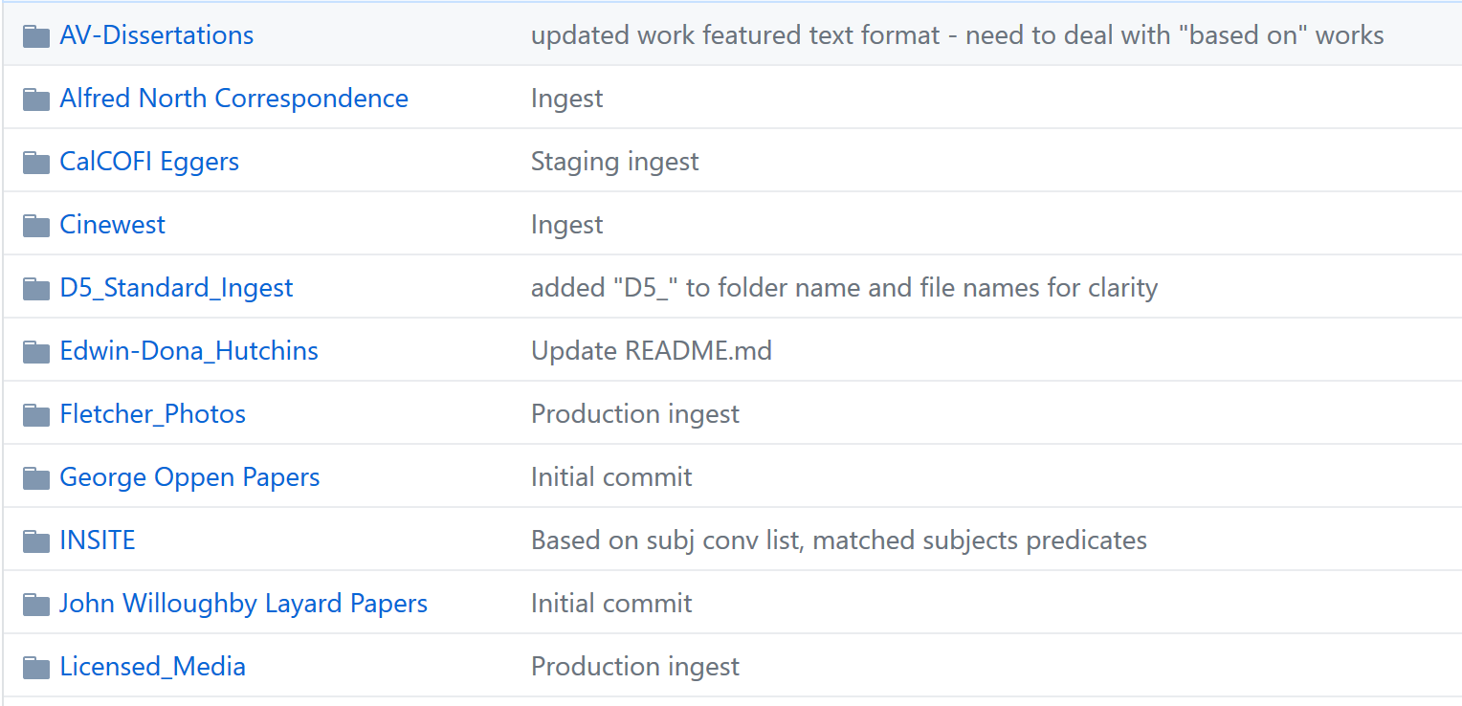
Notes:
Demo of standardized commit messages

Slide 6
DIGITAL OBJECT METADATA AT UCSB
Current applications for git:
XSLT management
MODS and some MARC file storage
Digital object metadata creation, clean up and validation prior to ingest into digital library

Slide 7
DIGITAL OBJECT METADATA AT UCSB
Git features in use:
Version control
Branching
  Including “test” branches (ex. for CJK characters)
Merging
  Potential for some large-scale work in the future
Automated hooks
Notes:
Test branches were created with CJK data before the real metadata for the CJK manuscript collection was available. These branches were never merged back to the master

Slide 8
DIGITAL OBJECT METADATA AT UCSB
Branch rules and best practices:
Metadata editing happens only on branches
Branches that are ready for production are then merged back into the master
Ingest only happens from the master branch
Git repository includes guidelines for when to create a branch
Notes:
From Chrissy: We also developed guidelines for when to create branches and how they should be named. As part of the workflow development process, we identified four scenarios when we might need to create a new branch:
when we have a new collection that is not yet ready for ingest (either because of outstanding metadata work or because the code is still under development)
we need to batch update the metadata for a previously ingested collection because of some code change (great example is our righsstatement.org implementation)
batch updates to the metadata not requiring a code change (e.g., for metadata maintenance → we aren’t quite at this stage yet)
to provide sample records for our development team (these branches are never merged)
We also specify how the branches are to be named for easy tracking. New collections are given the name of the corresponding JIRA ingest ticket for the ingest. Code related changes are given the name of the JIRA development ticket tracking that work. Our metadata maintenance team plans to eventually set up another JIRA project to track their work. And finally all sample record branches are labeled as “sample”.

Slide 9
DIGITAL OBJECT METADATA AT UCSB
Validation and automated hooks:
Code available here: https://github.com/ucsblibrary/metadata-ci
Metadata that has been initially cleared for ingest undergoes one last QA review by means of a pull request and validation scripts
Notes:
And then some magic happens via connection to “Jenkins” and reports are generated for review/correction.

Slide 10
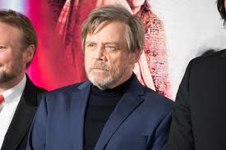
MARC METADATA AT UCSD
WHO IS MARC AND WHY DOES HE HAVE SO MUCH METADATA?
“Star Wars: The Last Jedi Japan Premiere Red Carpet: Mark Hamill” by Dick Johnson, licensed under CC-BY 2.0

Slide 11
MARC METADATA AT UCSD
BACKGROUND:
Machine Readable Cataloging
Created in the 1960s by Henriette Avram
Highly dependent on text strings
Fantastic for flat file structures
Less great at semantic relationships
Not well known for interoperability

Slide 12
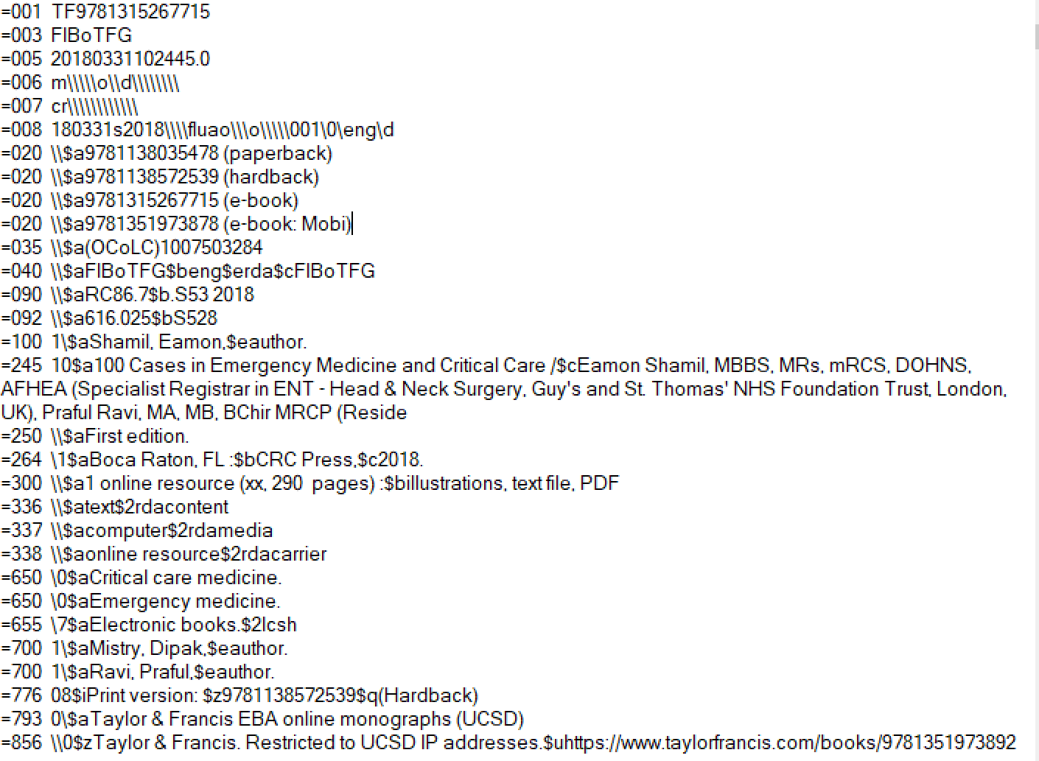
Notes:
001 pre-pendix, point out lcsh, 856, 7xx fields for linking, 793 for collection

Slide 13
MARC METADATA AT UCSD
BACKGROUND CONTINUED:
Patron-driven acquisition and working with vendor data
Taylor & Francis presented a unique workflow: discovery records were only available as a complete set vs. other vendors who provide update files
Removing and re-loading the entire file each month was not a viable option
Need for local edits before loading into local systems
Need to track changes and no desire for multiple files each month
Notes:
T&F update files were often erroneous. We receive 1-2,000 new titles each month. Wanted something that would ultimately be reproduceable, shareable.
Provide background on what patron-driven acquistion was and why these records were different. Also note that we are fairly unique in adding these to our catalog at all

Slide 14
MARC METADATA AT UCSD
GOALS:
Version control for the vendor-provided data
Rely on commit messages to identify versions instead of file names
Use diff file to identify new titles to be loaded
Become more familiar with git BASH interface and github

Slide 15
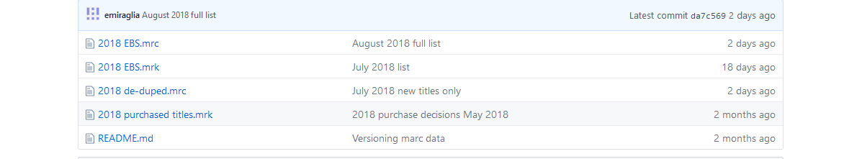
MARC METADATA AT UCSD
SUCCESSES:
Have been able to load files and push to a Github repository: https://github.com/emiraglia/TaylorFrancisEBS
Version control is working, have been able to pull previous iterations and have gotten better at meaningful commit messages

Slide 16
MARC METADATA AT UCSD
CHALLENGES:
File size: working with files over 50MB is difficult
Diff file: getting a successful diff is proving challenging (likely due to MARC format issues)
Notes:
if anyone has diff advice I would love it.

Slide 17
MARC METADATA AT UCSD
NEXT STEPS:
Try out git’s large file system
Try the same process with a smaller set of records with more specialized data
Investigate potential for collaboration with other units across the library (can I give this workload back to acquisitions?)
Notes:
large file system to hopefully prevent warning messages
collaboration: handing workflow back and/or staging downloads on github for database maintenance to grab

Slide 18
Summary Pros:
Version control
Commit logs provide a way to track changes
Collaborate and experiment in a secure way
Variety of available tools
Flexible
Closer collaboration with developers
Empowers and provides more control to metadata librarians
Allows more shared access to files between users
Notes:
(command line to various gui’s) lets staff work at different levels
flexible: workflow and file format-wise
shared accessfor project metadata (between multiple metadata staff)
This makes it easier to investigate past projects if needed even if the original analyst isn’t available (i.e. investigating where a data problem originated)
Shifting work between different analysts (i.e. picking up when someone is on leave)

Slide 19
Summary Cons:
Barriers to entry can feel high
Learning curve can be steep
Need for continued practice
Potential for data loss with larger files without added installations
Notes:
need for continued practice: this is not at all like riding a bike

Slide 20
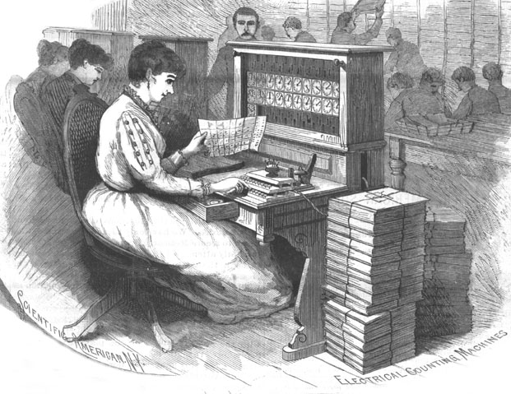
GITHUB FOR JOURNAL EDITING AND PUBLICATION
The Programming Historian: https://programminghistorian.org
“We publish novice-friendly, peer-reviewed tutorials that help humanists learn a wide range of digital tools, techniques, and workflows to facilitate research and teaching. We are committed to fostering a diverse and inclusive community of editors, writers, and readers.”
Notes:
The Programming Historian is an open source, peer-reviewed publication consisting of programming tutorials and blog posts

Slide 21
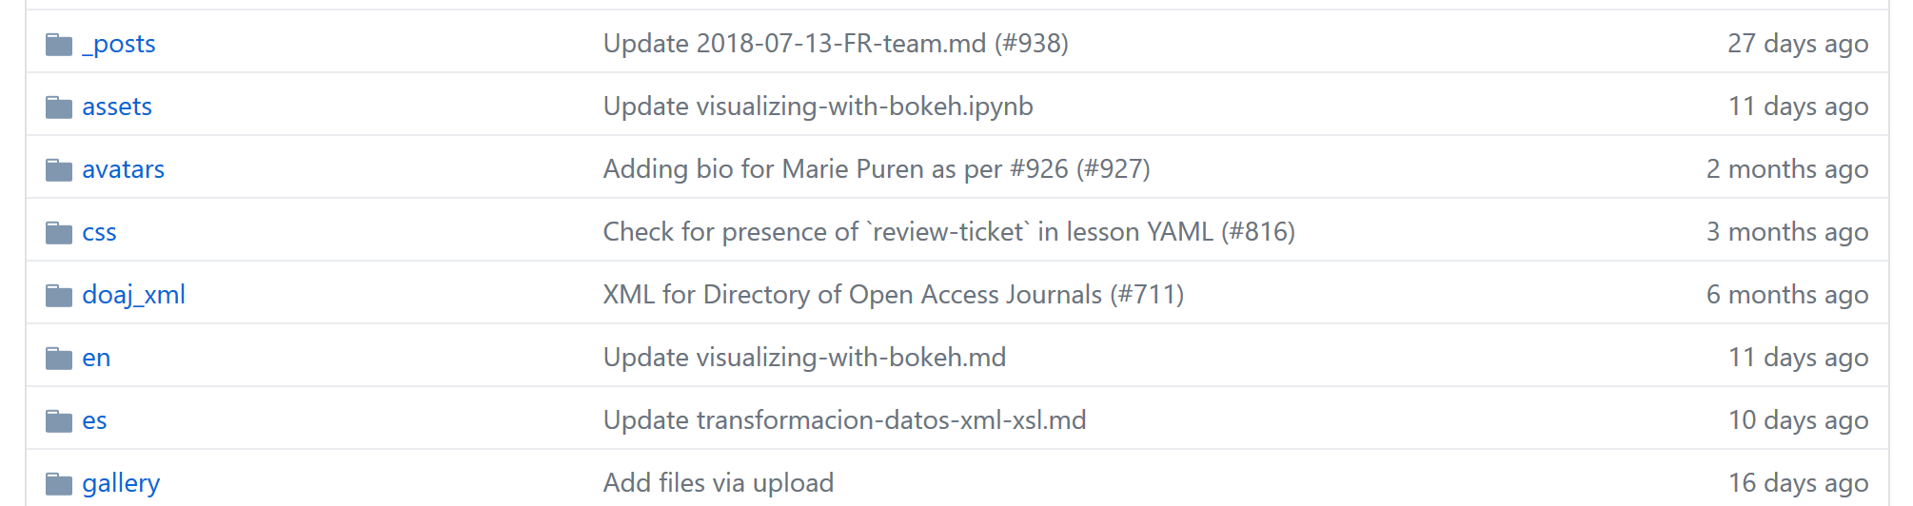
GITHUB FOR JOURNAL EDITING AND PUBLICATION
Repository for The Programming Historian: https://github.com/programminghistorian/jekyll
Notes:
the journal is published using jekyll, so Github is actually an integral part of their publishing process beyond the normal file storage/version control uses. the indexing xml for DOAJ is also included

Slide 22
GITHUB AT THE WHITE HOUSE
Office of the Federal Chief Information Officer using github to stage documents for public comment: https://github.com/ombegov/a130 and to edit and consolidate existing sites: https://github.com/ombegov/policy-v2
Site also relies on Jekyll and other softwares
Files and site are public domain

Slide 23
Thank you!
Contact for UCSD Digital object content: ahutt@ucsd.edu
Contact for UCSB Digital object content: crissmeyer@ucsb.edu
Presenter/contact for UCSD MARC content: emiraglia@ucsd.edu

