Slide 1
Zooming to the Future
Video Conference Technology in Resident Education
Martin Rawlings-Fein
Radiology IT @ UCSF

Slide 2
Disclosures
I have worked is the UC system for the past 17 years
Initially I was at Cal doing document delivery
Now I am at UCSF doing Radiology Resident Education which consists of setting up conferences between 14+ distinct sites across the urban campus.
  ZSFG (2), Mission Bay (3), Parnassus (3), VAMC (2), Mt Zion (3), China Basin (1)
I am part of the Zoom Working Group at UCSF

Slide 3

Videoconferencing

Slide 4
Definitions
Video Conferencing - provides real-time two-way audio/video communication between two or more locations.
Web Conferencing - provides live audio/video communication between two or more locations to conduct meetings, training, or presentations via the Internet.
Webinar - a specific type of web conference that is typically one-way (speaker to the remote audience with limited remote audience interaction).
Webcast - is essentially "broadcasting" over the internet or streaming.

Slide 5
Radiology Residents
UCSF provides a superlative training experience for its radiology residents…We are so fortunate to learn from radiologists who are not only leading the field but who also see our training as a top priority.”
    Emily Edwards, MD, Residency Class of 2018
  We do not use patient data in any resident conferences regardless of the HIPPA and FERPA protections assured by the Business Associate Agreement (BAA)

Slide 6
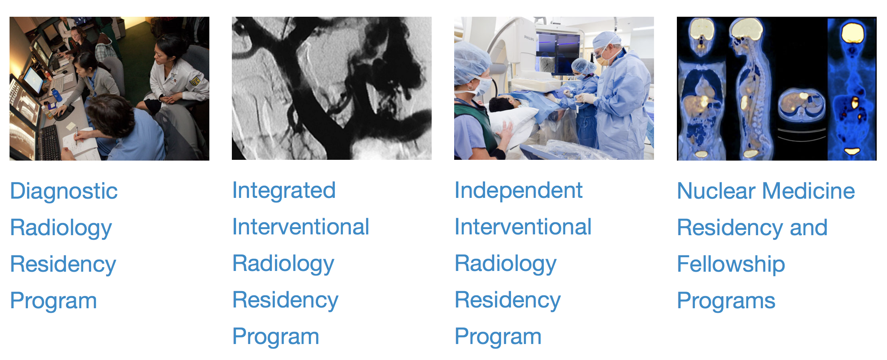
Radiology Residency Programs

Slide 7
Clinical Education of Residents
Morning and Noon Conferences
Short PACS Teaching Sessions at ZSFG
Grand Rounds
Journal Club
UCSF Resident Review Course (1st of its kind 5 day Conf)
Electronic teaching file with nearly 70,000 unique cases
CORE website
T32 Conferences
MBI, Tech and RN Conferences
Notes:
The faculty in the Department of Radiology are internationally recognized for their clinical expertise and research accomplishments. Even more importantly, our faculty members are highly skilled educators and are committed to resident education.
picture archiving and communication system (PACS)
Residents attend these lectures in person or via videoconferencing system accessible from videoconferencing suites at each hospital or on residents' laptops and tablets.
Invited speakers from around the country give Grand Rounds at various times during the year. This lecture series provides UCSF residents an opportunity to interact with well-known and respected faculty members from other institutions. In addition, senior residents invite the speaker of their choice for a visiting professorship each year.
A journal club is conducted with each section's lectures to help residents read literature critically. Each journal club meeting focuses on one or two significant papers. The meetings are conducted by two faculty members with training and expertise in epidemiology and research design.
Five full-day sessions Monday through Friday, from 8:00 am to 5:00 pm, with a 90-minute lunch break mid-day. Lectures will cover the major radiology subspecialties in half-day sessions as listed below. Each subspecialty will include didactic lectures and unknown/instructive cases. Speakers will feature 45 UCSF Radiology Faculty.
UCSF offers an expansive array of digital teaching media, including an electronic teaching file with nearly 70,000 unique and interesting cases (as of May, 2013), as well as a CORE website that presents the imaging features of a wide variety of diseases in a manner that facilitates preparation for board certification exams. There is also a traditional library containing a large collection of reference texts and videos available for checkout.
T32 Training Grant - Research Training in Biomedical Imaging - The T32 program exists to jumpstart the academic careers of junior radiologists and nuclear medicine physicians and to provide the essential foundation for developing a research program as an independent investigator.

Slide 8
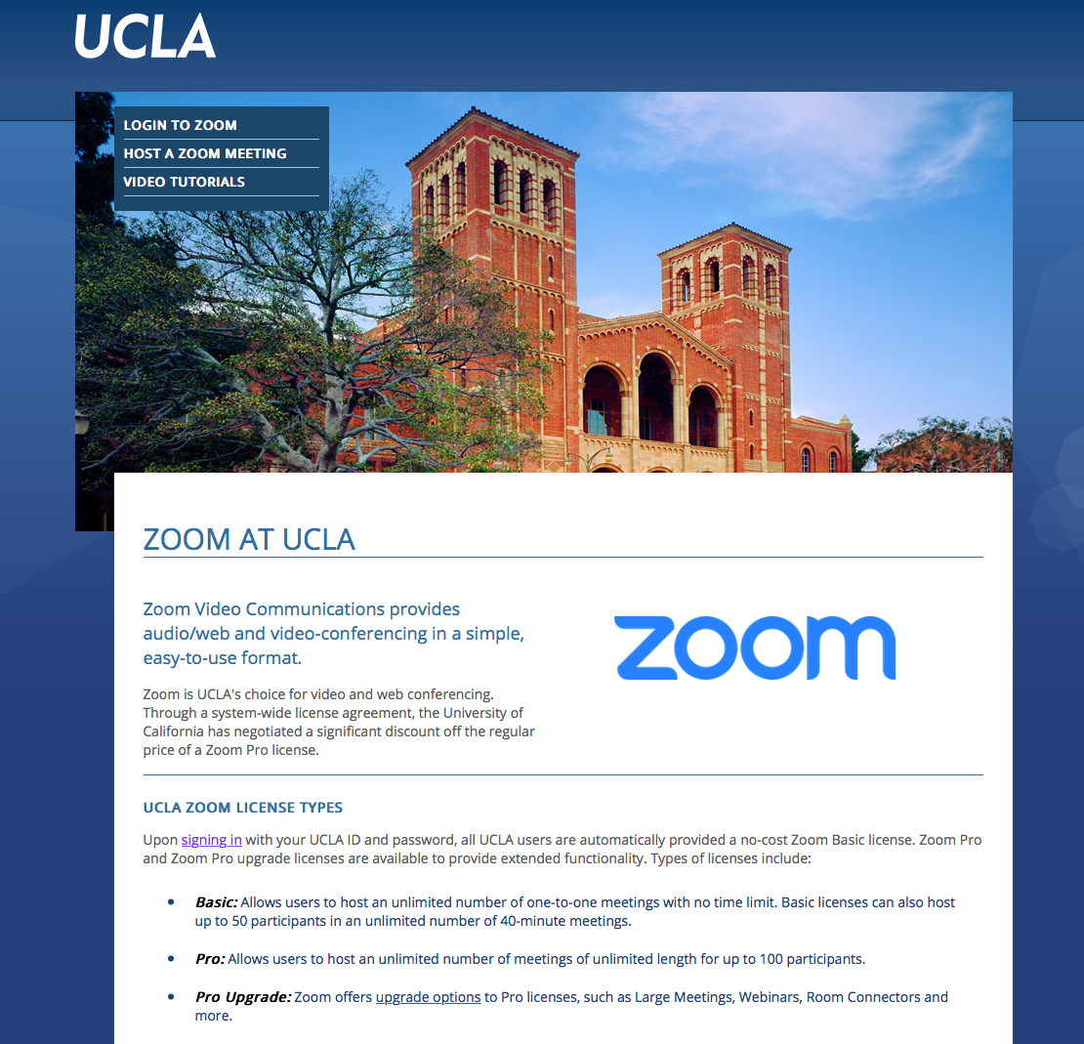
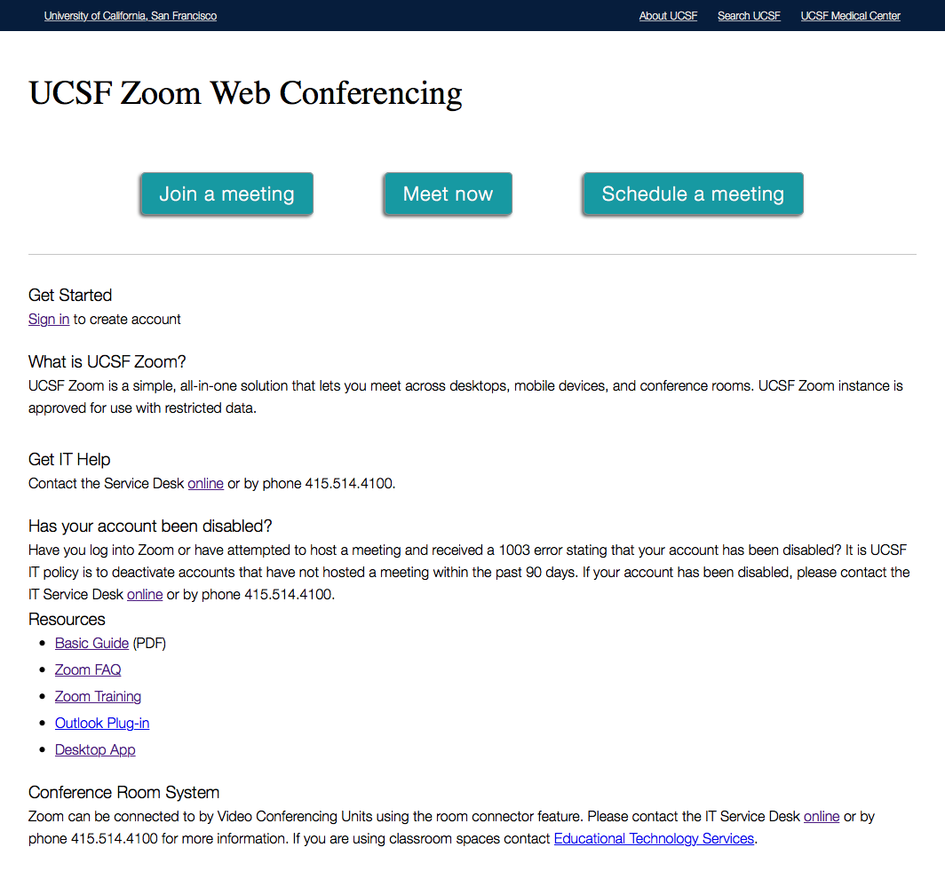
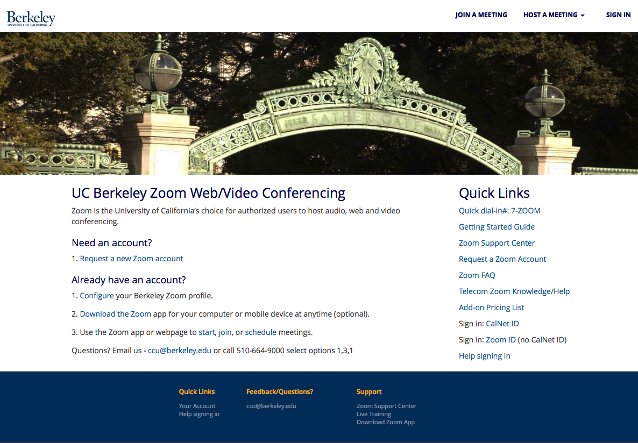
Web Conferencing
Our program uses ucsf.zoom.us
On top of a robust cisco videoconferencing network we are able to engage wherever residents, fellows or students have a mobile device
The UC uses Zoom:
  Different Rollouts
  Same Zoom

Slide 9



Evolution of EdTech in Radiology
Notes:
Health for the World a project of the Radiology Society of North America (RSNA) used Zoom before the Radiology Department or the University.

Slide 10
Why Zoom?
UCSF Zoom is a simple, all-in-one solution that lets you meet across desktops, mobile devices, and conference rooms. UCSF Zoom instance is approved for use with restricted data.
Zoom can be connected to by Video Conferencing Units using the room connector feature.
Notes:
[zoom number]@zoomcrc.com

Slide 11

Beyond the Standard Zoom Menu Bar
Mute and Unmute
End Meeting
(End Meeting for All
Closes the Call for all sites)
Polling
(Note: You can only
create a max of 25 polls
for a single meeting.)
Annotate
Start and Stop Video
(No Need for Post its)
Breakout Rooms
Chat with participants
Share your Screen
(Select “Share Screen” during Meeting)
Record
(Click “Record” to begin
recording the audio and
video screen share. )
Invite
(Once you click invite, Invite by Email,
Invite by IM, Invite by Phone)

Slide 12
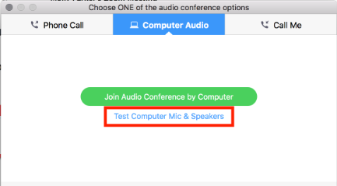
Joining Audio ( Through Computer)
Prerequisites
Microphone, such as the built in microphone, a USB microphone or an inline microphone on headphones
Speaker or headphones
When joining a meeting, if you haven’t
selected to always join audio by
computer, a prompt will appear.

Slide 13

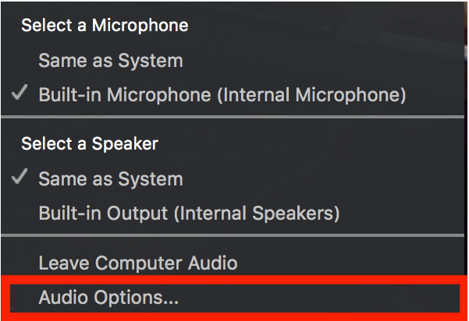
Joining Audio ( Through Computer)
During a Meeting You can access your audio settings and test your audio when you are already in a meeting. In the meeting controls, click the arrow next to Mute/Unmute.
Click Audio Options.
This will open your audio settings.

Slide 14
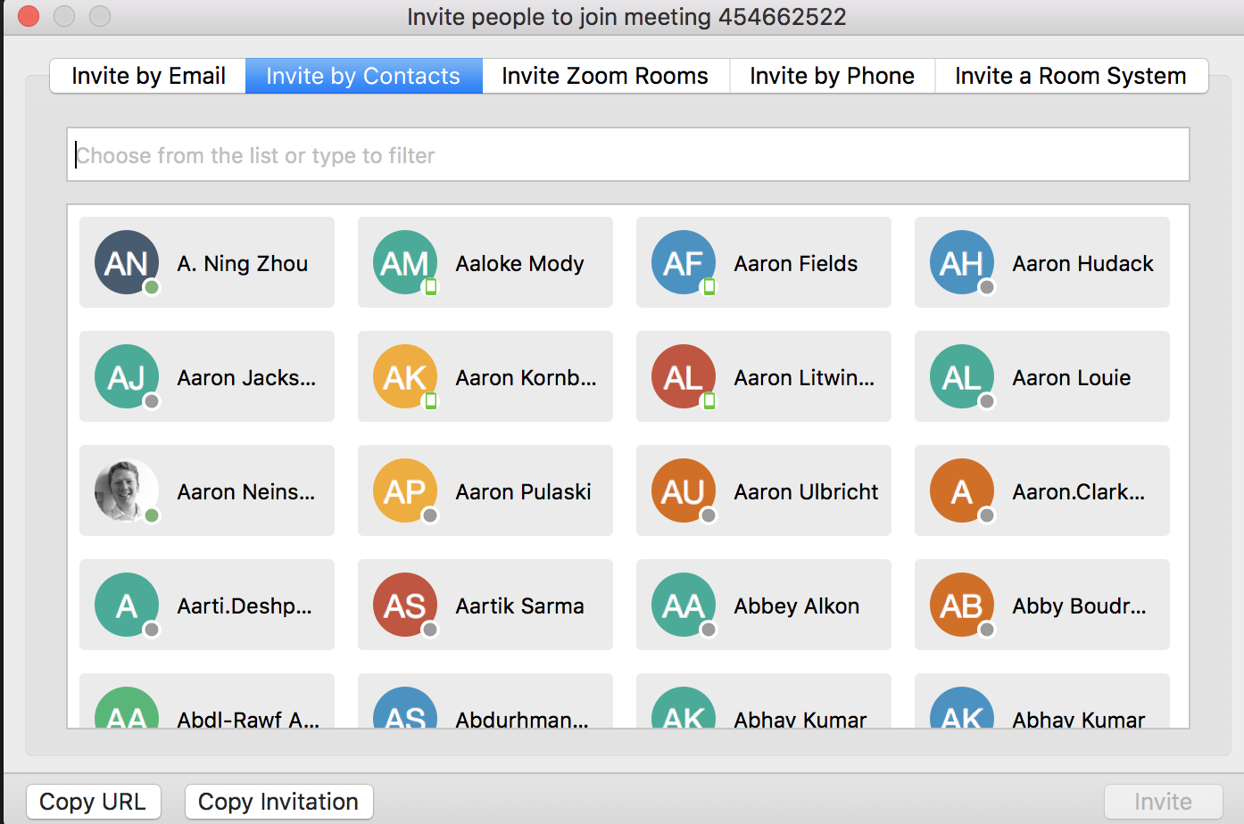
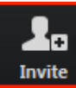
Invite People to Join Meeting
During a meeting, you can invite people to join the conference by clicking on Invite tab in your meeting controls.
Click Copy URL or Copy Invitation if you want to send your instant meeting information elsewhere. Copy URL will copy the join link and Copy Invitation will copy the full invitation text. You can then paste it using ctrl-V on a PC, cmd-V on a Mac, or by right-clicking and choosing Paste.

Slide 15
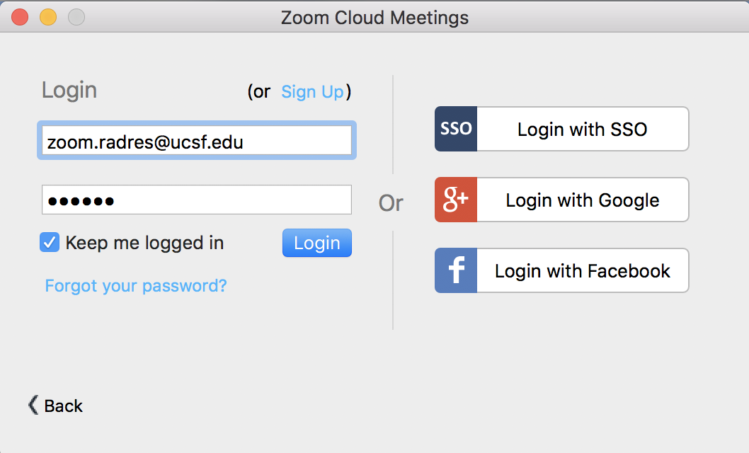
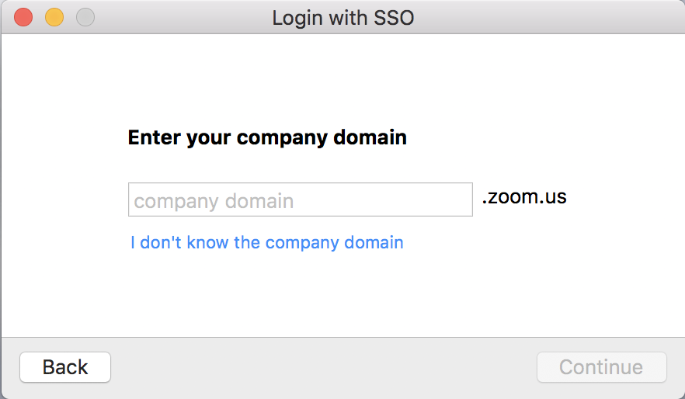
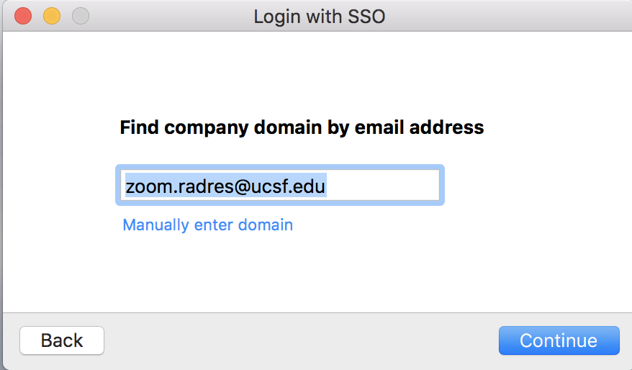
Using Your Desktop App
Download or open your Zoom Client App and select “Sign in”
Select “Login with SSO”, enter “ucsf” as domain, and enter your MyAccess user name and password

Slide 16
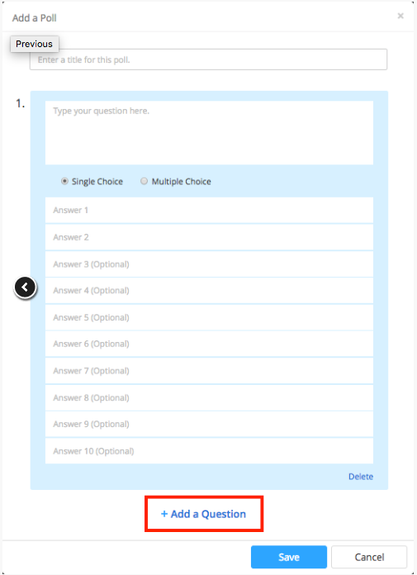
Creating a Poll
Go to My Meetings page and click on your scheduled meeting.
From the meeting management page, scroll to the bottom to find the Poll option. Click Add to begin creating the poll.
Enter a title and your first question. You can mark the question as a single choice or multiple choice question and click Save.
If you would like to add a new question, please click Add a Question to create a new question for that particular poll.

Slide 17
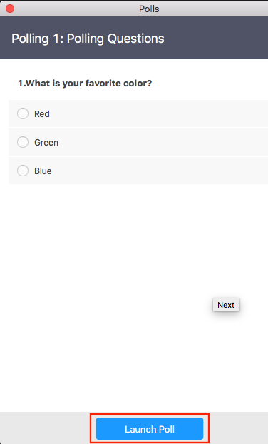
Launching Polling
Start the scheduled Zoom meeting that has polling enabled.
Select the Polling option in the menu bar.
Select the poll you would like to launch.
Click Launch Poll.
The participants in the meeting will now be prompted to answer the polling questions. The host will be able to see the results live.
Once you would like to stop the poll, click End Poll.
If you would like to share the results to the participants in the meeting, click Share Results.

Slide 18
Advanced Sharing (iOS)
Zoom allows for screen sharing on desktop, tablet and mobile devices running Zoom.
The host and attendee can screen share by clicking on the Share Screen icon.
The host does not need to "pass the ball" or "make someone else a presenter" to share.
The host can "lock screen share" so no attendee can screen share.

Slide 19
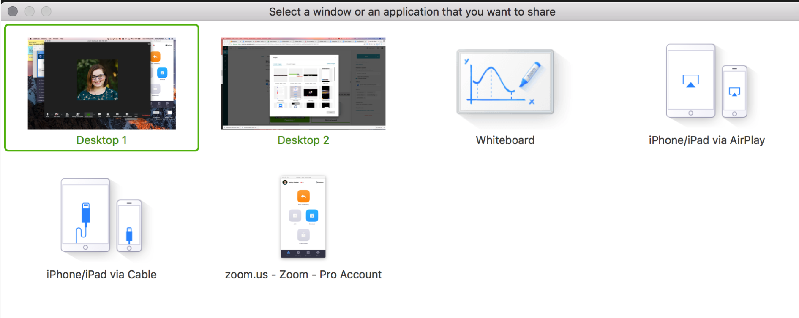
Advanced Sharing (Desktop)
To start screen sharing, select
Share Screen in your meeting
controls.
This will open up the window
to select a window to share.
Click the screen you want to
share. You can choose your
desktop, an application that
you already have open, a
whiteboard or an iPhone/iPad.

Slide 20
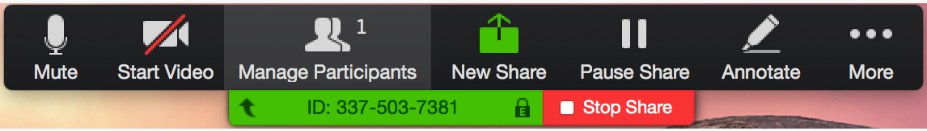
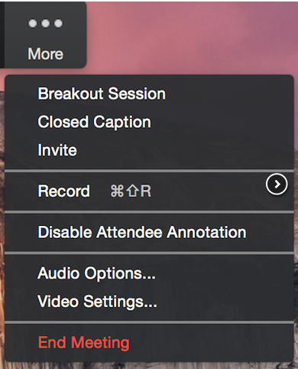
Advanced Sharing
Mute/Unmute: Mute or unmute your microphone.
Start/Stop Video: start or stop your in-meeting video.
Participants/Manage Participants: View or manage the participants (if the host).
New Share: Start a new screenshare. You will be prompted to select which screen you want to share again.
Pause Share: Pause your current screen share
Annotate: Use screen share tools for drawing, adding text, etc.
More: Hover over move for additional options.

Slide 21
Annotation
Annotation tools:
Mouse
Select
Text
Draw
Spotlight/Arrow: Turn your cursor into a spotlight or arrow.
Eraser
Color
Undo
Redo
Clear
Save: this allows you to save all annotations on the screen as a screenshot. The screenshot is saved to the local recording location.
Select Annotate to begin annotating on your shared screen.
This will open the annotation tools.

Slide 22
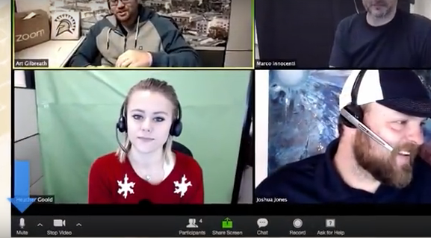
Breakout Rooms
Breakout Rooms allow you to split your Zoom meeting in up to 50 separate sessions. Up to 50 breakout rooms can be created
Max 200 participants in a breakout room (requires Large Meeting 200 add-on)
Breakout room participants have full audio, video and screen share capabilities
Check out: ucsf.zoom.us for videos
Notes:
The meeting host can choose to split the participants of the meeting into these separate sessions automatically or manually, and can switch between sessions at any time.
We only get 100 participants in our pro accounts

Slide 23
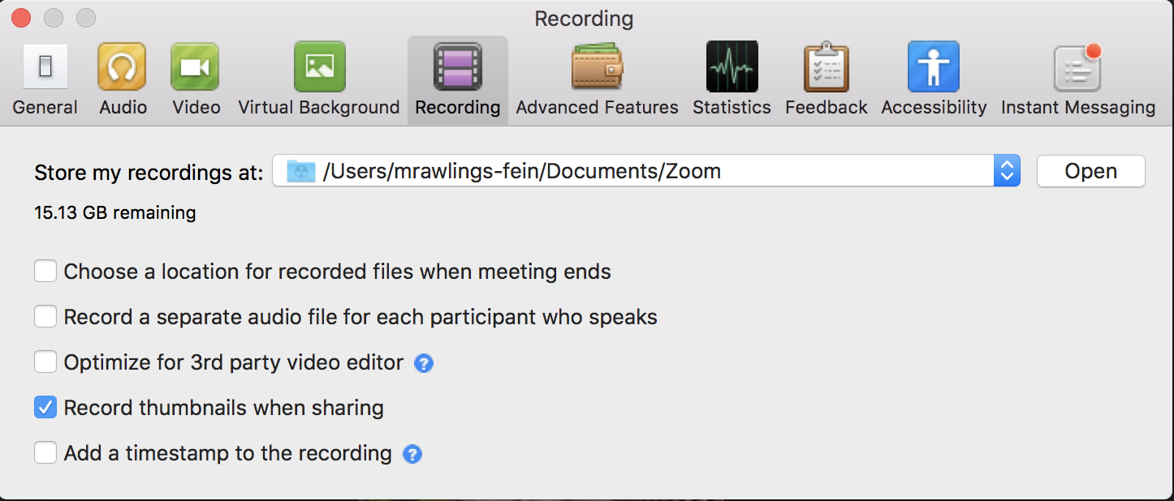
Recording
Start a Zoom meeting as the host.
Click the option to Record.

Slide 24
Recording
Hosts and participants will see the following
indicator in the top left corner when the recording has started.
Note: If the above recording icons are not visible in the meeting, the conference is not recording.
After the meeting has ended, a prompt will appear stating
”You have a recording that needs to be converted before viewing.” Wait for the recording to convert before it can be accessed.
(Note: By default, the audio/video file (MP4) will be named "Zoom_0.mp4.")

Slide 25
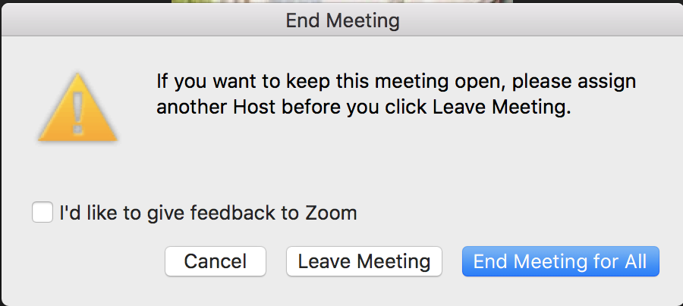
End Meeting
End Meeting: This will end the meeting for all participants. If you want to have the meeting continue, you should give another participant host control before leaving the meeting.
Zooming to the Future: Video Conference Technology in Resident Education

Slide 26
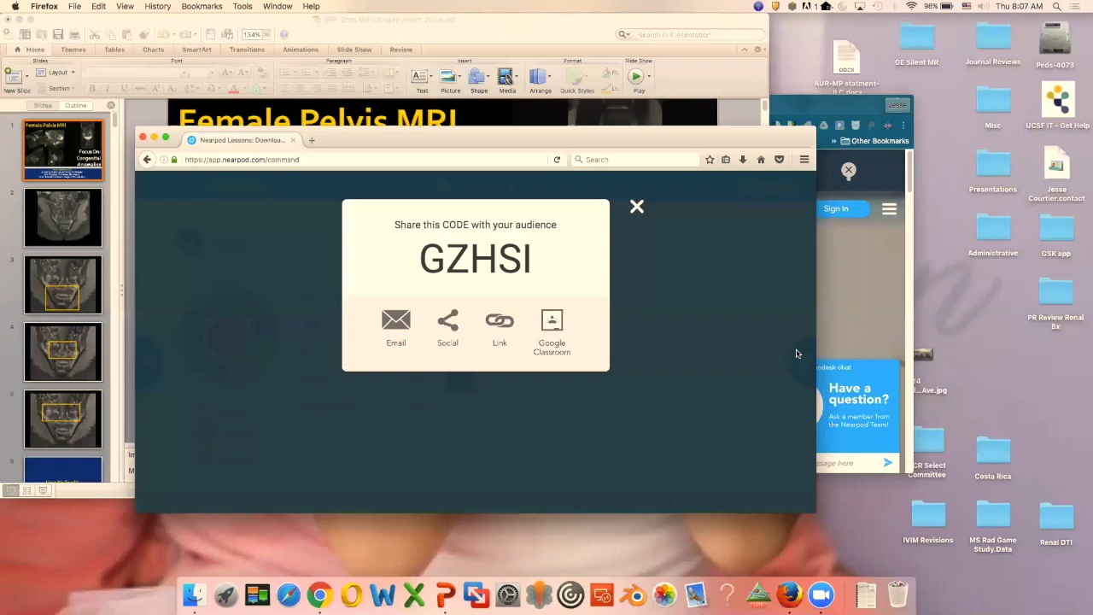
Engaging Education
Nearpod is an interactive classroom tool for teachers to engage students with interactive lessons.
Poll Everywhere is a polling software, like the polling feature in Zoom or Nearpod, you can ask a question and get instant results.
RSNA Diagnosis Live™
Zoom Polling Tool
  All use existing mobile devices,
  smart phones, or tablets, etc.
Notes:
NearPod - Synchronize and control lessons across all student devices
Teachers share a live session, students enter a code, and the lesson is synced to all devices.
Evaluate student responses live or with post-session reports
View student answers individually or as a class and generate post-session reports with one click.
Poll Everywhere works in PowerPoint, Keynote, and Google Slides
"I'm going to ask for your opinion. In order to respond, I need you to take out your phone or any other web-enabled device you may have. Go ahead and do that now.”
Examples include offering prizes for participation, making it a game or competition, and of course giving credit for quizzes or tests.
Radiology Society of North America (RSNA)
Instead of an audience response clicker, use your own mobile device for an engaging learning experience. The radiology classroom will never be the same! Play along by studying images on your mobile device and then choose or locate the answer. Get immediate feedback, and see how you compare to your peers. iPads and Android tablets work best, but you can also play along on smartphones or laptops.
The polling feature for meetings allows you to create multiple choice polling questions for your meetings. You will be able to launch the poll during your meeting and gather the responses from your attendees. You also have the ability to download a report of polling after the meeting.

Slide 27
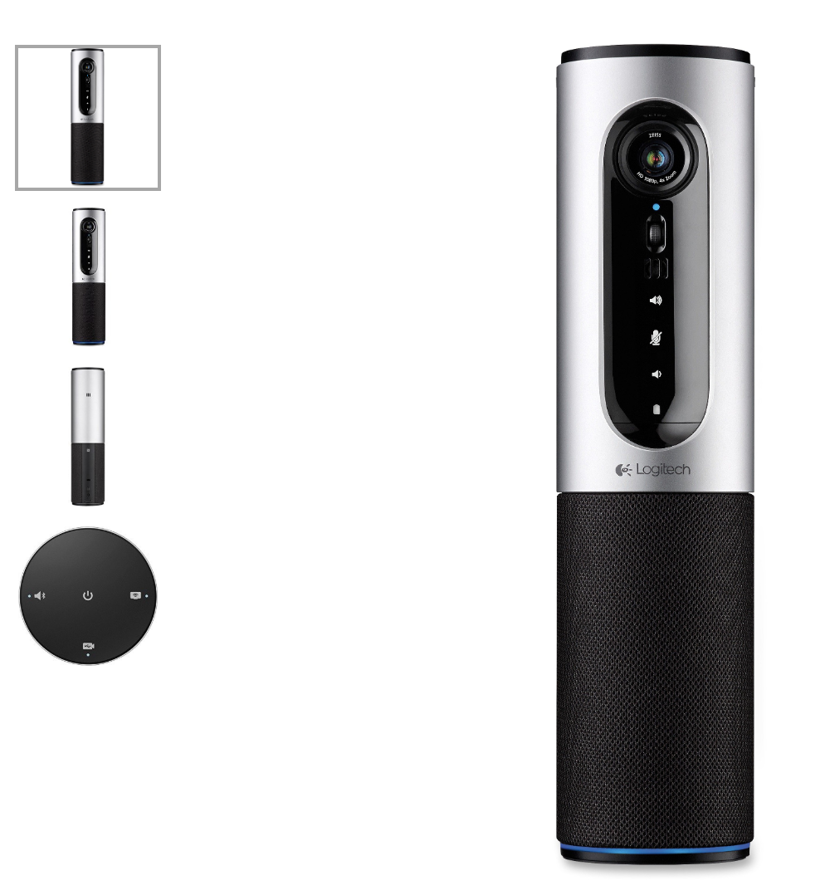
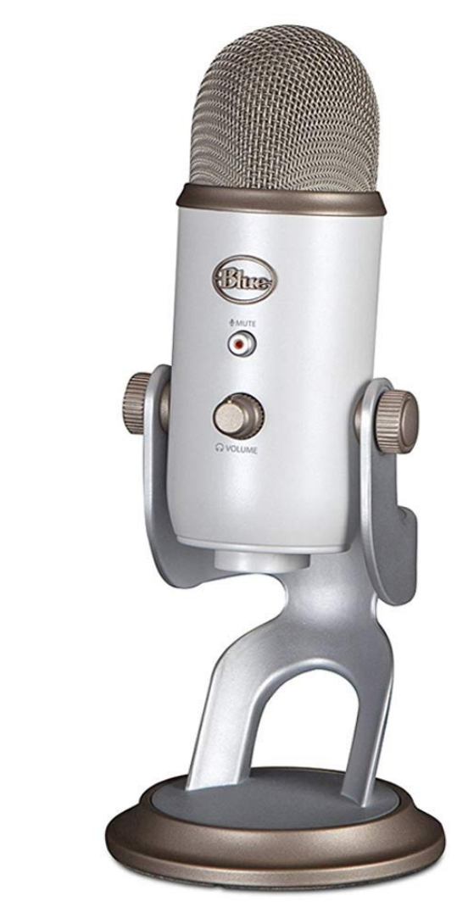
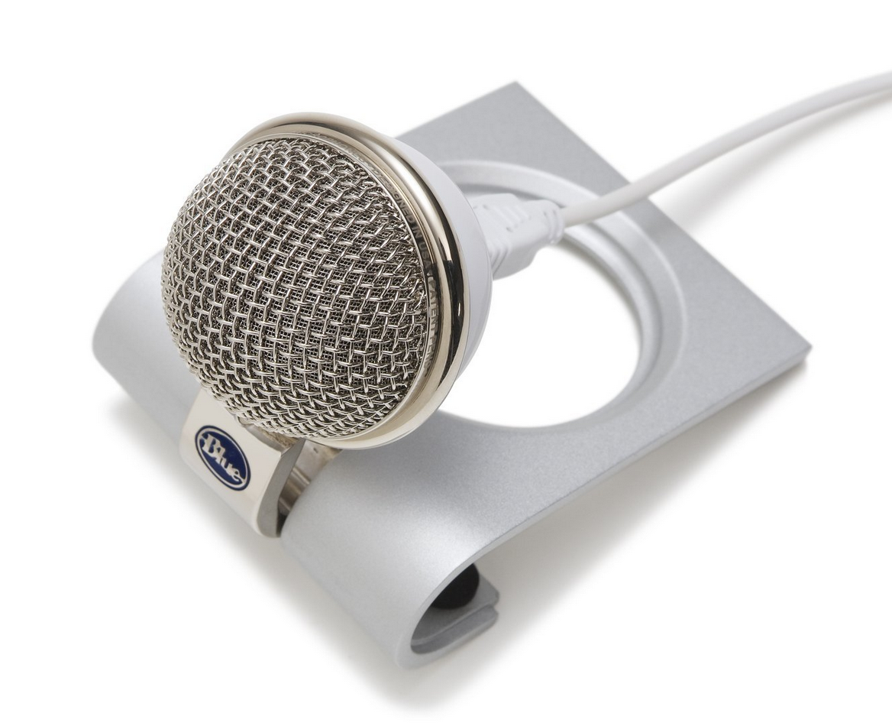
Additional Hardware
Logitech Conference Cam Connect (Audio and Video)
Snowflake Mic (Audio)
Yeti Mic (Audio)
SIP Room Connector (Audio and Video) via [Meeting ID]@zoomcrc.com
Zooming to the Future: Video Conference Technology in Resident Education

Slide 28
Tips & Etiquette
Use Client App and Outlook plug-in for easier scheduling
Customize Personal Meeting ID to host meetings without scheduling in advance (use your phone number as your Zoom number etc.…)
Manage Zoom meetings (edit or cancel) on your Outlook Calendar first then on your Zoom account
Enable Join Before Host option to allow for participants to gather before the meeting starts
For assistance, contact the IT Service Desk at 415-514-4100 or it.ucsf.edu

Slide 29
Questions?
Martin.Rawlings-Fein@ucsf.edu
UCSF Dept. of Radiology & Biomedical Imaging
Educational Tech Specialist
513 Parnassus Ave., Room S-255
416-502-5838

