Slide 1
UCPath Pilot Testing
The UC Riverside Success Story

Slide 2
UCR / UCPath Pilot Testing
Why UCR joined the UCPath Pilot
Testing Strategy
Test Phase Planning and Execution
Tracking Progress and Final Results
Lessons Learned
Summary
Notes:
We will describe our test planning and execution experiences in the UCPath Pilot conversion project. How we successfully used campus resources from HR, Academic Personnel, Payroll and Finance to plan, execute and validate each test phase. We will show you how we tracked our progress and most importantly give you our lessons learned so that other UC locations can use this information in their upcoming implementation.

Slide 3
Vision and shared purpose
Efficiencies of Centralizing and Standardizing
  Cost of maintaining the legacy systems
  Introduced Shared Service Centers facilitating business process efficiencies
    Problem: Campus departments had various processes and approval flows
    Solution: Community input to standardize and modernize – ServiceLink application
We took being a Pilot seriously
  Joined late
  Knew we could make things better for the UC system

Slide 4
Testing strategy
Risk Based – Focus on high impact and critical path areas
  Limited Testing on “non-critical” systems, functions & processes
  UCR had 30-50% more AP tests vs. Staff
  Invited AP partners (UCSD and UCLA) to collaborate on identifying and executing tests in high risk areas
Testing Contributors and Participants
  Campus resources

Slide 5
Test phase planning and execution
Test Planning
  Responsible for managing all local test activities
  Testing Components
    Integrated Functions: a connected group of business processes
    Populations: a person’s profile – Academic Personnel, Staff, Student employees
    Local Remediated Systems
    Inbound and Outbound UCPath Interfaces
    Security: Role and Row provisioning
Resources
  How many for how long and how often?
Notes:
Integrated Function
Hire to Pay
Rehire to Pay
Concurrent Hire (Within a Business Unit)
Voluntary Term, Retirement, Off-Cycle Pay
Population
Work Study employee exceeding WS hour limit
Rehired Retiree (Staff only)
Faculty Lecturer
Exempt Non Benefit Employee

Slide 6
Estimating testing resources: SWAG
Integrated Function: IF_15 Personal Data Change Population: Exempt Benefit Employee – single job
Integrated Function ID | Integrated Function Description | Global FSPD | Testing Sequence | Process | High-Level Test Cases (by Ownership Group) | Owner (in Production) | Test Case Creator | Negative Test Case Needs | Notes
IF_15 | 15. Personal Data Change | WFA.10 | 10 | Submit Personal Data Change Request via UCPath Template | - Location submits Personal Data Change Request - Location approves Personal Data Change Request via AWE | Location | Functional team |  | E.g., SSN, Personal Address, etc.
IF_15 | 15. Personal Data Change | WFA.10 | 10 | Submit Personal Data Change Request via Case Management Inquiry | Location submits inquiry via Salesforce | Location | UCPC |  | E.g., DOB and gender
IF_15 | 15. Personal Data Change | WFA.10 | 10 | Submit Personal Data Change Request via Person Self-Service | Location submits change via Person Self-Service | Employee | Functional team |  | E.g., Legal name change
IF_15 | 15. Personal Data Change | WFA.10 | 20 | Process Personal Data Change Request | UCPC processes personal data change and closes case (if applicable) | UCPC | Functional team
IF_15 | 15. Personal Data Change | ODS | 30 | ODS | Confirm data is sent to local ODS | N/A - batch/automated | Functional team
IF_15 | 15. Personal Data Change | WFA.17 | 30 | Guardian | If name change, location updates I-9 via Guardian | Location and Employee | Functional team
IF_15 | 15. Personal Data Change | Vendors | 30 | Vendor Checklist | Validate data reflects in appropriate vendor files based on the data conditions: - Secova - Kaiser - Blue cross - Etc. | N/A | Functional team
IF_15 | 15. Personal Data Change | Corp Sys | 30 | Corp Systems Checklist | Validate data reflects in appropriate vendor files based on the data conditions: - BN - UCRS - AYSO - Union Roster - LMS - Etc. | N/A | Functional team
Steps | Integrated Function Description | Global FSPD | Process | "High-Level Test Cases (by Ownership Group)" | "Owner (in Production)" | Test Case Creator | Estimated Execution Time | Notes
Step 1 | 15. Personal Data Change | WFA.10 | Submit Personal Data Change Request via UCPath Template | - Location submits Personal Data Change Request - Location approves Personal Data Change Request via AWE" | Location | Functional Team | 10 min | E.g., SSN, Personal Address, etc.
Step 1 | 15. Personal Data Change | WFA.10 | Submit Personal Data Change Request via Case Management Inquiry | Location submits inquiry via Salesforce | Location | UCPC | 10 min | E.g., DOB and gender
Step 1 | 15. Personal Data Change | WFA.10 | Submit Personal Data Change Request via Person Self-Service | Location submits change via Person Self-Service | Employee | Functional Team | 10 min | E.g., Legal name change
Step 2 | 15. Personal Data Change | WFA.10 | Process Personal Data Change | UCPC processes personal data change and closes case (if applicable) | UCPC | Functional Team | 10 min
Step 3A | 15. Personal Data Change | ODS | ODS Burst | Confirm data is sent to local ODS | N/A - batch/automated | Functional Team | 1 hr
Step 3B | 15. Personal Data Change | ODS | Load ODS | Update the test system | Location | Functional Team | 30 min
Step 3C | 15. Personal Data Change |  | Confirm Change | Confirm data in ODS | Location | Functional Team | 15 min
Step 4 | 15. Personal Data Change | WFA.17 | Guardian | If name change, location updates I-9 via Guardian | Location and Employee | Functional Team | 15 min
Step 5A | 15. Personal Data Change | Vendors | Run Interface | Run Interface | N/A | Functional Team | 10 min
Step 5B | 15. Personal Data Change | Vendors | Vendor Checklist | Validate data reflects in appropriate vendor files based on the data conditions: | N/A | Functional Team | 15 min
Step 6A | 15. Personal Data Change | Vendors | Run Interface | Run Interface | N/A | Functional Team | 10 min
Step 6B | 15. Personal Data Change | Corp Sys | Corp Systems Checklist | Validate data reflects in appropriate vendor files based on the data conditions: | N/A | Functional Team | 15 min
Extrapolated Time | Step | Execution Time | Tester | Developer | UCPath | DBA
31 hours 40 min | Step 1 | 10 min | X
 | Step 2 | 10 min | X
 | Step 3 | 1 hr |  |  | X
 |  | 45 min |  |  |  | X
 |  | 15 min | X | X
 | Step 4 | 15 min | X
 | Step 5 | 10 min |  |  | X
 |  | 15 min |  |  | X
 | Step 6 | 10 min |  |  | X
 |  | 15 min |  |  | X
 |  | 13 hrs 30 min | Tester Time: 1:10 System Time: 1:50
Notes:
We took a complete list of tests, including our local tests, and estimated the execution time for each. Then we noted, in the sequence of steps, if overnight processing was required. Testing time might take a total of 1 hr 10 min, but 2 overnight processes had to run before we could validate the expected results.
Knowing we had 45 versions of this integrated function to run, we used 13 hrs 30 min as the time to complete one test and determined how many people would be needed to run 45 tests within the 8 week test phase.

Slide 7
Test phase planning
Testing Resources
  Planning Phases SME 20%
  Testing Phases: SME and Testers 20% FTE = 1 day/week, or 2 - ½ day/week
  5 BA Coordinators and 1 PM 100% + 1 Huron Consultant 100%
  Functional Leads – as needed
Critical Local Systems
  New systems, databases and applications
  HRDWv2 and SDopev2 daily consumers and Web Service consumers
    EACS, Enterprise Directory, Time & Attendance, Parking, Banner, ServiceLink, UCR NetID Table
  One-time conversion for EMPLID systems
  Defer to post deployment all non-critical systems
Security Provisioning
  Role: Inquiry, Transactor, Approver
  Row: Global vs. SSC alignment vs. Dept Employee
Notes:
Each test phase had new deliverables and more transaction responsibility was shifted to the locations to execute. Security provisioning is an example. It took about 3 days after the testing cycle started to provision all of our testers in the environment. This was previously completed by the Central Office a week prior to the test phase start.

Slide 8
Tracking progress and results
*Quality of conversion data directly impacted test coverage and results
Test Phases
  IT1 6 Weeks (Extended to 8) – Are we connected?
    12 system interfaces
    6 IDM interfaces
    Development resources
  IT2 8 Weeks – UCPath happy path
    Committed to 357 test scenarios → 424 completed
    50 Integrated Functions
    Focused on UCPath transactions
    Manual submission of 8 system interface files
    UCPath training started 1 week before testing taking time from test phase
    Manually tracked test scenario input in excel by IF
    Could not validate final test results in payroll
Notes:
There were significant populations that did not convert. Especially, student employees and hourly employees (Police)
Vacation balances did not convert and delayed Manage Accrual testing

Slide 9
Tracking Progress and Results
Test Phases Cont
  IT3 8 Weeks – Added UCPath functionality, local systems, reports, negative testing
    Committed to 285 test scenarios → 350 completed
    51 Integrated Functions
    Local Systems: 7 critical path systems, started to automate upload of interface files
    20 new part-time/full-time testers (6.8 FTE), 17 part-time/full-time SMEs (8.9 FTE)
    Introduced Test Tracking Tool to assist with measuring test results
    Paycheck and Labor Ledger validation was completed 5 weeks after IT3 end
  UAT 6 Weeks (Extended to 7) – Critical and High Impact processes, role based security, local systems
    Committed to 261 test scenarios → 329 completed
    41 Integrated Functions
    35% reduction in tests from previous test phases due to shorter timeframe
    10 local systems in scope 22 out of scope
    Scenarios focused on high risk areas and things not thoroughly tested
    Validation ended 2 ½ weeks after UAT
Notes:
UAT validation
Tolerance in IT2 → Did an employee get paid?
Tolerance in IT3 → Did the employee get paid the right amount, were deductions correct?
Tolerance in UAT →Did the employee get paid the right amount, were deductions correct, are the accruals correct?

Slide 10
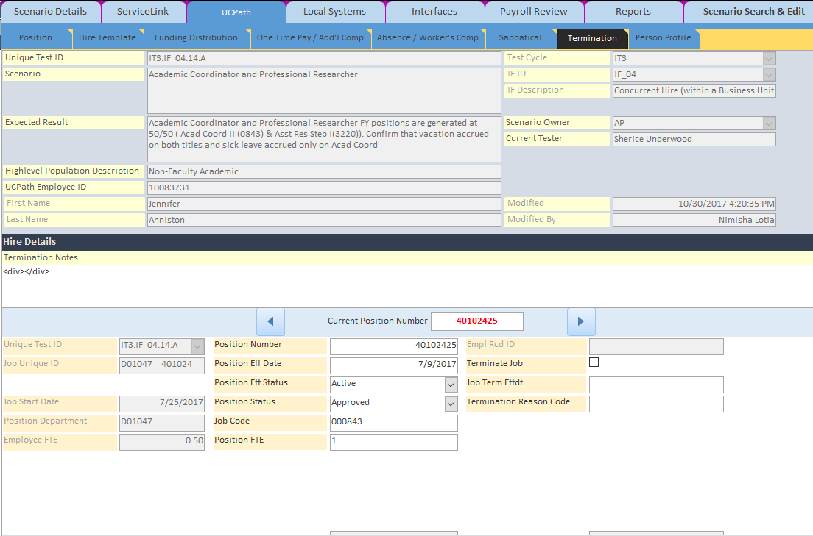
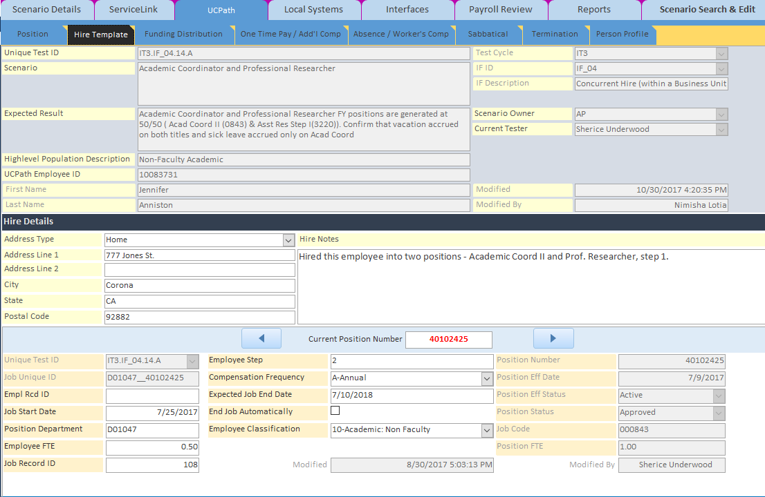
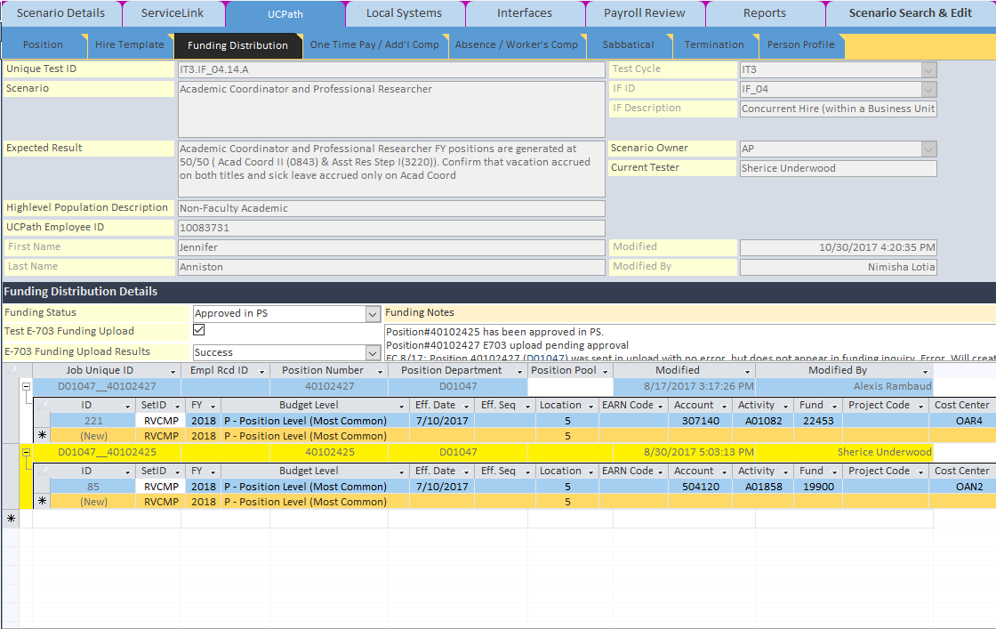
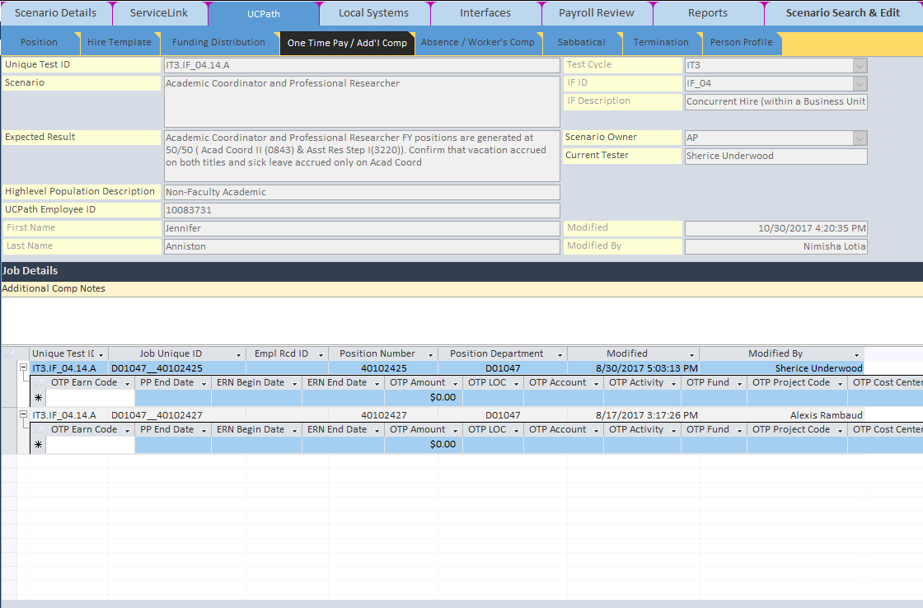
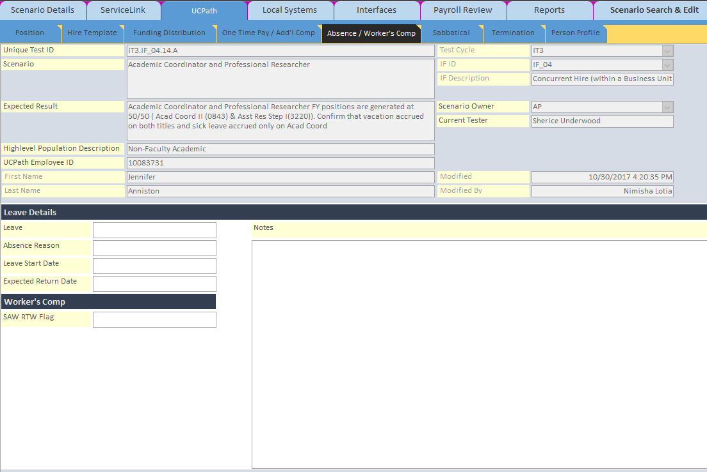
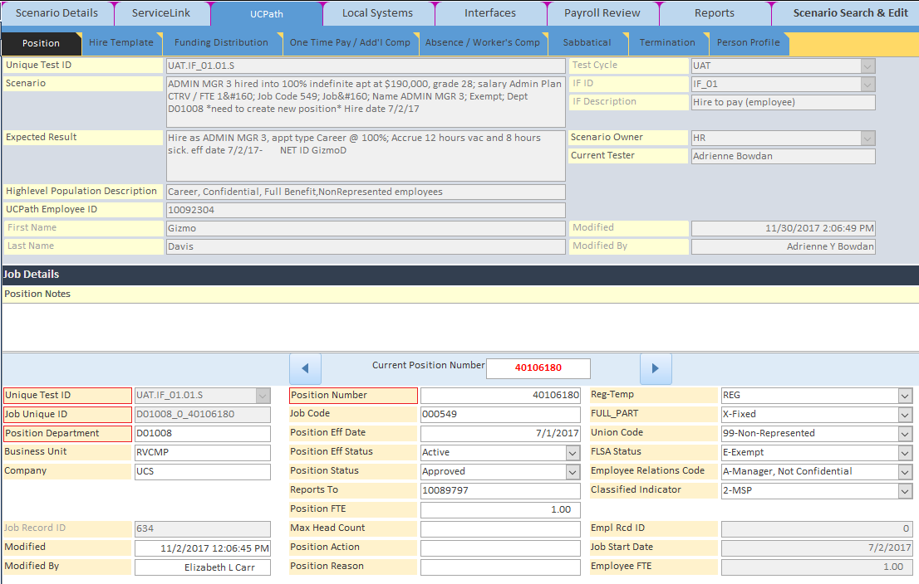
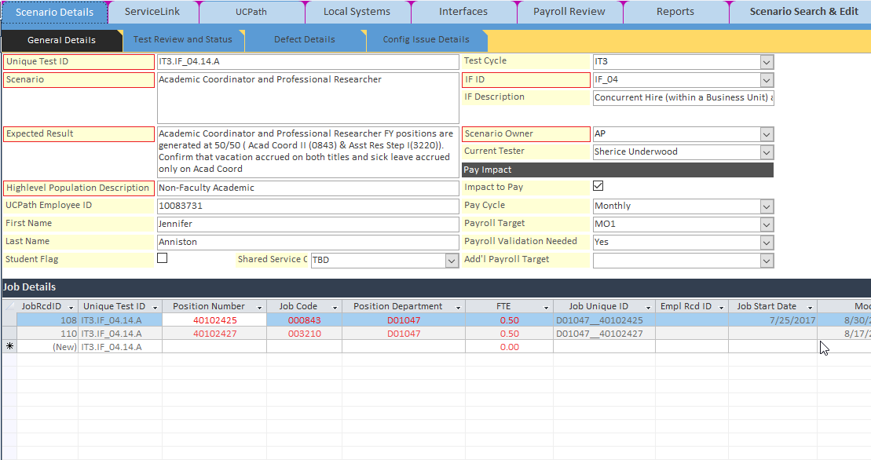
Testing Tool
Notes:
Testing Tool form in Access – Backend is a SharePoint List
Testing Tool Benefits
Able to stage scenario data up front
Robust tracking of input and results allows for meaningful metrics
Able to quickly identify causes of defects by reviewing input data
Detailed input tracking eases financial testing and validation
Storing granular input data allows for validation of HRDW queries and remediation

Slide 11
Tracking progress and results
Notes:
We progressively improved our test execution and understood the nuances of the validation components. Plus, tracking what was entered was helpful to determine if something passed or not.
The question was: Is the experience getting better, worse or staying the same?

Slide 12
Notes:
Posting the results visually assisted in understanding our progress. Paycheck review and GL review were always the last tests to complete.
*Front-load the Impact-to-Pay transactions. Waiting toward the end of the test phase will not allow enough time to validate pay issues.
ALM has a concept of write once use-many. If there was a critical defect blocking one, all common tests were blocked.

Slide 13
Lessons Learned
Co-location! Co-location! Co-location!
Campus resources are experts but not testing experts
Partner new testers with experienced testers to expedite training
Plan for loaner laptops and sufficient internet bandwidth
Part-time testers should have no less than 2 days per week. This prevents struggling to remember what they were doing and reduces incomplete tests
Providing a data entry tool or process is critical to test validation—
If you can’t validate, it isn’t a test

Slide 14
Lessons Learned
For non-new hire tests, data mine real employees to fit your scenarios
  NDAs and Confidentiality Agreements will enforce privacy policies
Execute impact-to-pay scenarios first
  Early payroll cycles in a test phase are small which back-loads validation
  IT3 had 50% of impact-to-pay validation pending at the end of test phase, delaying our exit
Payroll cycles without holidays or cycles in summer months will exclude important test scenarios for hourly and student employees
  Tuition Remission and Work Study programs are not active in summer session
Monitor Web Services!
  Impacts security provisioning
  Feeds new employee information to downstream systems
  Used for FAU validation check between UCPath and locations

Slide 15
Summary
Quality of conversion data directly impacts testing
Recommend using campus experts
Remember the time-box of a test scenario might take minutes to enter, but days to complete
Track test phase metrics to compare against future phases – Is the quality, results, and overall experience getting better?

Slide 16
Questions?

Slide 17
Appendix

Slide 18
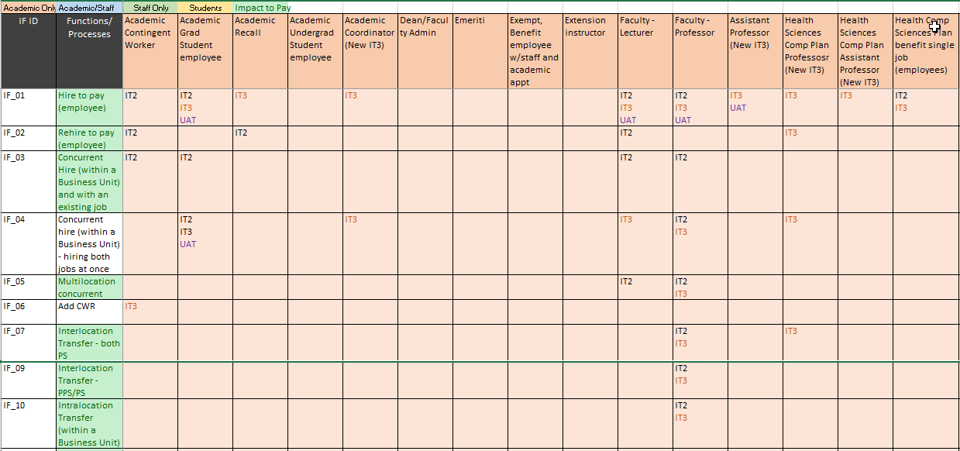
Test coverage matrix - Scope
Notes:
52 Integrated Functions
123 UCR Populations

Slide 19
Test coverage matrix - scope
IF ID | Description | Staff/Academic | Impact to Pay? | #IT2 Scenarios | #IT3 Scenarios | #UAT Scenarios
IF_01 | Hire to pay (employee) | Both | Yes | 37 | 45 | 21
IF_02 | Rehire to pay (employee) | Both | Yes | 16 | 5 | 1
IF_04 | Concurrent Hire (within a Business Unit) and with an existing job | Both | Yes | 27 | 27 | 11
IF_05 | Multilocation concurrent hire | Both | Yes | 8 | 5 | 2
IF_06 | Add CWR | Both | No | 4 | 2 | 2
IF_07 | Interlocation Transfer - both PS | Both | Yes | 5 | 3 | 1
IF_09 | Interlocation Transfer - PPS/PS | Both | Yes | 2 | 2 | 1
IF_10 | Intralocation Transfer (within a Business Unit) | Both | Yes | 6 | 6 | 5

