Slide 1
“A lot of researchers didn’t realize they were going to have to become programmers”
(UCCSC, 2017)
Vince Kellen
CIO, UC San Diego

Slide 2
The Code Handoff
Pitfalls and Good Practices for Handing Code off to a New Developer Researcher
Geoffrey Boushey
Application Developer, UCSF

Slide 3
Quarterly SWC Workshops
Today’s Offerings
Classes in Python, SQL, Unix
Monthly Programming and Pizza
Consulting Sessions
Programming support currently offered by DSI:
Notes:
So today we have a suite of classes that we offer.
We trained a cohort of UCSF staff to teach SWC workshops so we no longer need to bring in several instructors
We discovered that one of our library systems engineers was interested in teaching and now he teaches Python, SQL, and Unix classes
We still offer monthly programming and pizza sessions
And are trying a quarterly collaboration in the makers lab

Slide 4
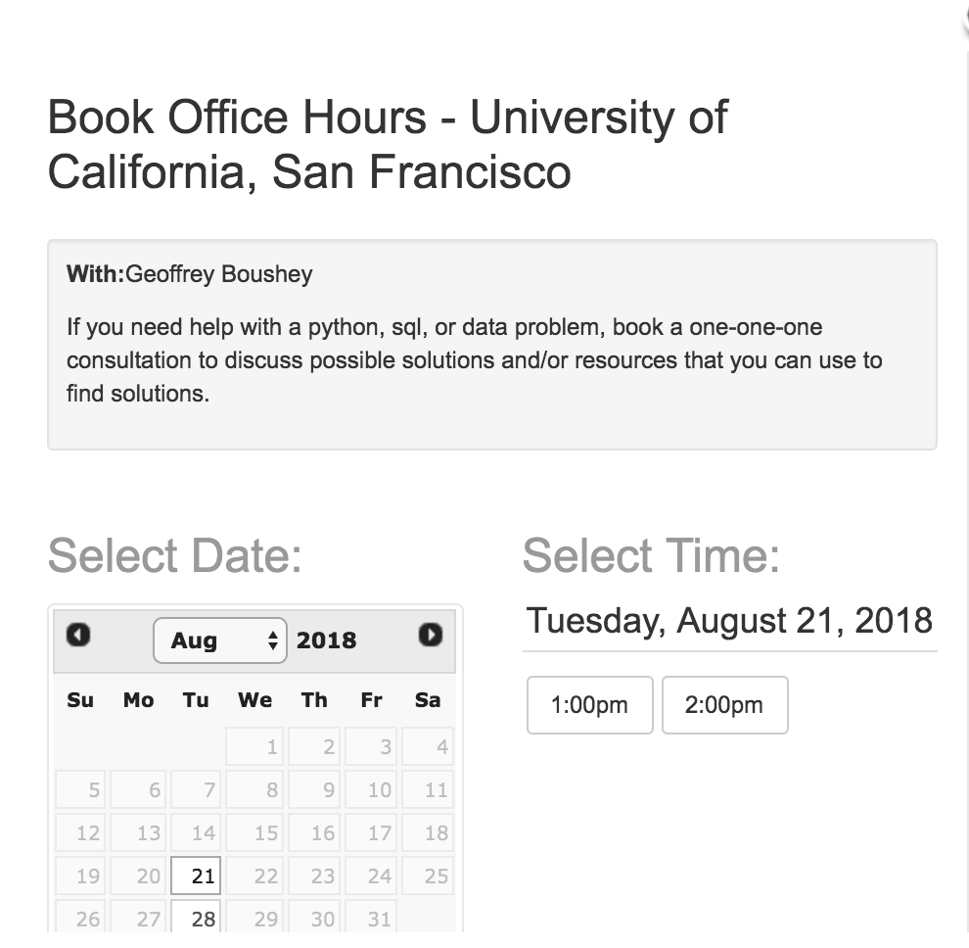

Slide 5
What do researchers ask about?
Common questions
  Data processing
  Getting software to compile and run
  Taking ownership of a new code base
  Archiving and versioning
Less common questions
  Math, science, stats, machine learning, algorithms

Slide 6
Why are code transfers difficult?
UC grad students, postdocs, and researchers are conscientious, motivated, and busy.
Technical skills are varied and uneven
The code used by UC labs is often essential to continuity of research.
When things go wrong, it’s frustrating interesting.
How and why do code transfers become difficult to manage?

Slide 7
The setup
A graduate student applies for a postdoc, and lists “Python” just high enough on the CV to meet the requirements, but just low enough on the CV to avoid becoming a programmer.
The PI looks at the CV and says “Python? Excellent!”
“Hey could you take over this Python code base?”

Slide 8
Taking ownership of a new code base
Common problems, in the order they are typically encountered
No Code
No Repository
No Build
No Data
No Tests
No Documentation
No Collaborators

Slide 9
No Code

Slide 10
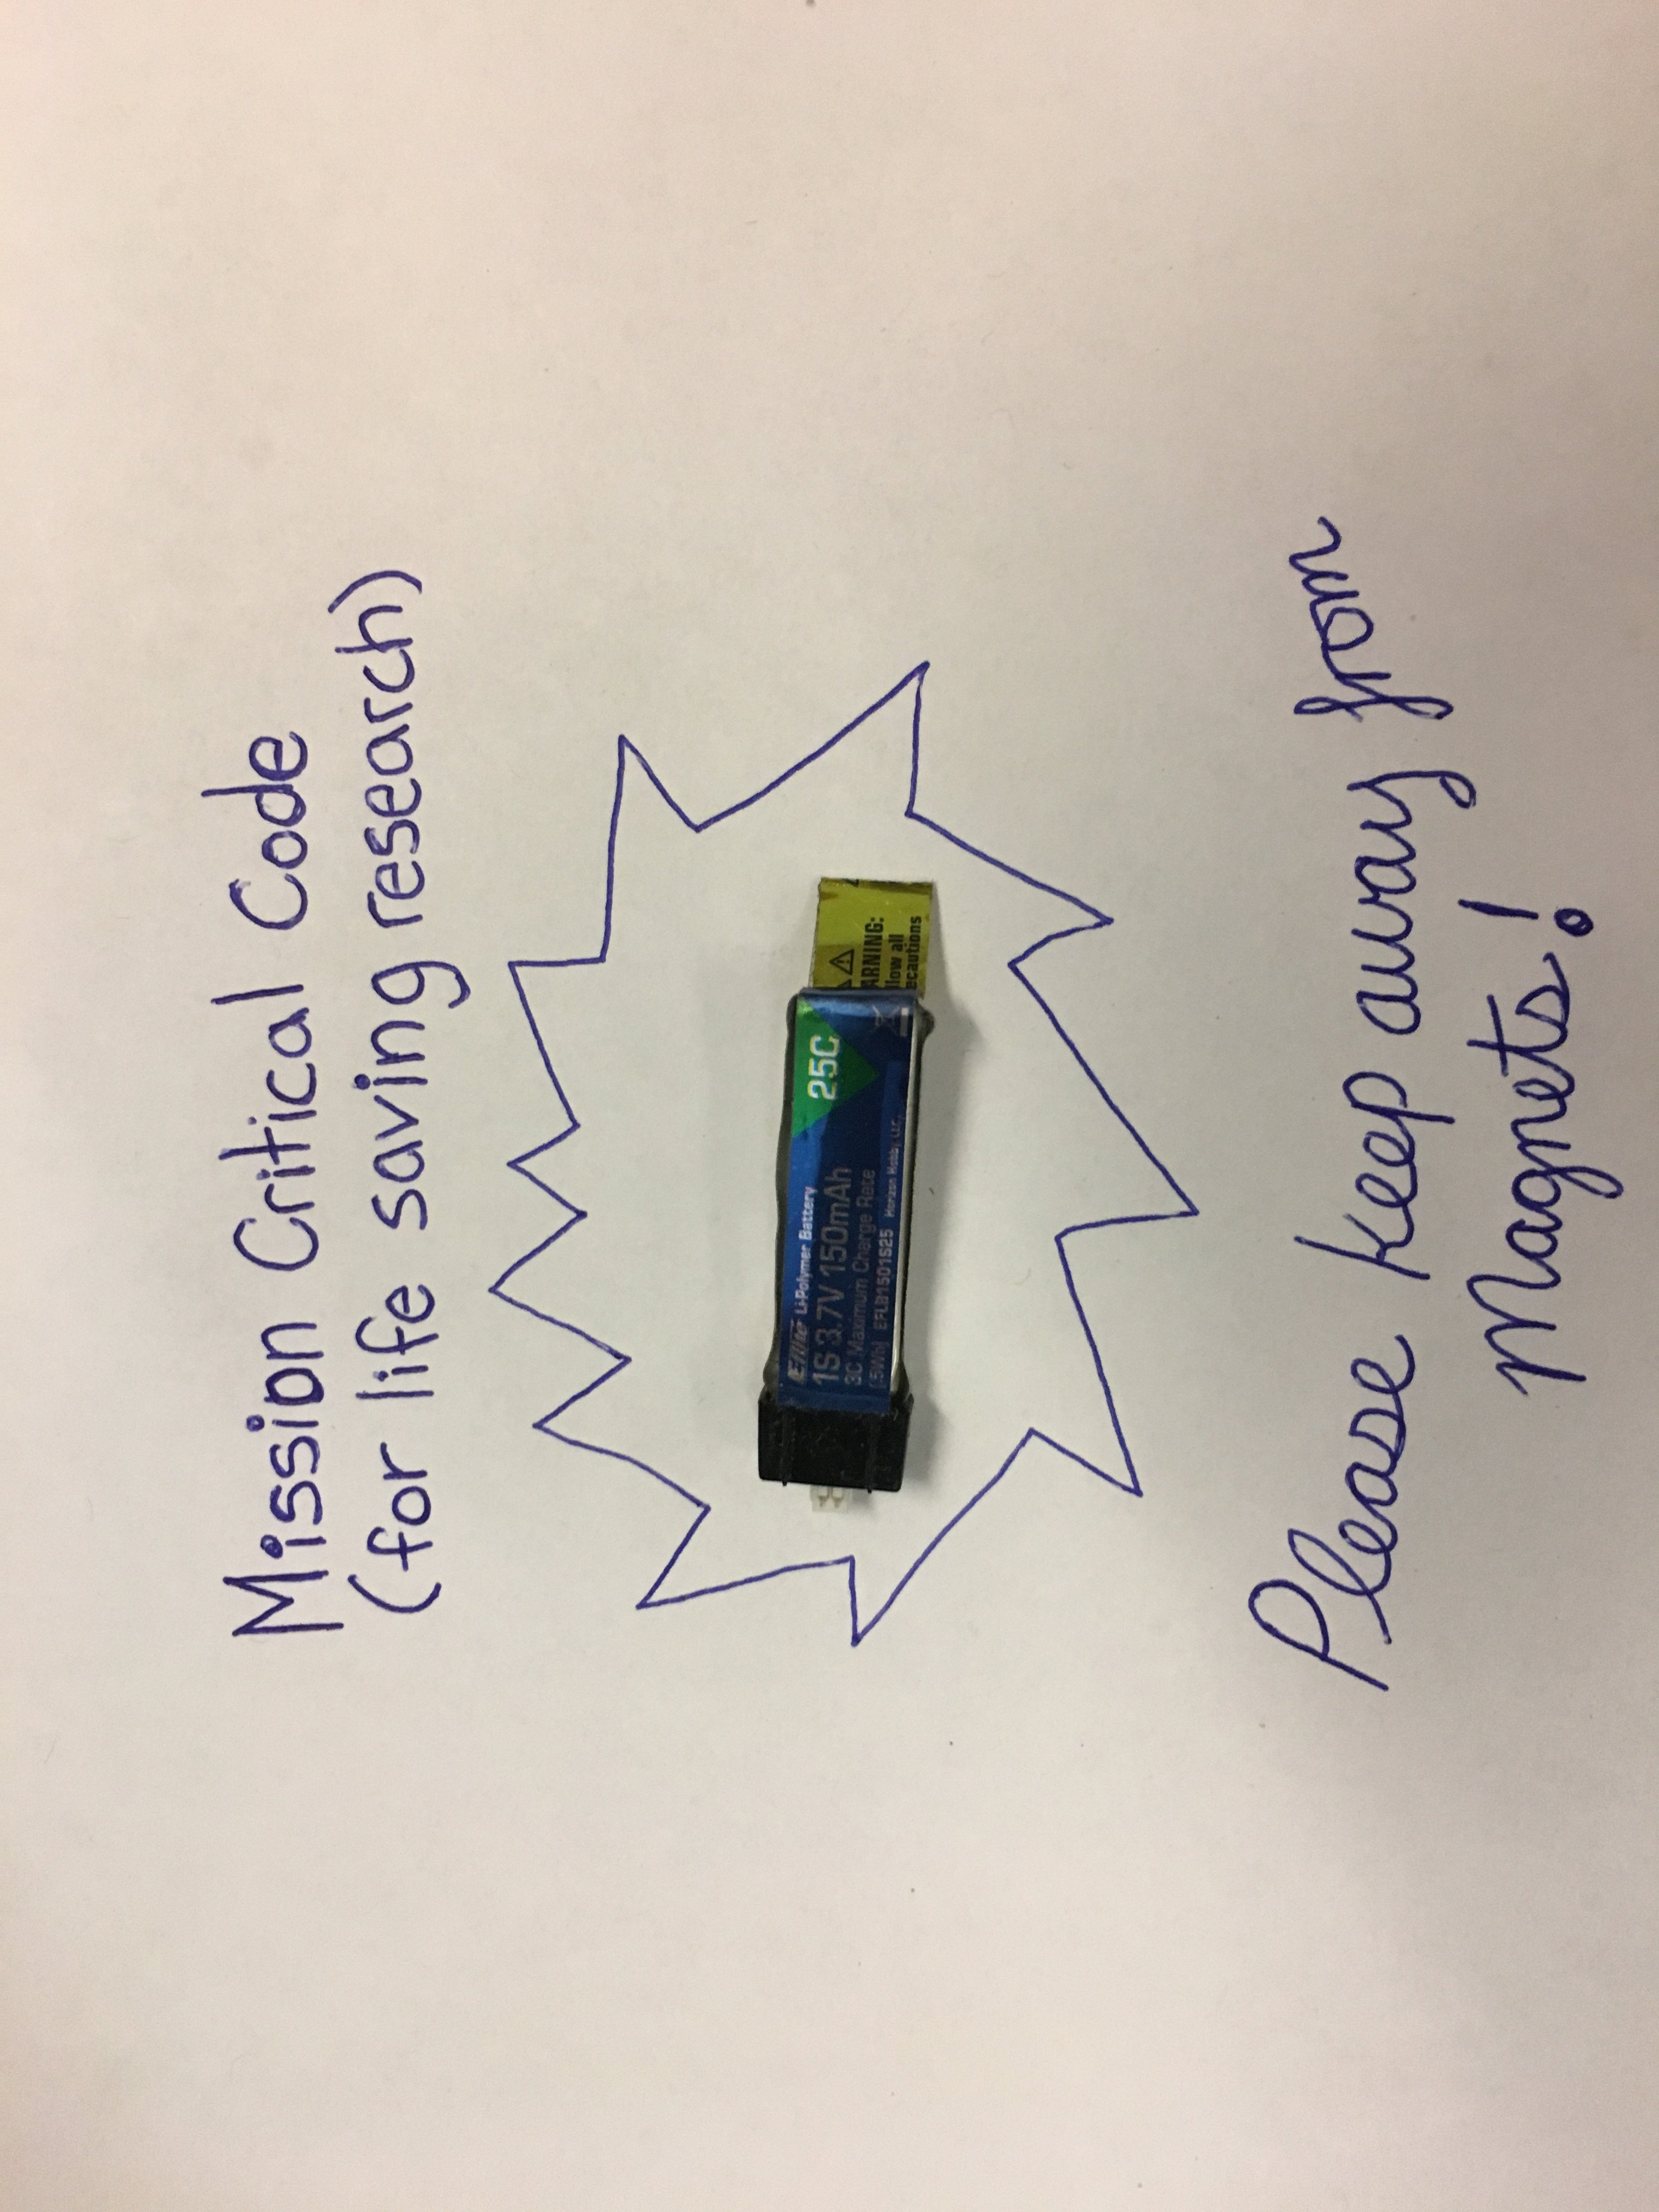

Slide 11
No Code
No files
Executable files only
Generated files only
Interpreted files only

Slide 12
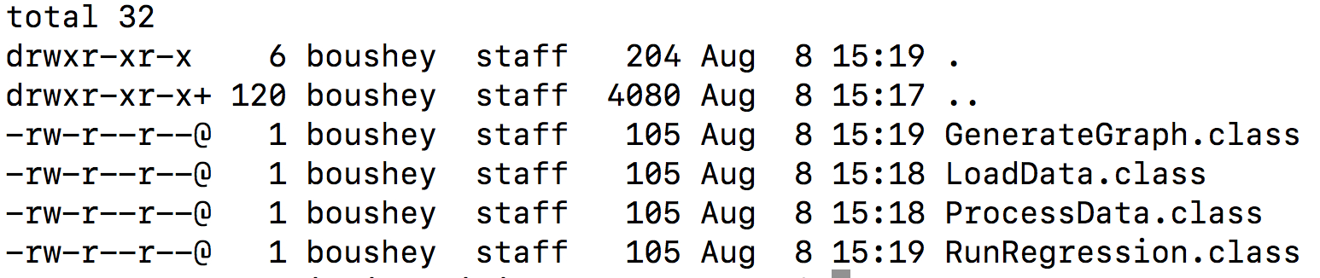
Executable Files Only – No Source

Slide 13
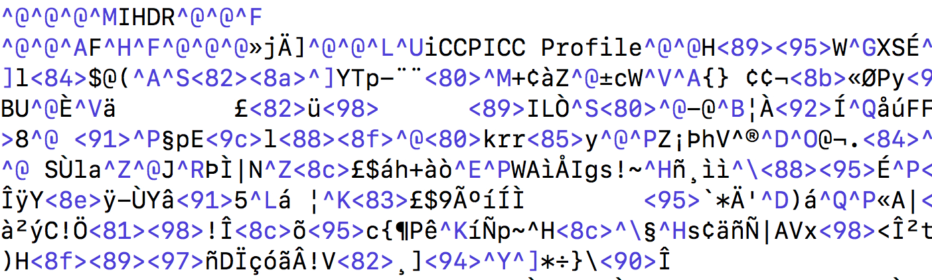
Encoded Files Only

Slide 14
What to do?
Email the original developer
Search or grep development or qa servers
Search through old email threads
Use a decompiler
Create an archive!

Slide 15
No Repository or Versioning

Slide 16


Slide 17
No Repository or Versioning
No versioning
No copy of record
Prod, test, development, qa are handled through code changes
Run time environment is determined by examining the code

Slide 18
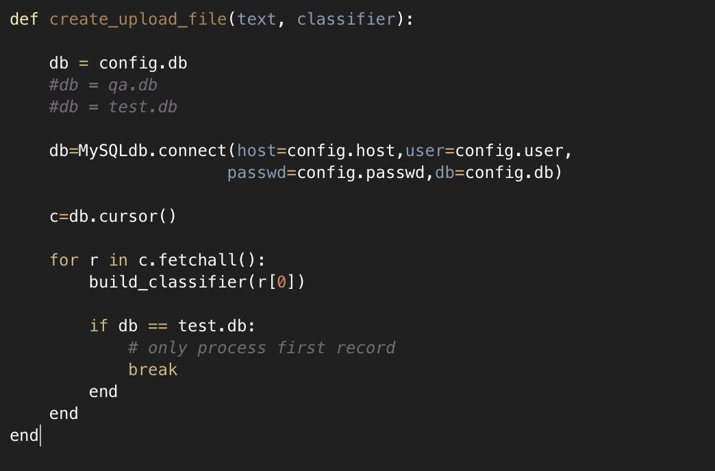

Slide 19
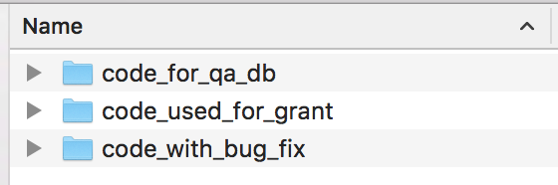

Slide 20
What to do?
Minimal Use of Versioning
Git init
Git add .
Git commit –m “first commit”
Git push
Be careful with protected information
Be careful with information overload

Slide 21
No Build Instructions

Slide 22
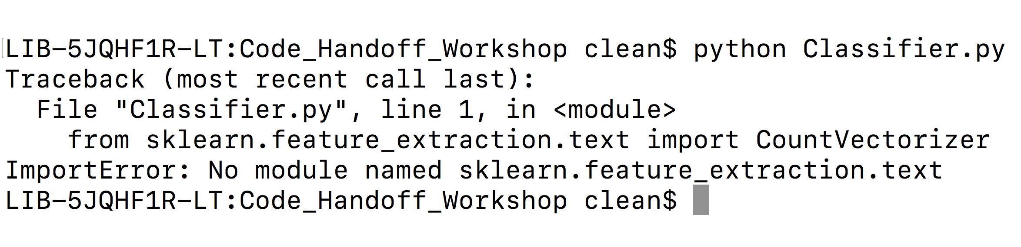

Slide 23
No Build Instructions
Run, install, repeat
Manual list of dependencies
List of installation commands
Installation scripts (bash, python,…)
Make files
Ant, maven, bundle,...

Slide 24
No Data

Slide 25
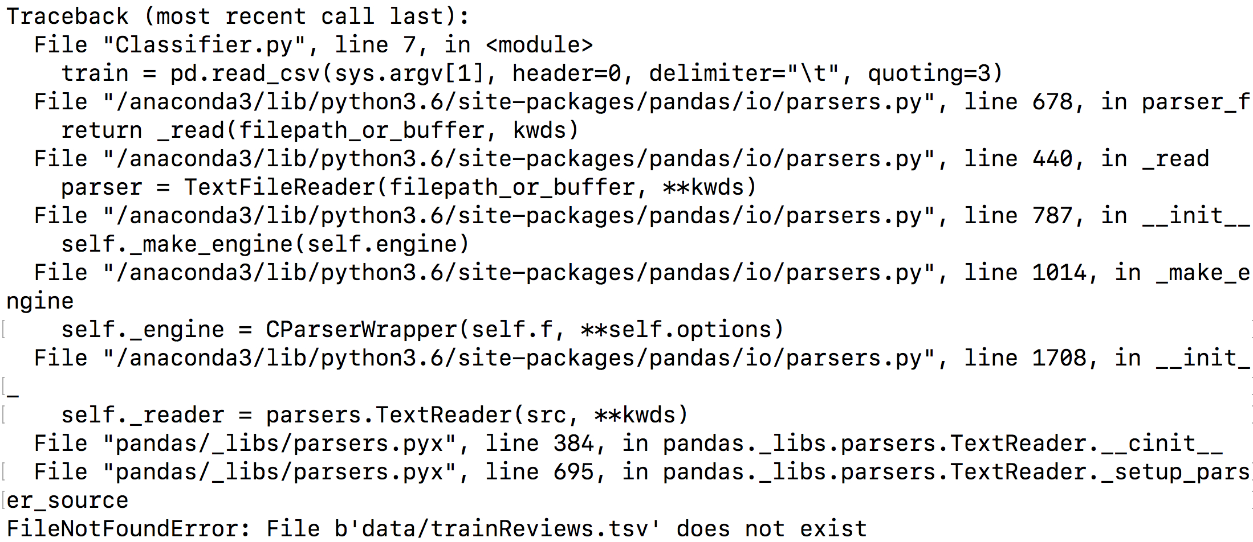

Slide 26
Missing Data Files
Reverse engineer a data file
Look for file i/o
Look for database calls
Look for web based apis or json files
Follow error messages
Create and archive a test data file!

Slide 27
No Data Preparation Information

Slide 28
No Data Preparation Information
Missing Information about how data was collected
  JSON
  Web APIs
  Databases
  On line spreadsheet
  Data harvesting on web, social media

Slide 29
No Data Preparation Information
Missing information on how data was prepared
  Scripts
  File I/O calls
  Regular Expressions
  Unix Commands

Slide 30
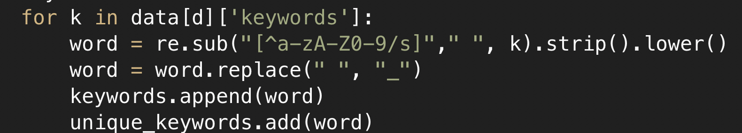

Slide 31
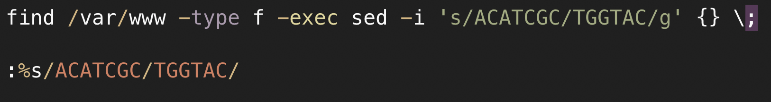

Slide 32
No Data Preparation Information
List data sources
Treat data preparation code as essential code
Save unix commands in a shell script
Save unix or vi editing histories

Slide 33
No Tests

Slide 34
Did it run the way it was supposed to?
Formal vs Informal Testing
Formal
  Unit, Functional, Integration, Regression
  JUnit, PyUnit, Rspec, TestUnit, …
Informal
  Scripted parsing of output files
  Instructions for how to visually verify an output file

Slide 35
No Code Documentation

Slide 36
No Code Documentation
Code doesn’t make use of methods
Code was exported from interactive shell to scripts
Code emerges from a series of operations on data
“Cut and Paste” or “Copy and Modify”
Lack of awareness of standard
Confusion about what standard to adopt

Slide 37
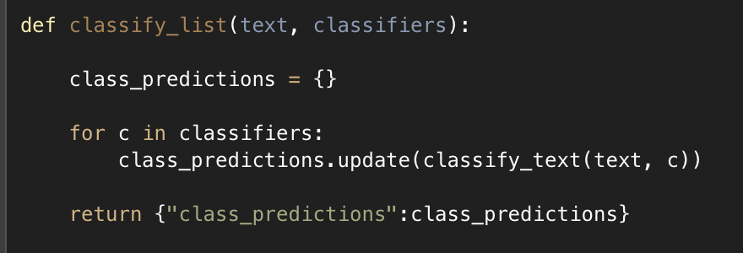

Slide 38
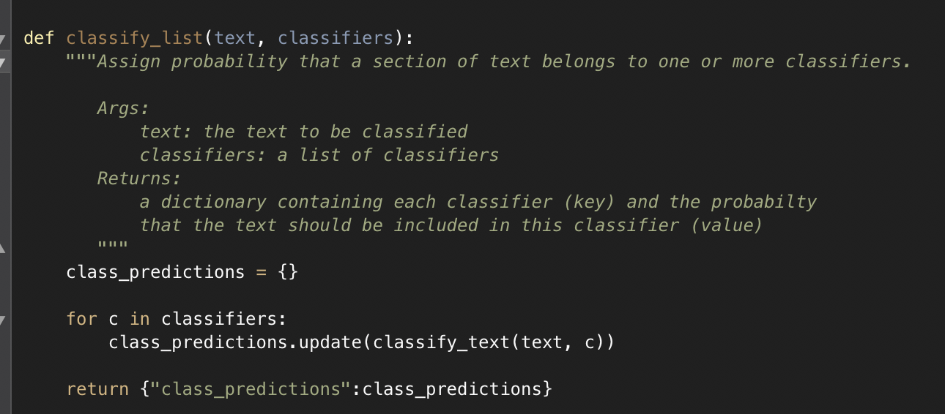

Slide 39
No Code Documentation
Documentation styles abound
  Epytext
  reST
  Google
  Numpydoc
  Comments (# // /**..**/)

Slide 40
No Overview

Slide 41
No Context
What is this application for?
What does it do?
What kind of input is needed?
What kind of output is produced?
What benefit does it bring?

Slide 42
No Collaborators

Slide 43
No Collaborators
If at all possible, ask a collaborator to…
  Fix a bug
  Add a feature
  Write some documentation
  Create or respond to an issue
  Merge a pull request
  Use github or other versioning system

Slide 44
“Le mieux est l'ennemi du bien. (The perfect is the enemy of the good.)”
- Voltaire
Tech support analyst, UC Davis

Slide 45
Good practices
If you do these things, you’ll be alright.
Find and identify an the official code of record
Create a repository with versioning
Write simple build instructions
Provide a sample input file
Write tests
Retain and archive data creation files
Write a brief overview of purpose and context
Find and engage with collaborators

