Slide 1
Why do Technology Implementations Fail?
Understanding your customer and their problems for successful system implementation

Slide 2
Who am I?
Huy Tran
IT Manager, UC Davis Arts Group
hqttran@ucdavis.edu

Slide 3
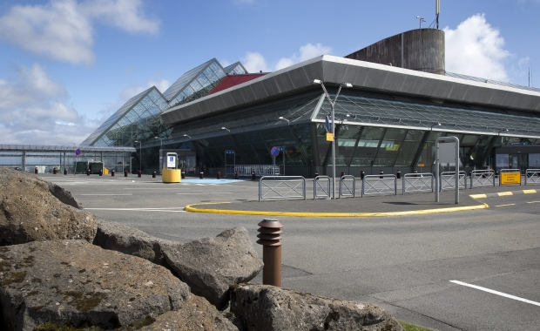
Keflavík Airport, Iceland

Slide 4
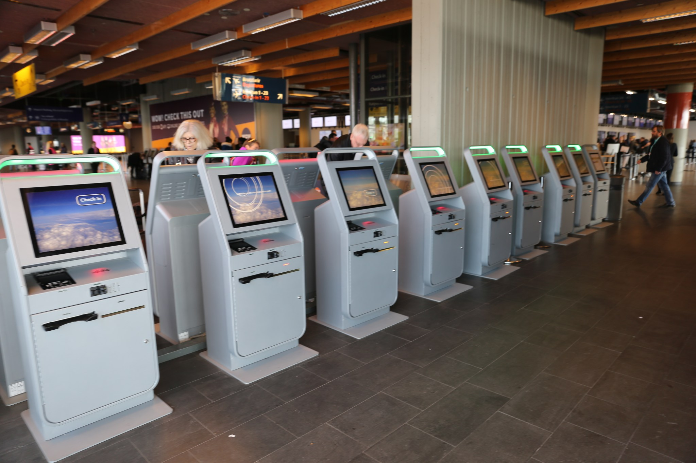
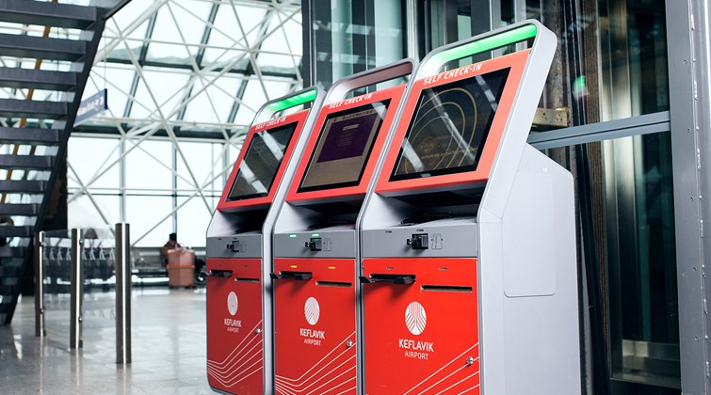
Keflavík Airport, Iceland

Slide 5
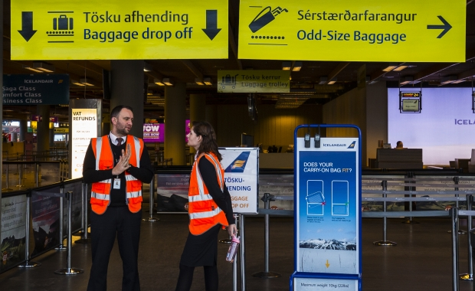
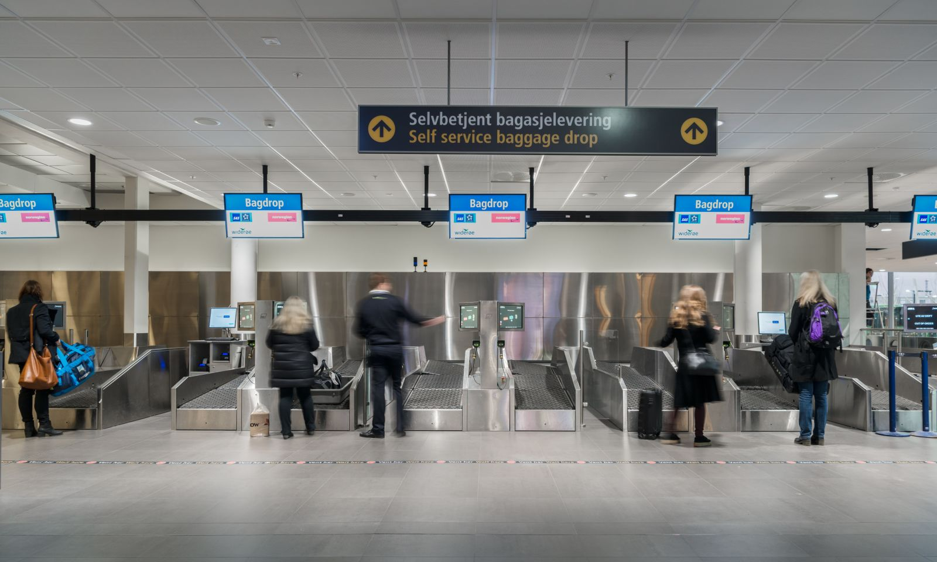
Keflavík Airport, Iceland

Slide 6
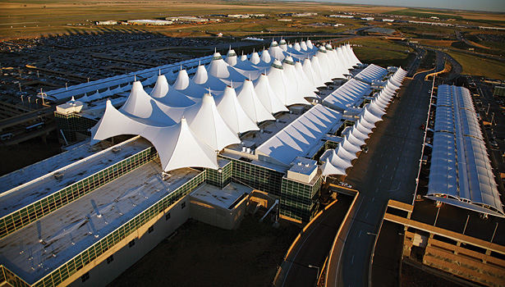
Denver International Airport
$560 million over budget
16 months late
Only used in one concourse
Only one airline for outbound flight
Second, manual system built for all other baggage operations
Shut down after 10 years of operation

Slide 7
Lean Principles
How to create business solutions

Slide 8
People, Process, Technology
People
Process
Technology
Notes:
People – 50% Passengers, Counter Agents, Gate Agents, Airport management, Airline Management, Baggage Handers, Security/Border
Process – 30% Passenger Identification, Flight Verification, Boarding Pass issuance, Bag Tagging, Bag Collection
Technology – 20% touchscreens, databases, conveyer belt systems, scanners, software, etc.

Slide 9
Problem statement
Short and concise (1-2 sentences)
Include a baseline measure
Descriptive
Can be followed by a Goal Statement
  Be careful not to inject solution bias

Slide 10
Problem statement
The business unit has seen reimbursement requests double between 2015 and 2016 with average processing time growing from 24 hours to 2 days.
Passenger traffic through Keflavík International Airport rose from 1.83 million in 2009 to 8.76 million in 2017 causing baggage check-in time to increase 50%.
  Goal: Reduce the average baggage check-in time from 45 minutes to 20 minutes.

Slide 11
Three Critical Questions
What are we trying to accomplish?
How will we know when a change is an improvement?
What changes can we make that will result in an improvement?

Slide 12
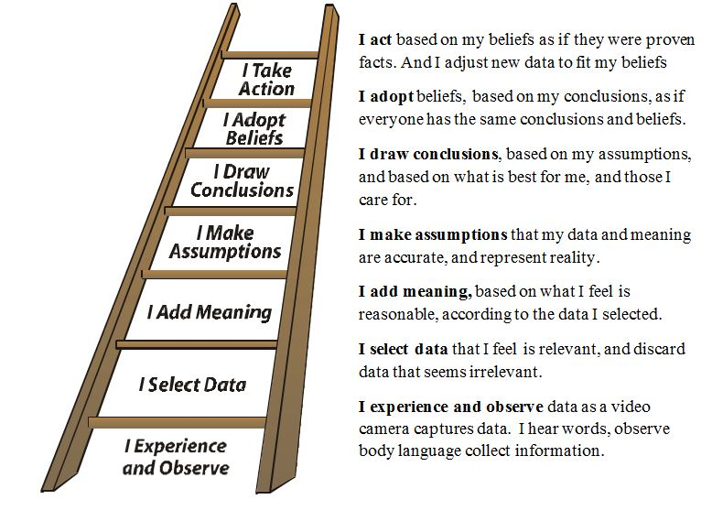
Ladder of Inference
Notes:
I take actions based on my beliefs
I adopt beliefs about the world
I draw conclusions
I make Assumptions based on meanings
I add meanings (cultural & personal)
I select data from what I observe
Observable Data & Experiences

Slide 13
Ladder of Inference
Passenger
Counter Agent
Belief-Based
Actions
I use the kiosk to check-in myself and my bags
Discourage Kiosk use
Beliefs
If no one uses kiosks, I will keep my job
If I use the automated process, I will get to my gate faster
Conclusions
If Kiosks are successful, I will be fired
Passengers using automated process will gate in less time
Assumptions
If management prefer machines, employees will be fired
Automated process is faster
Management added kiosks because it would be better
Meanings
Management prefer machine to employees
There are automated Check-in kiosks and baggage drop off machines
Filtered Data
There are automated Check-in kiosks and baggage drop off machines
Automated Check-in kiosks and baggage check are installed alongside traditional check-in counter
Automated Check-in kiosks and baggage check are installed alongside traditional check-in counter
Data

Slide 14
Change Curve
Denial
Commitment
Ops
Mngr
CEO
IT
Counter
Agent
Baggage
Handlers
Gate
Agent
Airlines
Passenger
Counter
Agent
Resistance
Exploration

Slide 15
Breakout Session: 15 minutes
Problem Statement
People, Process, Technology
Ladder of Inference
Change Curve

Slide 16
Thank you!
Questions?
Huy Tran
hqttran@ucdavis.edu

