Slide 1
Tablet-based eConsent for biospecimens
UCCSC 2018 at UC Davis
Oksana Gologorskaya, Eric Meeks, Research Technology, CTSI at UCSF

Slide 2
Enterprise Apps on a Consumer Grade Budget: a patient-friendly tablet-based secure consent form integrated with electronic medical records, powered by Qualtrics, Apple, KioskPro and the Epic API.

Slide 3
Overview
Learning Objectives
Research need and constraints: enable collecting consent from patients coming to clinical lab for medical care tests
Envisioned solution: tablet-based electronic form with embedded educational video and integrated EMR-based patient ID verification. Components and requirements
After launch: unexpected issues we could not test before going live
Going forward – growing out of pilot; really doing it at scale
Details worth zooming into

Slide 4
Learning Objectives
Share our experience following UCLA’s lead in building a solution for a shared research infrastructure need, but finding an alternative way to get there
Showcase the power of Qualtrics Platform and how it can be used for more sophisticated interactions
Share lessons learned and small but tricky technical things we had to figure out to make it work
Next step: scaling this solution. Stick to this path or re-architect? Audience discussion

Slide 5
Research Need and Constraints

Slide 6
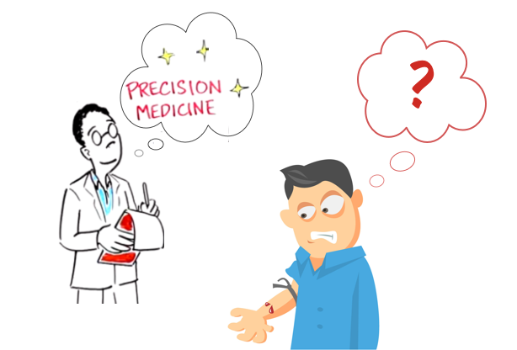
Research Need: ask patients coming for a blood test to donate their blood samples for precision medicine research
Notes:
The consent we are asking for is not a consent to participate in a specific study, but a universal consent to allow to use biological specimens in any kind of research

Slide 7
Constraints
Minimal impact on clinical care workflow
Compliance with HHS OHRP regulations for protection of human subjects in research
  Informed Consent
  Security & privacy protection
Notes:
Easy process = Absolutely no admin overhead, e.g. managing data
Minimally invasive process
Informed Consent
How consent is regulated (HHS OHRP, Common Rule, guidelines)
Verify identity and eligibility
Show educational video before asking for consent
Digital signature method
We relied on UCLA work for the consent process
Privacy and Security
HIPAA regulations + UCSF security and privacy policies
Encryption, secure storage of private info
Restricted access to the info

Slide 8
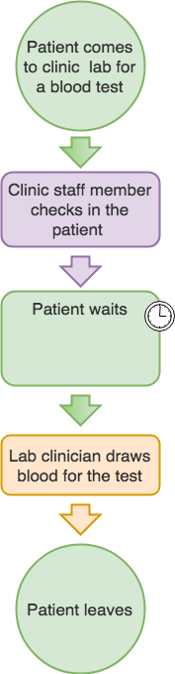
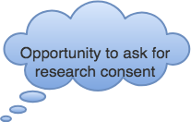
Clinical care workflow: blood test

Slide 9
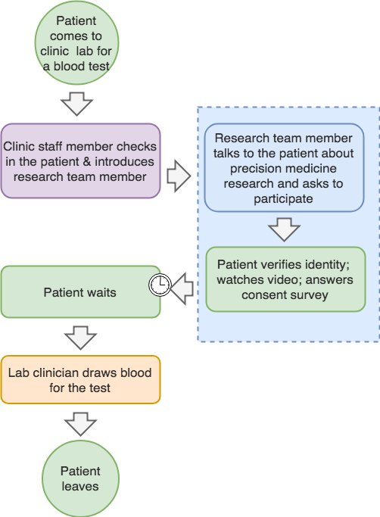
Modified clinical workflow
Patient answers consent survey while they wait
Minimal burden on clinic staff

Slide 10
Compliance with human research regulations
Informed consent
  Educational video integrated in the consent process
  Patient identity verification based on MRN, name and birth date
Privacy and security protection
  Data collected from patients in a way that protects their privacy
  Secure data transmission and storage (encryption, controlled access)
Notes:
Video is the tool to inform a potential participant about the purpose

Slide 11
Solution

Slide 12
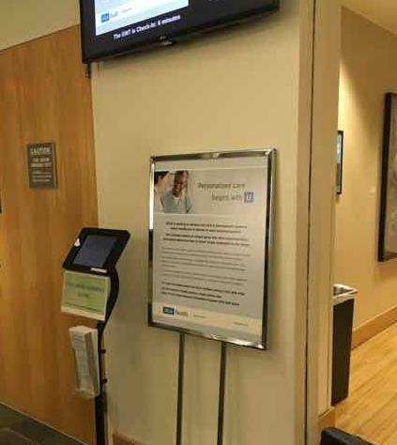
UCLA already had a solution
In-clinic kiosk
  iPad
  Video
  Custom app for consent
  Integrated with EMR, document management system, pathology system
Notes:
UCLA universal consent project: 2 ways to consent – via Epic MyChart or in-clinic kiosks
We could reuse:
Method for obtaining electronic consent, including identity verification

Slide 13

UCLA Onsite Consent Work Flow
Demographic Data
Enter
Initials
E-Kiosk
Enter Medical
Record Number
Pick Birth Year
Discreet Consent Data
Managed in Pathology
CONSENT
PROCESS
Identity
Validation
Consent
Seen in
Custom
Registration
Field
Individual
Consent
Form
Medical
Records

Slide 14
On-Site Consent Process
2 question
Opt-In/Out
10 day
no action
window
Yes
Pick up detailed
Information sheet
Did you
See video?
No
See
Video
2 question
Opt-In/Out

Slide 15
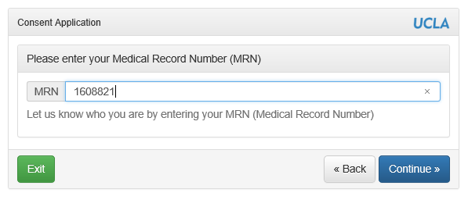

Slide 16
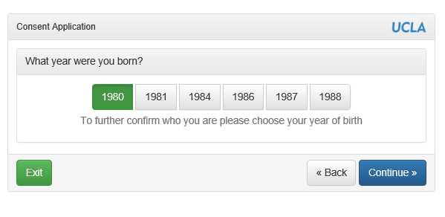

Slide 17
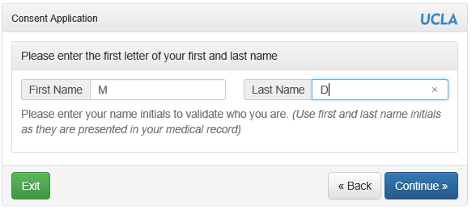

Slide 18
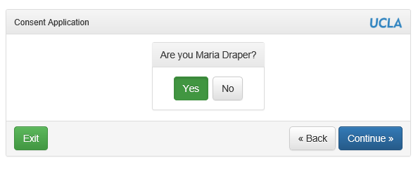

Slide 19
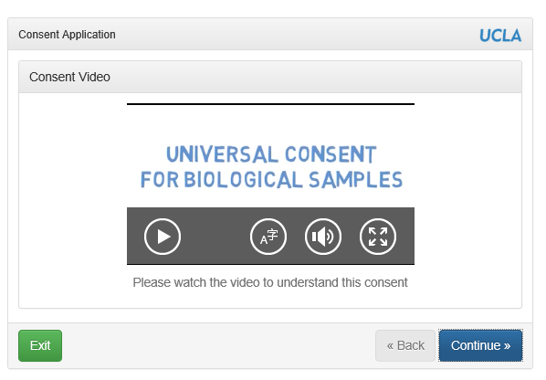

Slide 20
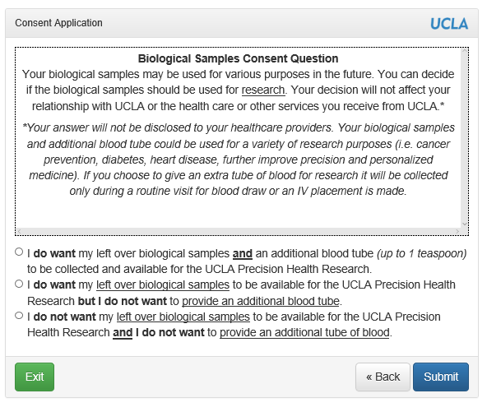

Slide 21
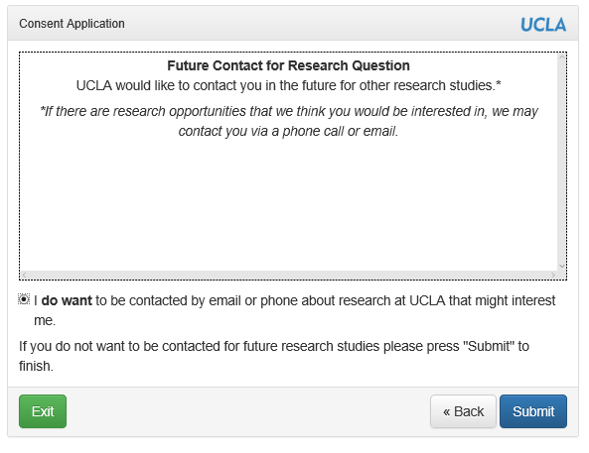

Slide 22
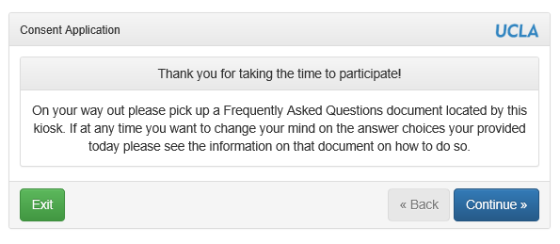

Slide 23
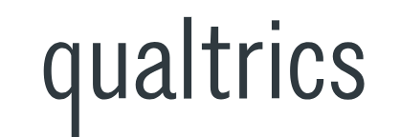


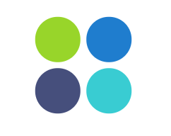
UCSF Solution: reuse UCLA’s wisdom, repurpose our own systems
iPad as a device for obtaining consent
Instead of the custom app, use Qualtrics – HIPAA compliant, secure research survey platform
To make iPad function as a kiosk, use KioskPro app

Slide 24
Let’s see the UCSF solution…
Initial pilot version: http://tiny.ucsf.edu/econsent
Version 2.0 for self-directed in-clinic eConsent http://tiny.ucsf.edu/econsent1
Notes:
Switch to the iPad or Browser to demo the eConsent solution

Slide 25
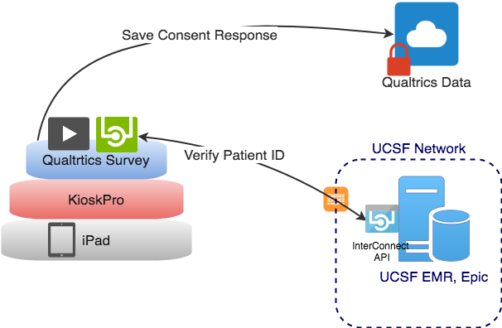

Slide 26
UCSF Solution Components
Component | Purpose | 1st time technical implementation complexity
iPad | eConsent collection device
KioskPro | Turn iPad into a kiosk
Qualtrics eConsent survey | Enables seamless process for in-clinic eConsent
Patient education video | Inform patients about precision medicine research before asking for consent | * Embedding in the survey; producing it is a
Epic Interconnect API | Verifying patient’s identity
= easy
= moderate
= advanced
= beware

Slide 27
Qualtrics Survey for in-clinic eConsent – Implementation Highlights
Verifying patient identity
  Adjusting input controls (e.g. to accept numbers only)
  Generating random values for the year of birth selection
  Calling Epic API to validate the MRN and bring back patient’s info
Embedding video on a survey page
Validating user input and terminating survey when needed
Look and Feel, accessibility adjustments
Hiding the Powered by Qualtrics plug

Slide 28
Technical Challenges (and Conquests!)
Security. We are dealing with patient data, and that was sort of new for us.
API mismatch. Qualtrics and EPIC Interconnect do not speak the same language.
Server confusion. How a out-of-bounds (new) use case can fall on deaf ears.
Notes:
There are tools to solve the API mismatch problem, but they weren’t quite ready for prime time at UCSF, and they still did not solve our problem.

Slide 29
Security
Getting access to the EPIC Interconnect API at UCSF was a process.
According to the internets, Qualtrics is secure! https://it.ucsf.edu/services/qualtrics-web-surveys
  “Qualtrics can be used to collect and store protected patient and personal data. Please refer to UCSF policy regarding data security and HIPAA and FERPA regulations.“
We did have IRB approval.
We only needed patient demographic data (name, date of birth, etc.), not health data.
Notes:
Process for gaining access to EPIC dev/test environment (ARF) was geared towards researchers more so than developers
We could not find the source of this IT created web page

Slide 30
API Mismatch (a tale of two internets)
EPIC Interconnect only speaks POST, Qualtrics only spoke GET
EPIC Interconnect requires (preemptive) basic auth for security, Qualtrics only allowed query parameter selection
Qualtrics only understands flat JSON, Interconnect produces structured JSON
MuleSoft is a great solution for these types of “impedence mismatch” problems. But we didn’t go with MuleSoft
Notes:
It was clear that the Web Service feature in Qualtrics was designed to hit public API’s, not customer specific protected API’s (that has sense changed)
Note their documented use case “use this to retrieve the top 10 headlines from a news website ”
At least they spoke JSON, as opposed to physically mailing me a stack of punch card (interconnect prime)
We hate NIH (not invented here) syndrome, but MuleSoft was still sort of new at UCSF and Qualtrics would not support our MuleSoft authentication mechanisms either

Slide 31
Server Confusion
We needed to know the IP range of the Qualtrics servers to allow them into our network.
No one at UCSF or at Qualtrics could answer that simple question. Qualtrics has their own API server (for downloading survey results, etc.) that confused every new person we were redirected to.
We eventually figured out a way to determine this ourselves and dived into our web logs to find the answer
Notes:
API had become a 4 letter word to me, despite being neither a word nor four letters. When anyone at quatrics heard the word API, they would immediately assume that we wanted to access their API, and not the other way around. It was ridiculous.
The Qualtics champion at UCSF had moved on
Oksana filled out a form with a random string that we could search for in the web logs. What we found was interesting!

Slide 32

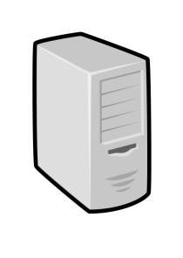




eConsent Pilot (security review document)
UCSF Network
Code at: https://github.com/CTSIatUCSF/EpicProxyAPI
Stateless Proxy API
(https://ctsi-secure.ucsf.edu)
10.67.0.29
Qualtrics Form
Servers
h
Proxy API takes HTTPS GET from Qualtrics, calls into Epic API via required HTTPS Post, and “flattens” the response data for Qualtrics consumption
443/https GET
443/https POST
Single REST based API is called from Qualtrics into Epic API, passing in MRN and private Access Token to retrieve:
Patient year of birth
Patient first name
Patient last name
This information is used to verify patient identity, as based on existing IRB approved eConsent work flow at UCLA
Qualtrics
API Servers
Interconnect API into Epic Data
iPad in Kiosk mode at a participating UCSF clinic (so might be in UCSF network actually).
Used by patient to fill out a Qualtrics form.
443/https
Form collects MRN, consent
and optional demographic data
Created By: Eric Meeks
Date Updated: 2-16-2017
Notes:
Everyone thought we were talking about the API servers
What is interesting is that at the time, we (UCSF) were allowed to store patient data in Qualtrics, but not allowed to store in in AWS
Qualtrics was not the only vendor example of this odd situation, quite a few people at UCSF knew about this (but not us)
It’s all about the BAA (business associate agreement)

Slide 33
Potential Next Steps, thanks to Qualtrics
The Qualtrics from servers now reside at a static IP address (162.247.216.12) outside of AWS
Qualtrics supports setting request header values, this is compatible with our MuleSoft authentication methods. They also support POST/PUT/PATCH/DELETE in addition to GET.
Conclusion: We aren’t the only ones using Qualtrics “Web Services” to access proprietary API’s and elevate a Survey to an Application. This is a GREAT use case for Qualtrics!
Notes:
We were planning on working with the UCSF MuleSoft to make an exception to work with Qualtrics, now that might not be necessary
The changes Qualtrics made allows them to more easily call into a protected system. That can’t be by accident.

Slide 34
Qualtrics Survey for in-clinic eConsent – Lessons Learned
Document configuration and code changes.
Be prepared for data cleanup
  Troubleshooting live survey results in lots of test data
  How do you deal with multiple entries for the same person? In our case, the last valid response wins.
Many things can go wrong. Network outage; API downtime. Sometimes, the only thing to do is to set the right expectation. For this project, less than 100% uptime was acceptable. But perhaps, better to keep it at 90 or higher ;)
Hiding Qualtrics branding completely may be a pain, especially the “Powered by Qualtrics” plug
Extracting data for the research team is a time consuming process
Qualtrics keeps evolving! Some things may be now available or easier to make work than before
Notes:
Document every step because you will forget where and why you changed something to make a specific feature work
Qualtrics user community is great! I learned how to actually get rid of the plug from there.
Qualtrics support is quite responsive.
We used the live survey to test and troubleshoot after the eConsent went live
Research team does not have access to the survey data – due to compliance requirements. If they need to monitor the progress and access data directly, they need to be able to access a custom report – a feature that needs to be added

Slide 35
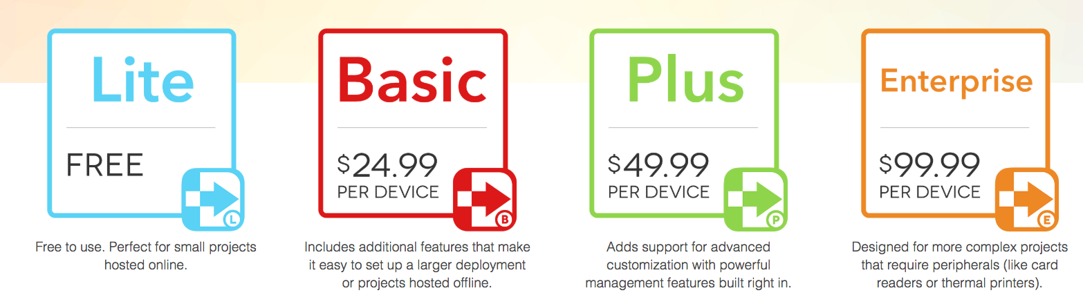
KioskPro to turn iPad into a Kiosk
Implementation Highlights
4 versions of KioskPro. We had to get the Basic (due to the need to clear cache and cookies on home page).
Resetting the survey for new patients and after inactivity limit
Customizing navigation, colors, settings access
Finding minimal effective setup

Slide 36
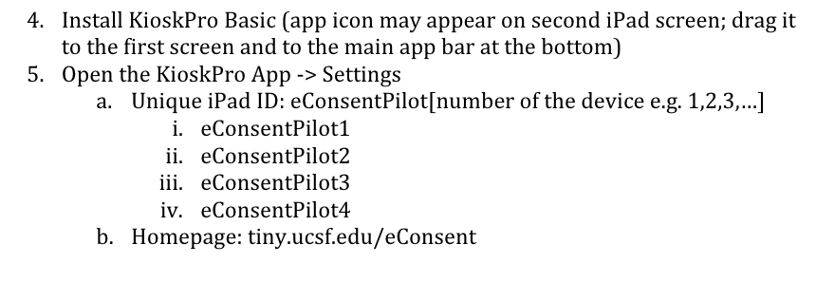
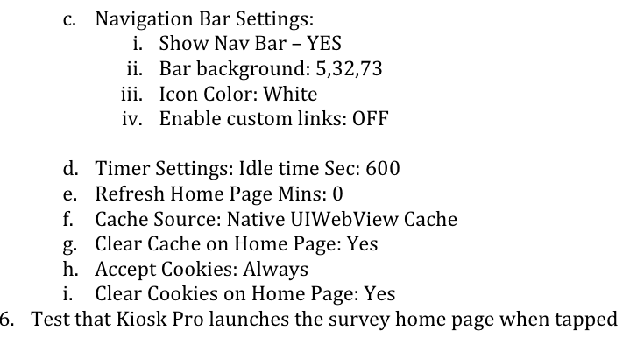
KioskPro to turn iPad into a Kiosk
Lessons Learned
Document every step (& admin passcodes)
KioskPro branding cannot be fully removed – the App icon will stay unless you pay extra. Guided access is a solution.
We used only basic functionality. So much more is possible: offline mode; remote device management; power control

Slide 37
iPad as a device for electronic consent
Implementation Highlights
Stripping down out-of-the-box iPad features
  Cleaning the unneeded apps;
  Enabling restrictions for enhanced security & privacy protection
Accessibility adjustments
Guided access mode
Anti-theft hardware considerations

Slide 38
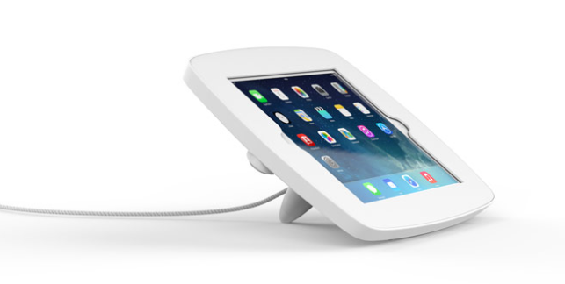
iPad as a device for electronic consent
Lessons learned
Maintenance challenges
  iOS updates will keep coming, as well as backup notifications, and this may be disruptive to users
  Keeping iPads charged and cleaned is additional burden
Protective anti-theft equipment may cost almost as much as the iPad
  and it may affect user experience

Slide 39
Initial pilot test: Parnassus & Mt. Zion blood draw
Consent | N | %
NO: I do not want my leftover samples to be collected and used for research | 8 | 13%
YES: I want my leftover samples to be collected and used for research | 52 | 87%
Total | 60 | 100%

Slide 40
Outgrowing pilot: really doing it at scale
Notes:
Our team kept discussing if it was time to actually start developing a real solution.
When you actually consider scale, you need to consider a few important requirements

Slide 41
Scaling it up
Remote device management
Ongoing data extraction to allow for monitoring and easier data access for research team
Integrating with UCSF clinical systems to enable actual use of the consents
  Saving the consent data back to Epic (UCSF EMR)
  Saving versions of consent at the moment of “Signing”
Launch simultaneously with the online patient portal-based consent

Slide 42
Acknowledgements
Huge Thanks to UCLA Universal Consent Team for sharing their approach, learnings and insights
UCSF eConsent for Biospecimens Team: Dan Dohan, PhD, UCSF Institute for Health Policy Studies, Marie Murphy, PhD, UCSF Institute for Health Policy Studies, Deborah Grady, MD, UCSF CTSI, Scott VandenBerg, MD, PhD, UCSF Cancer Center, Leslie Yuan, MPH, UCSF CTSI
Thanks to Cynthia Piontkowski and Anirvan Chatterjee from UCSF CTSI, and Andrew Robinson, UCSF Clinical Systems, for solving numerous technical puzzles and making this solution so much better!

Slide 43
Thank you! Questions? Ideas?
Eric.Meeks@ucsf.edu
Oksana.Gologorskaya@ucsf.edu
Research Technology, Clinical and Translational Science Institute at UCSF

