Slide 1
An Enterprise Metric Repository
Jeff Love
UCSF IT Enterprise Information Management
August 2018

Slide 2
Agenda
UCSF Enterprise Information Background (Real Short, I Promise)
The Problem
The Idea
What We Did and How We Did It
What It Looks Like
What’s Next?

Slide 3
UCSF Enterprise Information
Created 2013
Work areas: ETL development and support; data warehouse administration; data architecture; metadata and master-data management
12 team members
Project deliverables include data modelling, profiling, source-to-target mapping, ETL design and development, and a full documentation suite

Slide 4

The Problem

Slide 5
The Problem – Lots of Data; No Governance
Multiple (and different!) reporting of the same measures
Disagreement over definitions of key measures and metrics
  Case study: what’s our census?
  Data resided in siloed shops (it’s who you know)

Slide 6
What We Did About It: Tech Geek Efforts
Identified a business need
Brainstormed a flexible technical solution for data replication problems
Extensive data modelling sessions

Slide 7
A Quick Digression: Facts and Dimensions
A fact table contains the numerical data you wish to report on; for instance, how many students are currently enrolled? Every field in a row should directly tie to the numerical value at the heart of the row.
A dimension table contains business intelligence information that tells us the different ways we can look at a fact. A possible dimension for our example fact table above is “student.” A student has a lot of potential dimensional attributes we can use to slice and dice the enrollment number: how many of those students are women? How many came from a different country?
Other common dimensions include time (how many of those students enrolled longer than four years ago?), business units (how many of those students are in liberal arts programs?) and even individual people (how many of those students enrolled in Dr. Freep’s course in abnormal psychology?).

Slide 8
The Model
METRICID
UNIT_OF_MEASURE
METRIC_PERIOD_TYPE
DIM_SET
DIM_TYPE
Metric ID (PK)
Unit of Measure ID (PK)
Period Type ID (PK)
Dimension Set ID (PK)
Dimension Type ID (PK)
Metric Name
Unit of Measure Value
Period Name
Dimension Set Description
Dimension Type Name
METRIC
FACT_METRIC
Metric ID (PK)
Fact Metric ID (PK)
Metric Name
Description
Business Owner
Unit of Measure ID (FK)
Calculation
Version
Effective Date
Metric Value
Reported Date
Period Start
Period End
Metric ID (FK)
Version (FK)
Dim Set ID (FK)
Period Type ID (FK)
DIM_SET_DIM
DIM_VALUE
Dimension Set ID (FK)
Dimension Type ID (FK)
Dimension Value ID (PK)
Dimension Type ID (FK)
Dimension Set Description
Dimension Set Sequence
Dimension Value Name
METRIC_DIMENSION
Metric Dimension ID (PK)
Dimension Value ID (FK)
Dimension Type ID (FK)
Fact Metric ID (FK)

Slide 9

What We Did About It: Data Governance
How come your census number is totally bogus and mine rulez galaxies?
I know, let’s get everyone to agree on metric and measure definitions
For that, we’ll need a centralized Data Governance Council

Slide 10
What We Did About It: Data Governance
About a dozen key stakeholders: data producers, reporting group managers, financial data consumers
Guided and facilitated by the Enterprise Data Governance Director (within IT)
Nearly 200 financial measures and metrics strictly defined and approved

Slide 11
THEN What We Did About It: Nuts and Bolts
Source-data owners approached for access and guidance
Technical spec for data delivery (in the form of an Excel spreadsheet) prepared based on the model
Database tables built
ETLs designed and tested
Jobs scheduled
Data validated by source-data owners - should we have a front end?

Slide 12
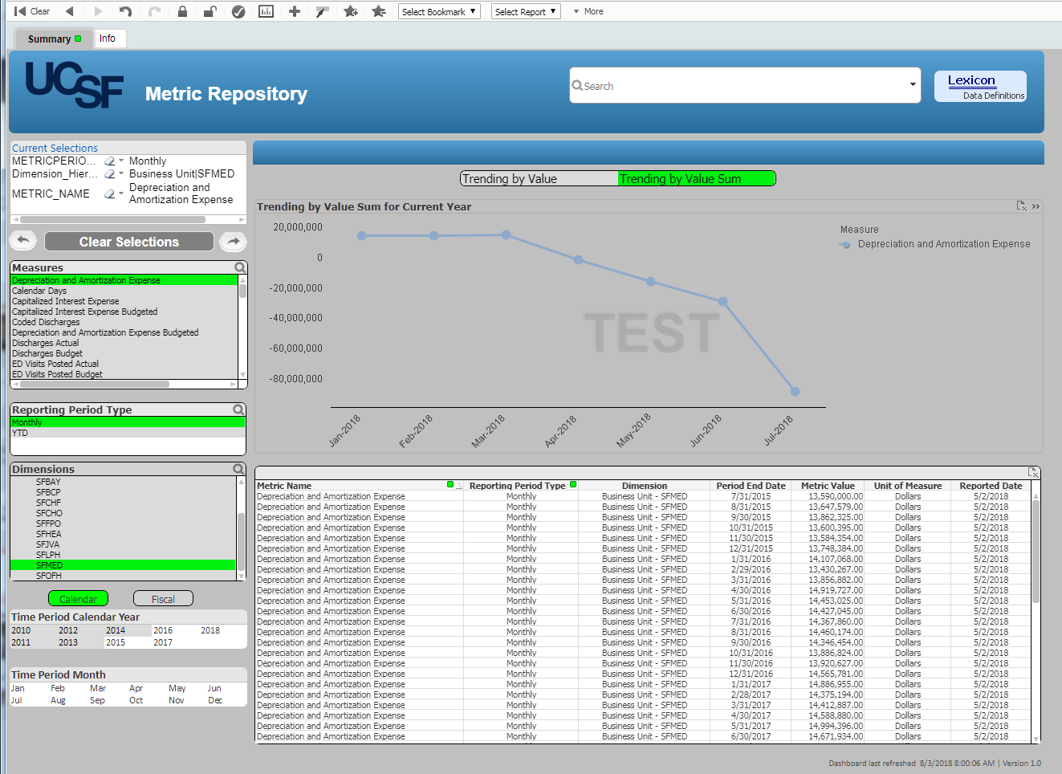
The Front End

Slide 13
We Built It. Here They Come
Source of truth for multiple enterprise measures and metrics
First dashboard sourced from Metric Repository live 5/2018
Additional reporting opportunities identified
Repository is now driving data stewardship efforts by the DGC

Slide 14
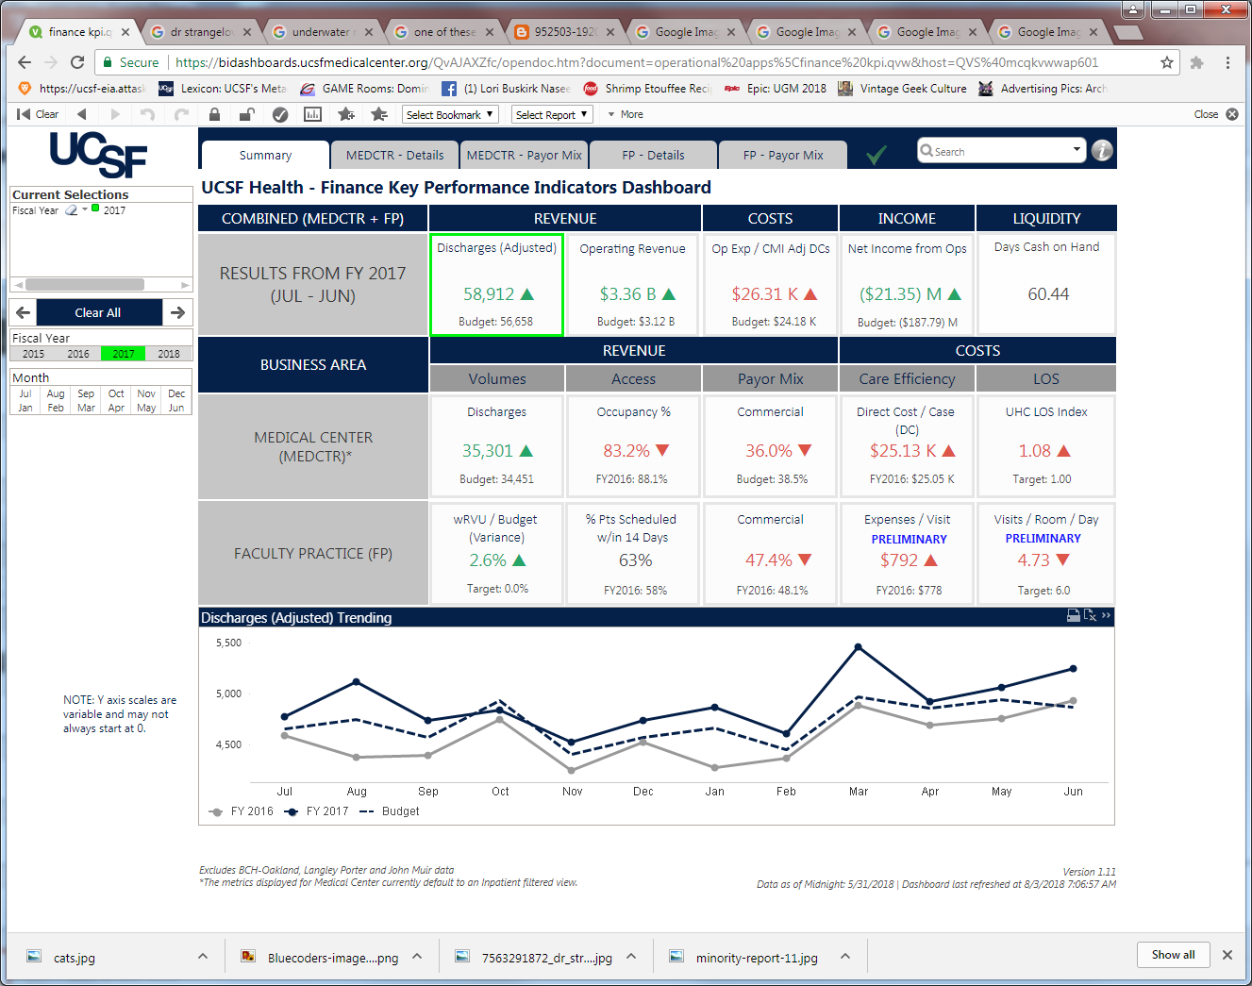
We Built It. Here They Come

Slide 15
What Next?
Sourcing and validation of additional financial measures and metrics
Data governance for clinical measures and metrics
Increased functionality

Slide 16

Current State

