Slide 1
Using the Canvas APIs to do Really Cool Stuff
Chris Brandt, DVM, MS, PMP
Brandon Edwards, TAP

Slide 2
Overview
Quick history of LMS use at the SVM / Selection of Canvas
Review of how the SVM is using the Canvas API to
  Provision course sites
  Create sections and groups
  Assignment of students to sections and groups
  Synchronize the class schedules and additional instructors
  Grade detail export

Slide 3
Background on SVM
4 year program
~140 students / year
Year 1-2: Block Curriculum
Year 3: Emphasis options (Small Animal / Livestock / Equine)
Year 4: Clinical rotations
~20 Courses per term
~50 Senior Clinic Sites
Most courses have > 10 instructors

Slide 4
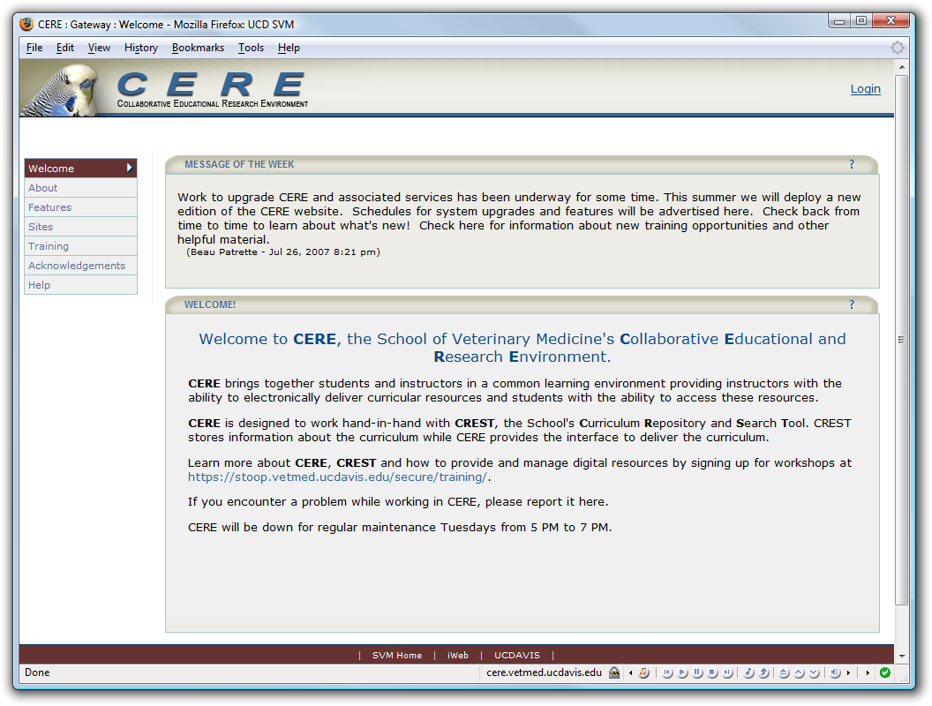
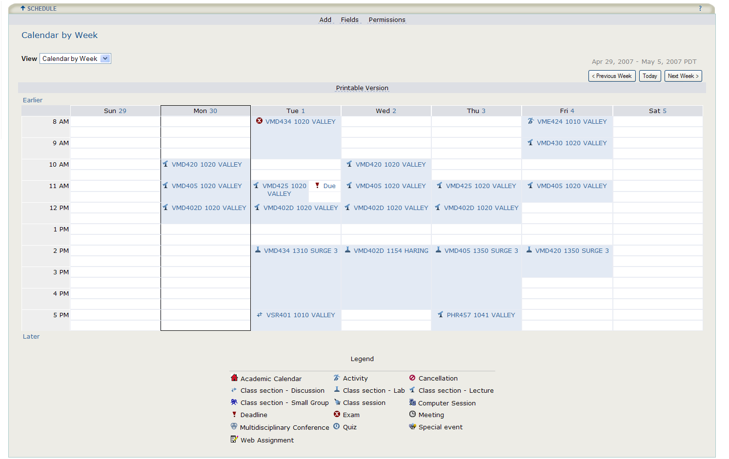
History
2005 – Sakai (CERE) / Ilios (CREST)
2013–2015 – Evaluate LMS options with Campus
2016-2017 – Pilot Canvas
Fall 2017 – Canvas Full Production

Slide 5
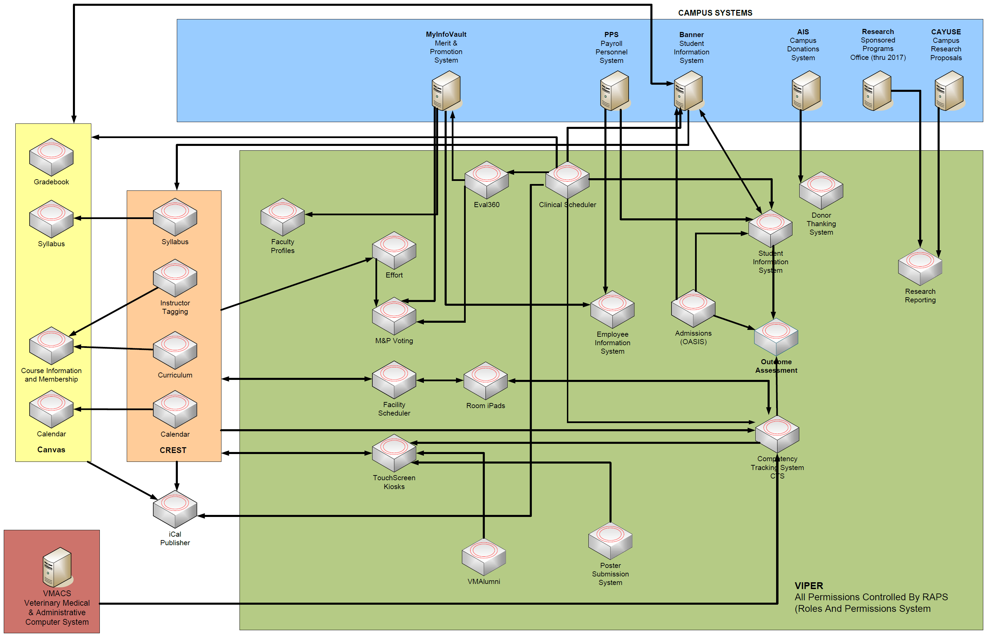

Slide 6
Selection of Canvas – Critical Requirements
Update the schedule automatically
Custom student schedules
Automate membership updates
Access to the data
Whatever other crazy ideas we come up with in the future…

Slide 7
Everything* that Canvas does when you view or save something is done via API

Slide 8
API Basics
Documentation - https://canvas.instructure.com/doc/api/index.html
Subaccount Admin
Create API Token
Chrome Dev Tools / Postman

Slide 9
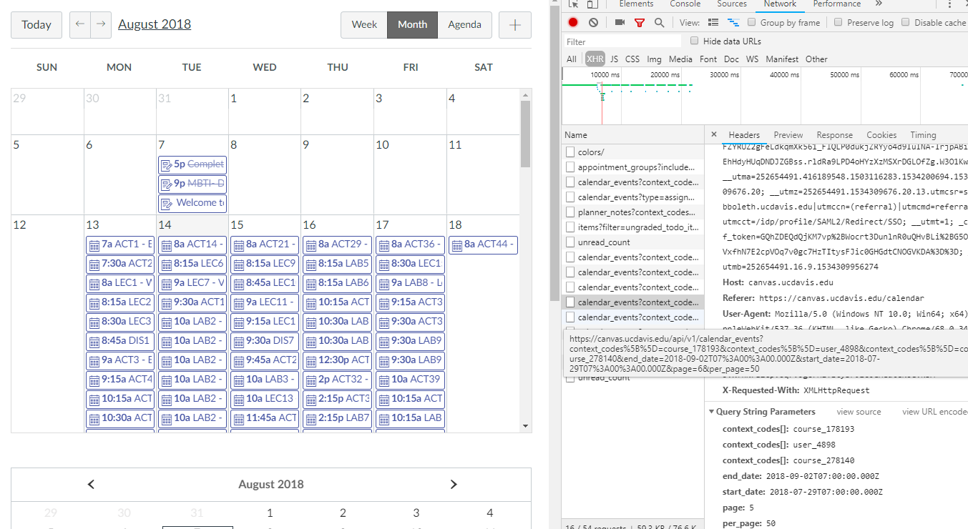
Chrome Dev Tools

Slide 10
Automation of Course Provisioning
Automate course provisioning to include
  Basic Course settings
  Additional LTI tools with custom endpoints
  Creation of sections and groups
  Assignment of students to sections and groups

Slide 11
Course Provisioning – Basic Course Settings
Set End Date for course to July 1 + 4 years from now.
Set Grading Mode to SVM Grading Scheme
Set “Restrict to Course Dates”
PUT
https://canvas.ucdavis.edu/api/v1/courses/[CourseID]
course[start_at]=2018-08-13T07:18:00Z
course[end_at]=2022-07-01T00:00:00Z
course[restrict_enrollments_to_course_dates]=true
course[grading_standard_id]=124
PUT
https://canvas.ucdavis.edu/api/v1/courses/[CourseID]/settings
restrict_student_past_view=false

Slide 12
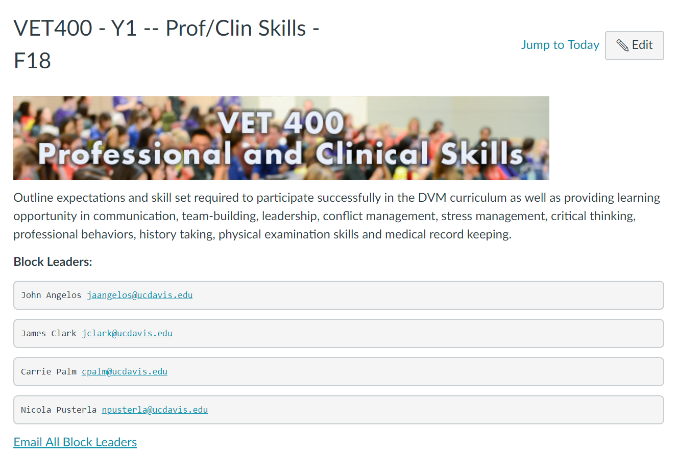
Course Provisioning – Syllabus Body

Slide 13
Course Provisioning – Syllabus Body
Build out the text from CREST data
  Header Image
  Course Description
  Block leader emails
PUT
https://canvas.ucdavis.edu/api/v1/courses/[CourseID]
course[syllabus_body]=
<p><img src=https://secure.vetmed.ucdavis.edu/Crest/CourseBanners/VET412.jpg></p>
<p>Basic mechanisms, etiology, causes and the approach to diagnosis and treatment of cancer with emphasis on veterinary patients.</p>
<p><strong>Block Leaders: </strong></p>
<pre>Michael Kent <a href=mailto:mskent@ucdavis.edu>mskent@ucdavis.edu</a></pre>
<pre>Luke Witten <a href=mailto:lwittenburg@ucdavis.edu>lwitten@ucdavis.edu</a></pre>
<p><a href=mailto:mskent@ucdavis.edu,lwitten@ucdavis.edu>Email All Block Leaders</a></p>

Slide 14
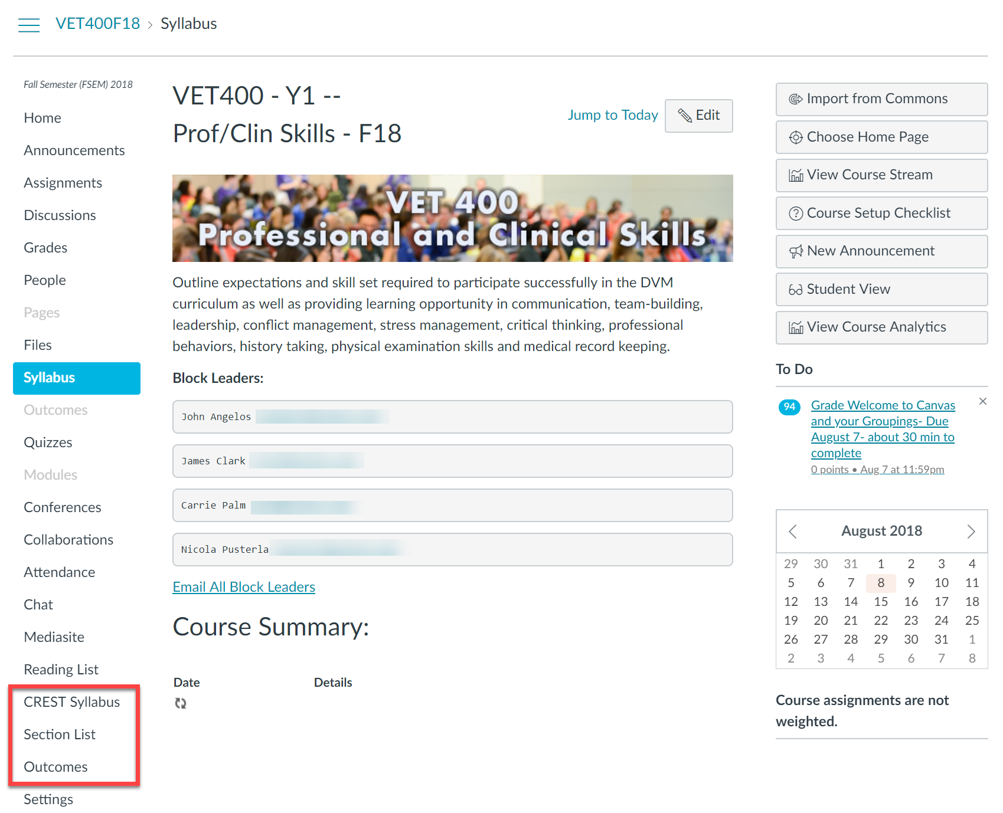
Course Provisioning – Redirect tools in Nav

Slide 15
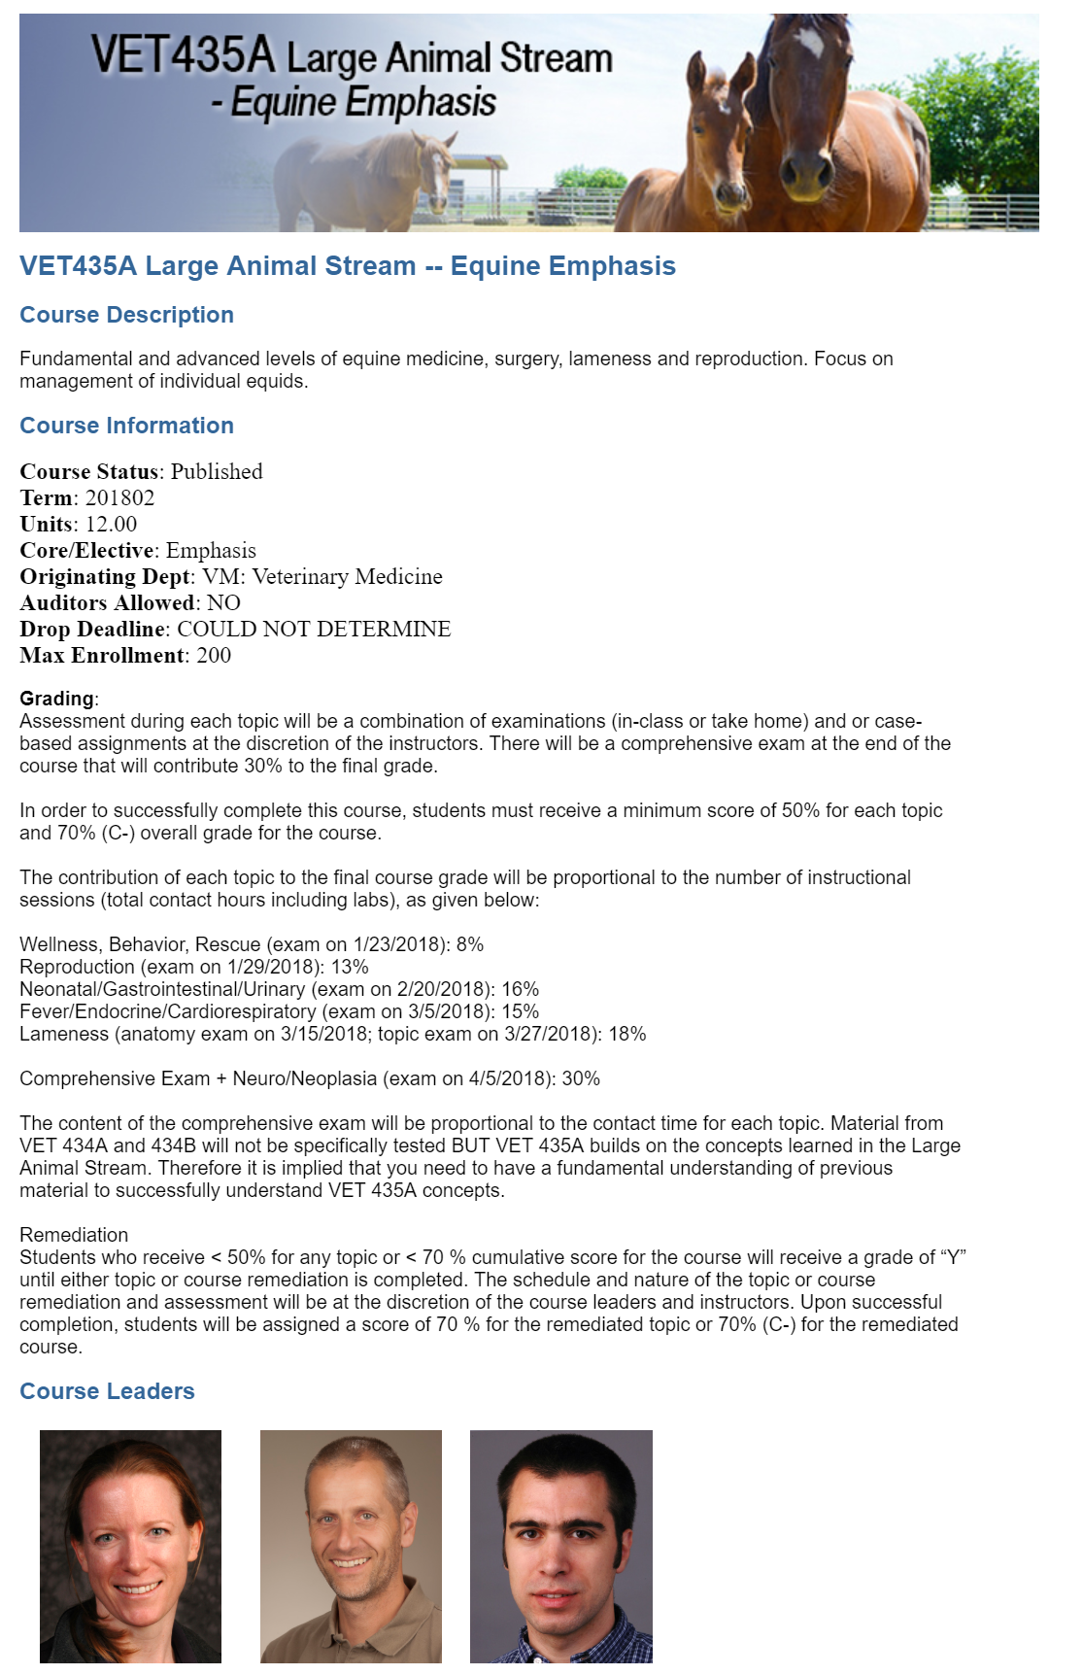
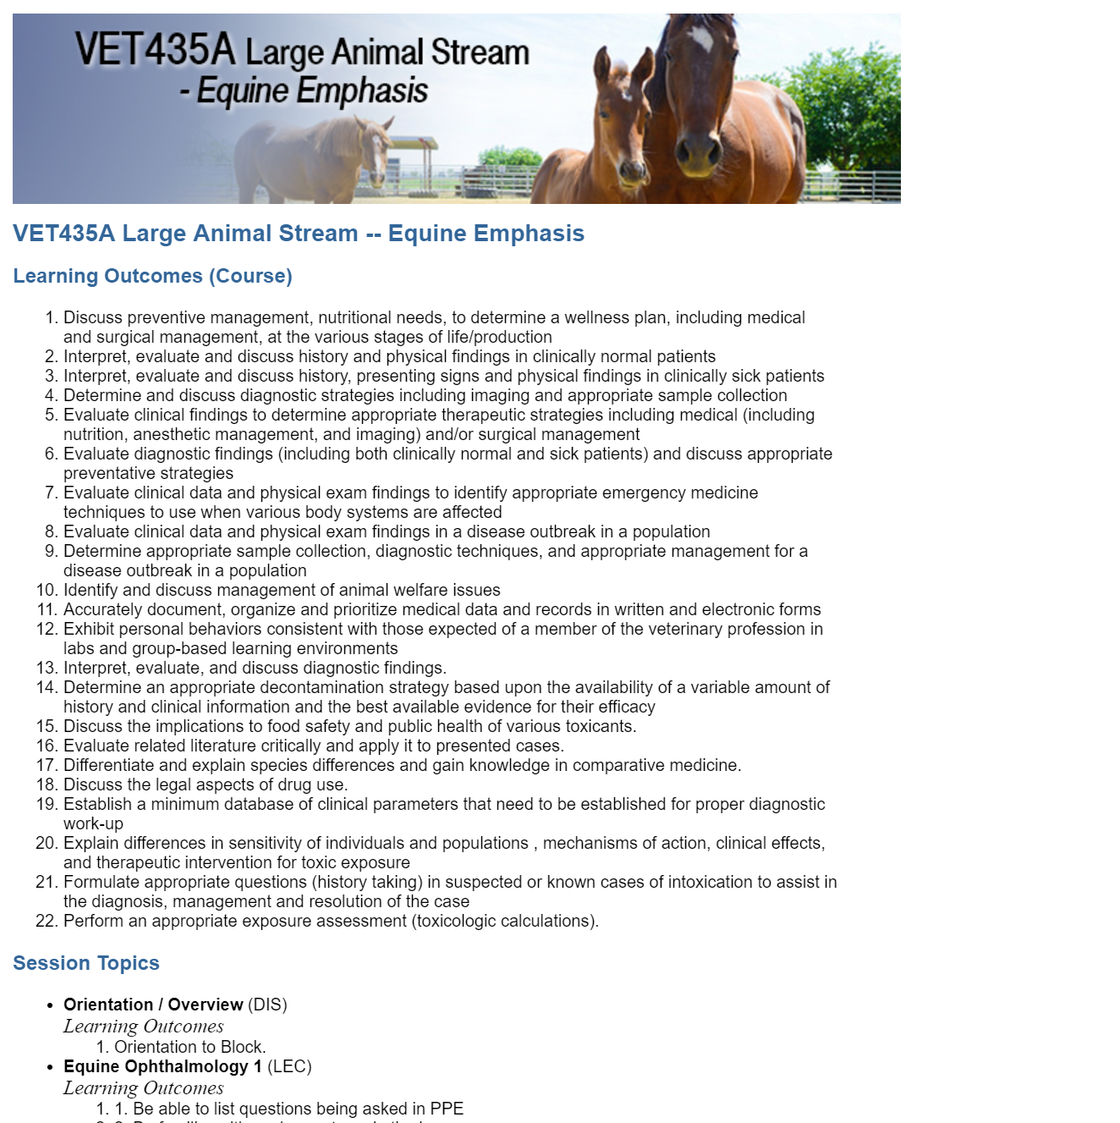
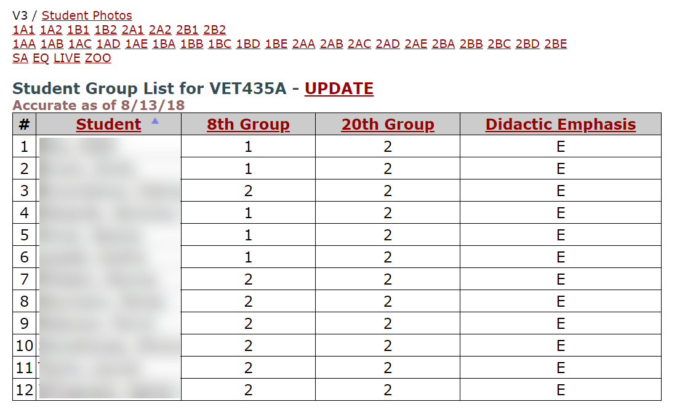
Course Provisioning – Redirect tools in Nav

Slide 16
Course Provisioning – Redirect tools in Nav
POST
https://canvas.ucdavis.edu/api/v1/courses/[CourseID]/create_tool_with_verification/
  custom_fields_string:
  consumer_key:N/A
  shared_secret:N/A
  name:My New Redirect Tool
  app_center_id:redirect
  config_settings:
    name:My%20New%20Redirect%20Tool
    url:https%3A%2F%2Fwww.google.com
    new_tab:1
    course_navigation:1

Slide 17
Course Provisioning – Sections & Groups
Identify which sections and groups are required for this course
Grab the data from Canvas for which sections exist
Create any missing sections
Repeat for groups

Slide 18
Section Hierarchy - Eighths
Whole Class
1
2
1A
1B
2A
2B
1A1
1A2
1B1
1B2
2A1
2A2
2B1
2B2

Slide 19
Section Hierarchy – Twentieths – Years 1 & 2
Whole Class
1
2
1A
1B
2A
2B
1AA
1AB
1AC
1AD
1AE
1BA
1BB
1BC
1BD
1BE
2AA
2AB
2AC
2AD
2AE
2BA
2BB
2BC
2BD
2BE

Slide 20
Course Provisioning – Sections & Groups
Get Sections (GET)
  https://canvas.ucdavis.edu/api/v1/courses/[CourseID]/sections
Create Sections (POST)
  https://canvas.ucdavis.edu/api/v1/courses/[CourseID]/sections
  course_section[name]=1AA
Update Sections (PUT)
  https://canvas.ucdavis.edu/api/v1/courses/[CourseID]/sections/[sectionID] course_section[name]=1AB
Similar for Groups

Slide 21
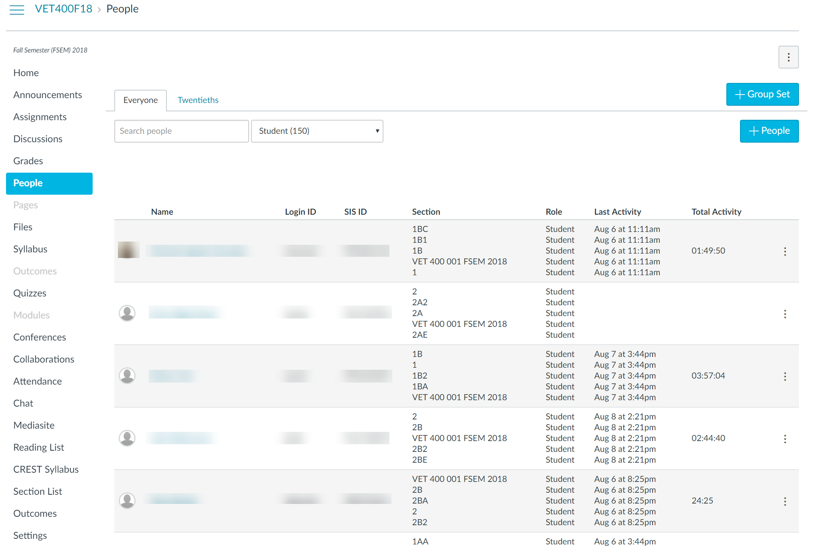
Canvas – People List

Slide 22
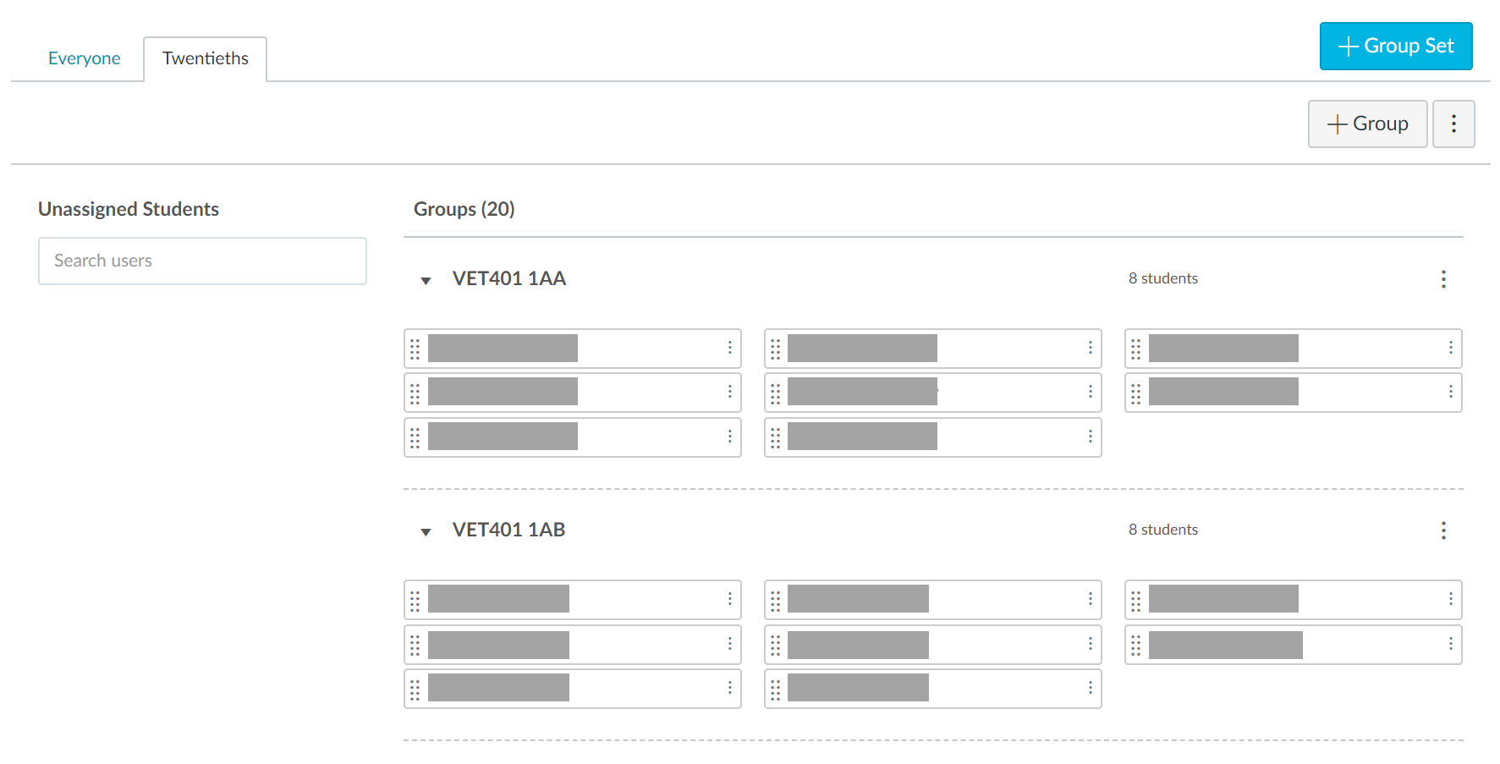
Canvas Group Management

Slide 23
Synchronization of Class Schedule
Course sessions and offerings are stored in Curriculum Database (CREST)
No edits allowed directly in Canvas
Student specific view based on Section membership
Synchronization starts once the Course has been set to ‘Published’

Slide 24
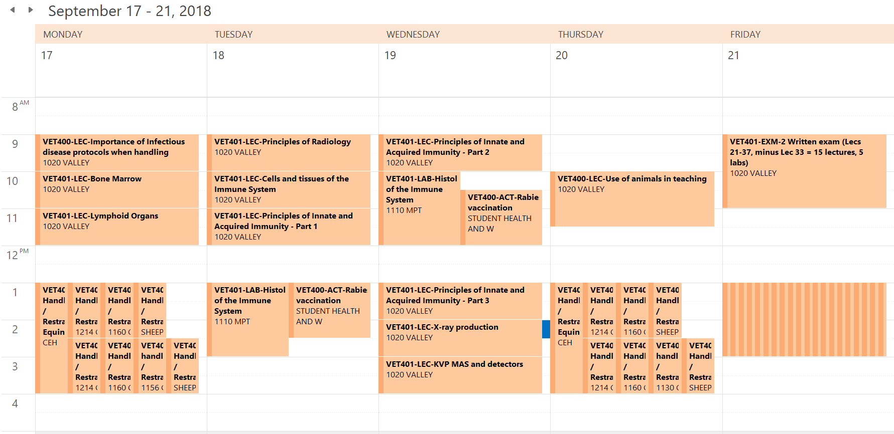

Slide 25
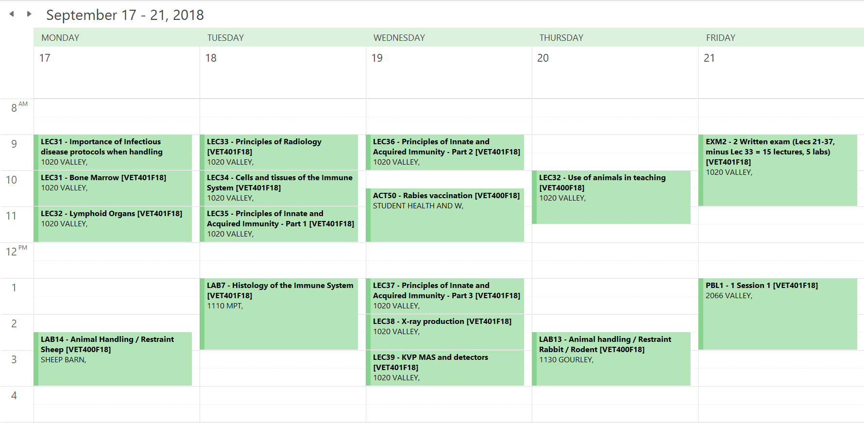

Slide 26
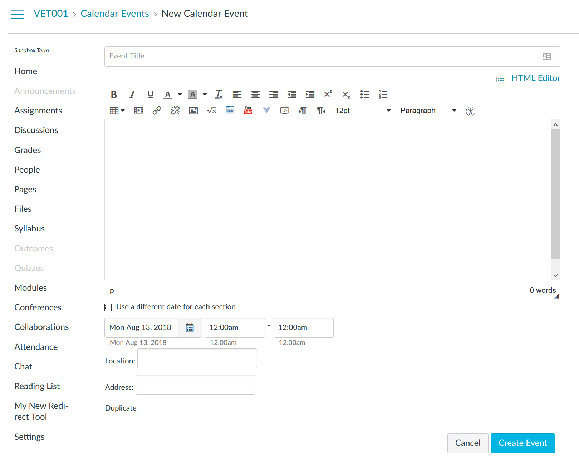
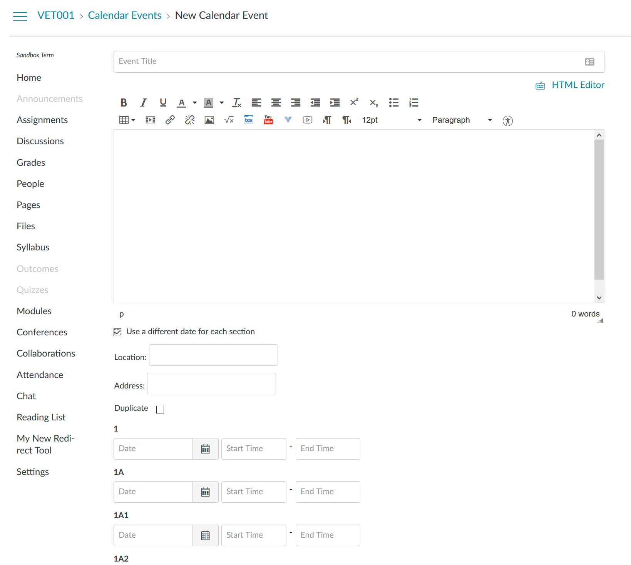
Section Specific Calendar Events

Slide 27
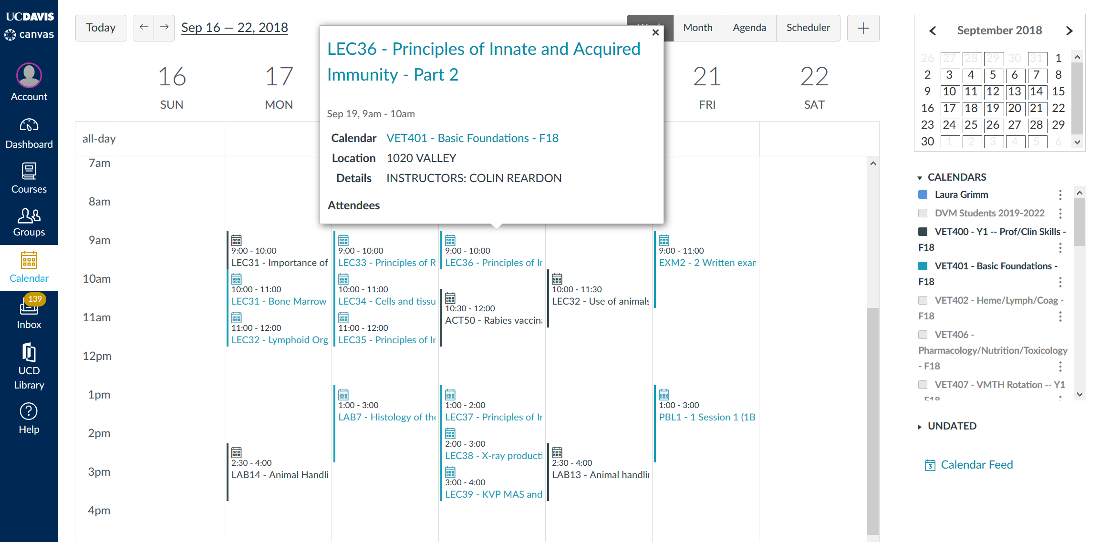

Slide 28
Synchronization of Class Schedule
For each course in term
  Get all the offerings from CREST
  Get all offerings from Canvas for Course
    GET
    https://canvas.ucdavis.edu/api/v1/calendar_events
    all_events=1
    context_codes[]=course_[courseID]
    excludes[]=assignment
    excludes[]=child_events
    type=event
    page=1
    per_page=100
  Compare with CREST
  Create / Update / Delete as required
  Update CREST database with EventID

Slide 29
Synchronization of Class Schedule - Create
POST
https://canvas.ucdavis.edu/api/v1/calendar_events
  calendar_event[title]=ACT1 – Session Title
  calendar_event[location_name]=1047 VALLEY
  calendar_event[description]=INSTRUCTORS: CHRIS BRANDT calendar_event[context_code]=course_[CourseID]
  calendar_event[time_zone_edited]=Pacific Time (US & Canada)
  calendar_event[start_at]=2018-12-25T16:00:00Z
  calendar_event[end_at]=2018-12-25T17:00:00Z
  calendar_event[child_event_data][1][context_code]=course_section_[SectionID]
  calendar_event[child_event_data][1][start_at]=2018-12-25T16:00:00Z
  calendar_event[child_event_data][1][end_at]= 2018-12-25T17:00:00Z

Slide 30
Synchronization of Class Schedule – Update
PUT
https://canvas.ucdavis.edu/api/v1/calendar_events/[EventID]
  calendar_event[title]=DSL1 - Examination of the respiratory/cardiovascular tract in large animals-review
  calendar_event[location_name]=TBA
  calendar_event[description]=INSTRUCTORS: CHRIS BRANDT
  calendar_event[context_code]=course_[CourseID] calendar_event[time_zone_edited]=Pacific Time (US & Canada)
  calendar_event[start_at]=2018-10-15T15:00:00Z
  calendar_event[end_at]=2018-10-15T17:00:00Z

Slide 31
Synchronization of Class Schedule – Delete
DELETE
  https://canvas.ucdavis.edu/api/v1/calendar_events/[EventID]

Slide 32
Synchronization of Instructors
Get all assigned instructors for the course
Get the currently assigned instructors
Create or Delete as necessary
GET
https://canvas.ucdavis.edu/api/v1/courses/[CourseID]/enrollments
  role[]=TeacherEnrollment,per_page=100,page=1
POST
https://canvas.ucdavis.edu/api/v1/sections/[SectionID]/enrollments
  enrollment[type]=TeacherEnrollment,
  enrollment[user_id]=sis_user_id:[BannerID],
  enrollment[role_id]=[RoleID],
  enrollment[enrollment_state]=active

Slide 33
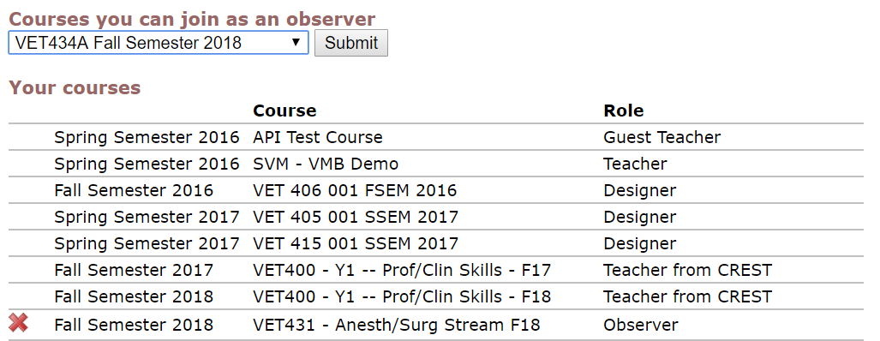
Auditing the Course
For Faculty / Staff who want to review material in course
Get list of currently joined courses
Select from list of available courses

Slide 34
Auditing the Course
For Faculty / Staff who want to review material in course
Get list of currently joined courses
Select from list of available courses
POST
https://canvas.ucdavis.edu/api/v1/sections/[SectionID]/enrollments
  enrollment[type]=TeacherEnrollment,
  enrollment[user_id]=sis_user_id:[BannerID],
  enrollment[role_id]=[RoleID],
  enrollment[enrollment_state]=active

Slide 35
Auditing the Course – Concluded Courses
If the course is already concluded, need to temporarily open it up for enrollment
PUT
https://canvas.ucdavis.edu/api/v1/courses/[CourseID]
course[end_at]=2018-08-17T17:00:00Z
course[restrict_enrollments_to_course_dates]=true
POST
https://canvas.ucdavis.edu/api/v1/sections/[SectionID]/enrollments
  enrollment[type]=TeacherEnrollment,
  enrollment[user_id]=sis_user_id:[BannerID],
  enrollment[role_id]=[RoleID],
  enrollment[enrollment_state]=active
Then update back to the original close date and set “restrict…” to false

Slide 36
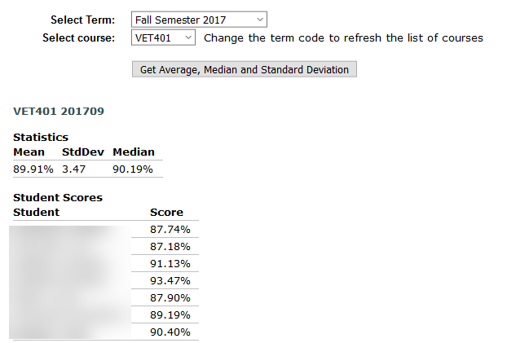
Course Grade Analysis
Get Mean, Median, and Standard Deviation for Courses within Canvas

Slide 37
Course Grade Analysis
Get Students in Course
Get Assignment Groups
Get Student Submissions for these students

Slide 38
Issues We Have Overcome
Paging
  Only 100 results per request so need to chain these together
Performance
  Each request takes ~200ms to return
  Use Threads to parallelize this work
Data Oops…
  Department staff adding teachers / Tas – Sync removing them
    Add roles for “Teacher from CREST” / “Dept Proxy from CREST”

Slide 39
Questions?

