Slide 1
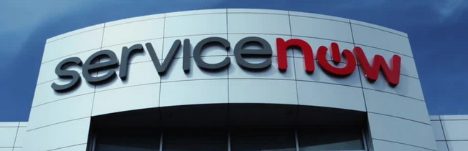

Lessons Learned and Best Practices: Getting from ServiceNow PPS Demos to Real Life

Slide 2
Panel Members
Eric Martin & Patrick Wagman –
UC Riverside
2. Lyle Wiedeman – UC Irvine
3. Kent Carpenter – UC Merced
4. Hampton Sublett – UC Davis

Slide 3
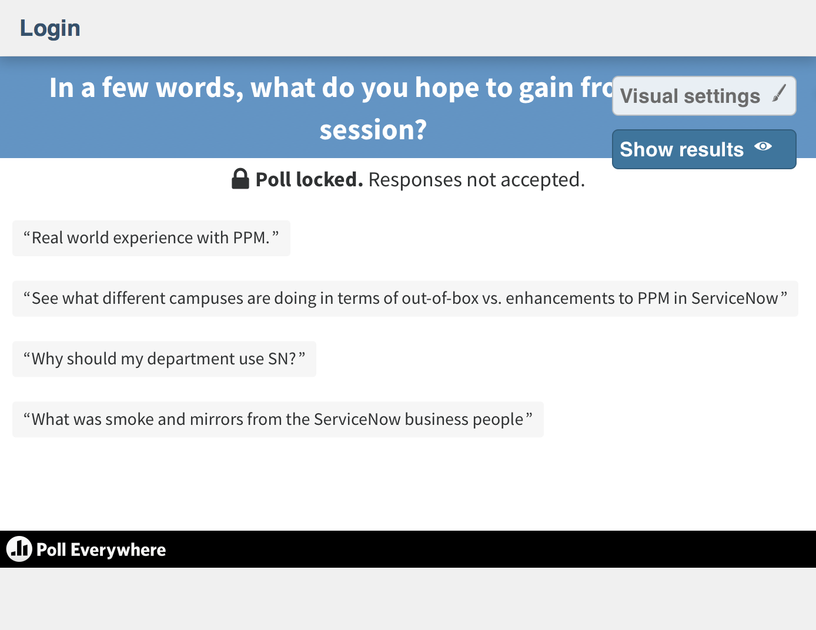

Slide 4
Eric Martin/Patrick Wagman – UCR
Years at UC:
  Eric Martin = 17, Patrick Wagman = 1
SN-PPS Modules in Use:
  Incident, Change, Request, Problem, Knowledge, Service Catalog, Service Portal, Demand, Project, and Resource (PPS).
Goals for SN-PPS:
  Streamline project intake, proper resource allocation, project management all in one place
Current PM structure on campus:
  No PMO. ITS has a matrixed project management model.
Lessons Learned:
  ServiceNow PPS has many settings that need to be configured and therefore, decided upon.

Slide 5
Lyle Wiedeman - UCI
Years at UC:
  36
SN-PPS Modules in Use:
  Project, Portfolio, Resource, Time Sheet
Goals for SN-PPS:
  IT Deployment with Campus Exposure
Current PM structure on campus:
  Small Central IT PMO (since 02/2018), a few PMs & lots of people managing projects
Lessons Learned:
  Executive buy-in = End user cooperation
Notes:
SN-PPS Modules in Use:
I include Time Sheets because that’s how we currently track actual time spent on projects. The internal time counters provided by ServiceNow seem to work OK as long as you remember to turn them on and off (which hardly anyone does). Time Sheets is something of an honor system but it’s better than what we had.
Goals for SN-PPS:
We are deploying ServiceNow in the Office of Information Technology (OIT) where all staff (400+ people, including students) are fulfillers. Currently there is no mandate that all OIT projects be managed in ServiceNow but there is a requirement that all project status reporting be done in ServiceNow. Eventually we would like to have all project tasks assigned using ServiceNow as well so we can better track resources and progress. We are experimenting with providing “ServiceNow as a Service” to other campus groups with the caveat that we will not be deploying multi-tenant. This will complicate our PPS implementation as other groups will probably want changes specific to their methodologies.
Current PM structure on campus:
Our PMO is under the Central Services Division of OIT and is small (four PMs, including the manager) and new (opened for business in February 2018). Our PM strategy to this point is to rely on team leads and SMEs to manage projects, although very few of them are trained as project managers. Until the PMO was formed there was no concerted effort to use common methodologies and processes. As a result, those who are trained PMs use whatever methodology they are most comfortable with. This has lead to a broad diversity of interpretation of things as fundamental as “what is a project” as well as varying approaches to PM across OIT. We’re addressing this through education, written policies and procedures (as we have time), showing positive outcomes from the PMO, and in general, being good examples. We’ve made a lot of progress be we still have a way to go.
Lessons Learned:
The No. 1 lesson we learned is that without strong executive buy-in, deploying any new process, including ServiceNow PPS, is an uphill battle. Implementing change is rarely a grassroots effort—it almost always has to come from the top. Directives from management may not make the job much easier but it certainly wards off a lot of the excuses and delays due to “other priorities.” By the way, the best management directives come with a deadline.
The No. 2 lesson is that current processes need to be in place before attempting to manage them in ServiceNow. Since ServiceNow is implemented around ITIL principles, it’s fairly structured (and predictable) in the way things work. Everything is fine until someone says “that’s not the way we do it.” Initially we tried to adapt ServiceNow to “the way they do it” but more recently we focus more on changing operations rather than changing ServiceNow.

Slide 6
Kent Carpenter – UCM
Years at UC:
  2 ½ years
SN-PPS Modules in Use:
  Project, Demand, Allocations, SDLC-Agile
Goals for SN-PPS:
  Investigating ServiceNow PPS
Current PM structure on campus:
  Single PMO Managing PMs – All IT projects
Lessons Learned:
  Develop processes before moving to ServiceNow

Slide 7
Hampton Sublett - UCD
Years at UC:
  13
SN-PPS Modules in Use:
  Project, Demand, Self-Service
Goals for SN-PPS:
  Campus Wide Deployment
Current PM structure on campus:
  Central IT PMO and numerous other PMs across campus
Lessons Learned:
  System Requirements: must-haves vs. nice-to-haves

Slide 8
Panelists’ Contact Info:
Eric Martin – UCR
    eric.martin@ucr.edu
Patrick Wagman - UCR
    patrick.wagman@ucr.edu
Lyle Wiedeman – UCI
    wiedeman@uci.edu
Kent Carpenter – UCM
    kcarpenter4@ucmerced.edu
Hampton Sublett – UCD
    hsublett@ucdavis.edu

