Slide 1
Endpoint engineering
  ucsc

Slide 2
The evolution of endpoint engineering
“In the beginning there were floppy disks and sneakernet.”
Paul Sosbee

Slide 3
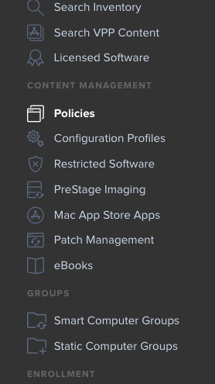
Enter the casper suite

Slide 4
we are not pushy people

Slide 5
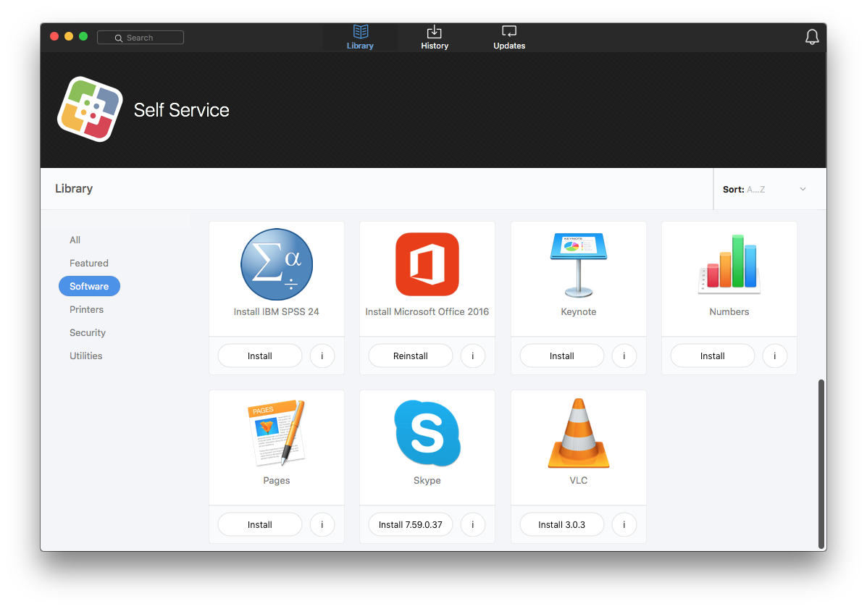

Slide 6



Slide 7
The unified inventory

Slide 8
autonomous jamf
Humanities
Soe
Socsci
Arts
Css
Decentralized

