Slide 1
UCCSC 2018
Endpoint Engineering
University of California, Berkeley
Alex Kim

Slide 2
scope of eos
Campus
Dept IT
Dept IT
Dept IT
Endpoint Operations and Services (EOS) is part of UC Berkeley’s central IT department (IST)
Customer base is all campus departments
EOS is the primary service provider for centralized endpoint engineering services: Windows and macOS campus configurations, patching, hardware and software standards, endpoint security, etc.
Central IT
(IST)
Security
and more
Windows
Network
EOS
Service Desk
Shared Services IT Desktop Support

Slide 3

Campus Adoption of EOS Services
Number of Endpoints in our Service Scope: ~16,000
  Windows: 11,000, Mac: 5000
Number of Berkeley Desktops (EOS standard configuration): ~11,300
  Windows 10: ~6,000
Accepted Self Service Offers
  Windows: ~33,000, Mac: ~13,500

Slide 4

Endpoint Operations and Services (EOS)
Manager: Laurie Graham
System Administrators:
Clifton Hom
Jim Vaughn
Stan Cheung
Alex Kim

Slide 5

What’s next for EOS?
Elevate EOS services using the Service Lifecycle framework
Focus on meeting UC Berkeley’s needs and providing value to the campus (students, faculty, staff, etc)
Security of Endpoints
Arguably, the weakest point of threat is the end-user, including IT staff, and the endpoint is the vehicle of attack

Slide 6

Security InitiativeS
Disk Encryption
Windows Defender Advanced Threat Protection (ATP)
Privileged Access to Systems

Slide 7

Disk Encryption

Slide 8
Disk Encryption
UCOP Minimum Security Standards for Encryption
“Laptops and mobile devices must be encrypted.”
https://security.ucop.edu/policies/security-controls-everyone-all-devices.html
Required starting July 2019
UC Berkeley using Dell Encryption
Windows - BitLocker
macOS - FileVault 2

Slide 9
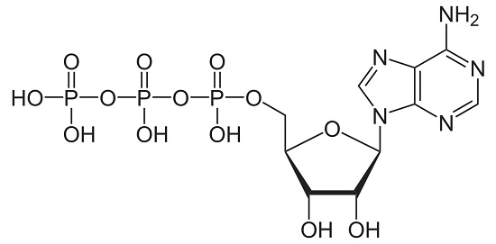
Windows Defender Advanced Threat Protection (ATP)

Slide 10

Windows Defender ATP
“Windows Defender Advanced Threat Protection (ATP) is a unified platform for preventative protection, post-breach detection, automated investigation, and response.”
UC Berkeley runs Windows Defender ATP in Microsoft Azure as a Cloud service
Windows Defender
Took over for EMET
Features: AntiVirus, Malware and Spyware Protection, Credential Guard, Device Guard

Slide 11
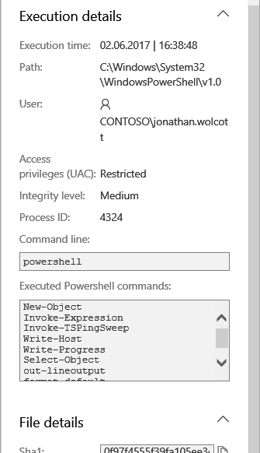
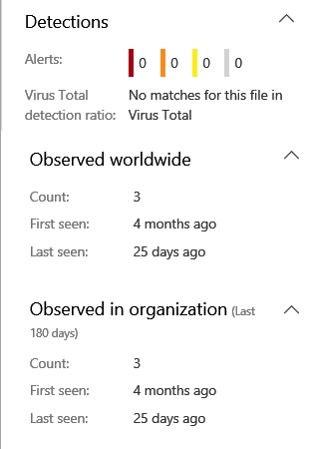
Windows Defender ATP Threat Detection
Alert Notification and Details

Slide 12
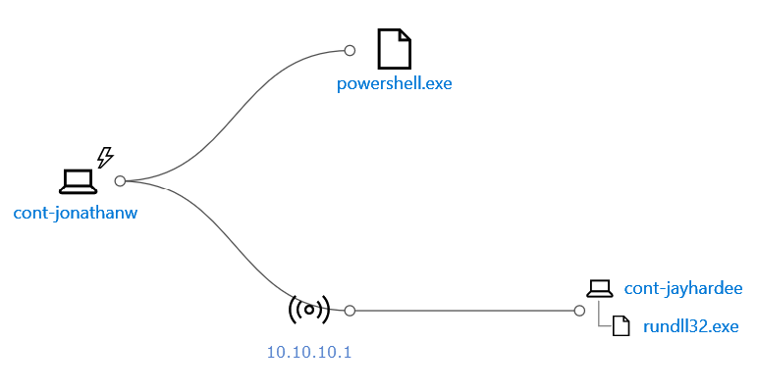
Windows Defender ATP Threat Detection
Incident Graph

Slide 13

Privileged Access to Systems
Berkeley “PAW”
Used for access to high-value systems like Active Directory
Privileged Access Workstation: Credential Guard, Device Guard, Restricted Network, Application Whitelisting, and more
Dedicated workstation for specific functions
Generally used by a smaller percentage of your IT staff

Slide 14

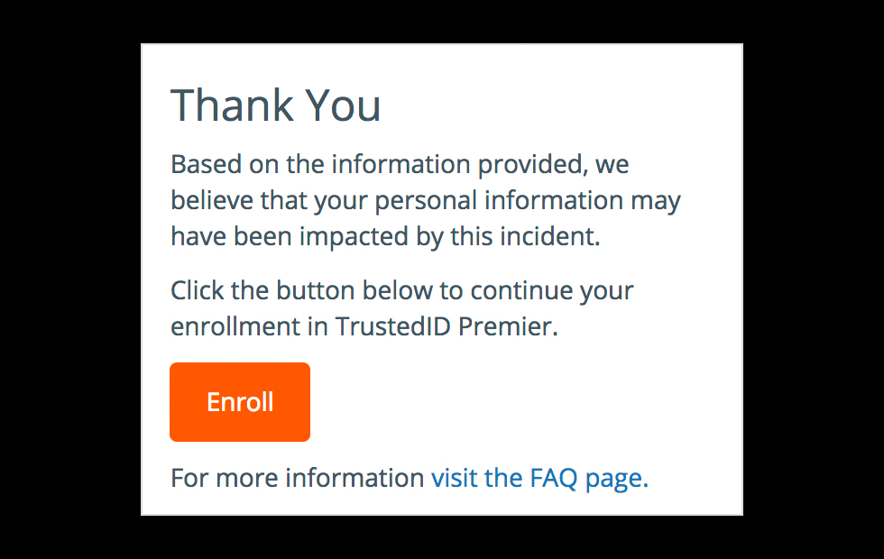
Privileged Access to Systems
Reduces surface area of potential threats and attacks: Pass-the-Hash, Pass-the-Ticket, Keystroke Logging
“Assume Breach”: If PAW is hacked, threat cannot easily move to high-value systems
In conjunction with other security systems like Privileged Access Management (PAM)

Slide 15



Summary of Security Initiatives
Disk Encryption
Data Security and
Protection
Defender ATP Automated Prevention, Detection, Response, and Investigation
Berkeley PAW
Prevention, Threat Reduction, Safe Guards

Slide 16
Conclusion
EOS is working with Security team, Windows team, and others in central IT to develop and deliver these services
IT Leadership and Management is supporting and has provided funding for these services
UC Berkeley and IT understand the value and significance of endpoints and endpoint engineering!

Slide 17

The END

