Slide 1
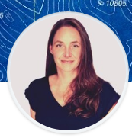
ACCELERATE: INNOVATION
Improve a Technology, Process or Experience
Jane Harrington
UC Davis

Slide 2
STEP 1:
Seed The IDEA.

Slide 3
STEP 2:
Make a Plan.

Slide 4
STEP 3:
Get the Green Light.

Slide 5
STEP 4:
Generate interest.

Slide 6
STEP 5:
Launch it.

Slide 7
STEP 6:
Accept & Review Proposals

Slide 8
STEP 7:
Get the Pitch.

Slide 9
STEP 8:
Select proposals

Slide 10
STEP 9:
Engage with Teams.

Slide 11
STEP 10:
Celebrate success

Slide 12
STEP 10.5:
ITERATE!

