Slide 1

People Skills

Slide 2
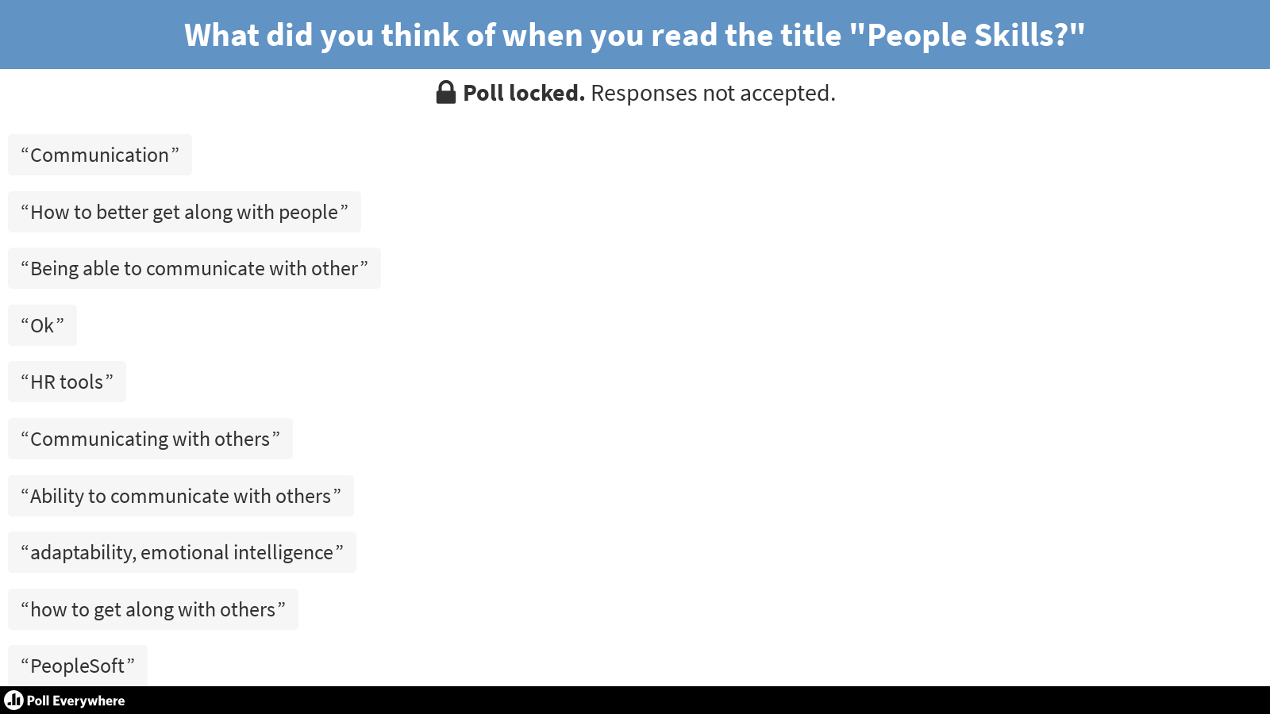

Slide 3




TRUST AND RESPECT
People
People
Tasks
Tasks
People
People
Tasks
Tasks

Slide 4

OBJECTIVES
FIRST FOCUS
1
Know your behavior style and how you impact others
SECOND FOCUS
Recognize the behavior style of others so you can meet their needs
2
Recognize and manage tension-reaction
behaviors effectively
3
4
Know how to be flexible and create win/win outcomes

Slide 5
WHY WE’RE HERE
Awareness
Options
Choices
Control
Power
Position
Money

Slide 6
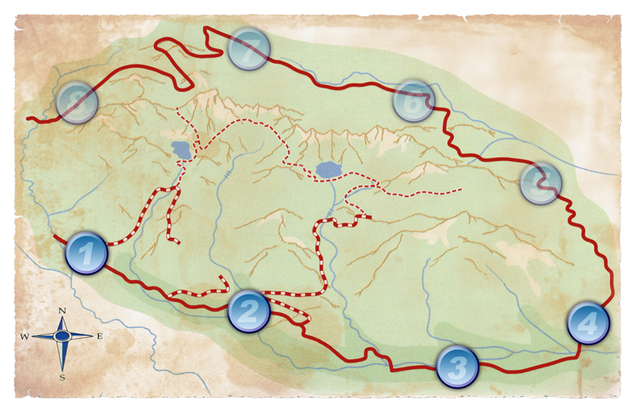
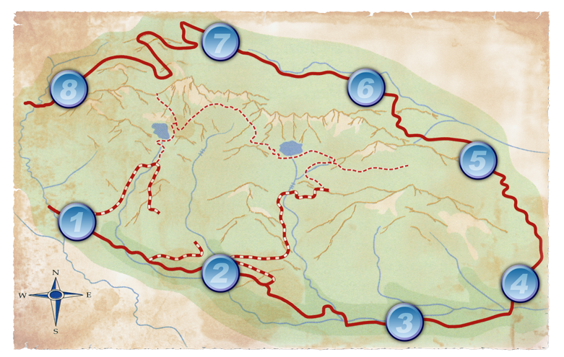
ROADMAP
Two Sessions - Self
Module 1: Behavior versus Personality
Module 2: How I See Me
Module 3: How I Show Up
Module 4: How You See Me

Slide 7
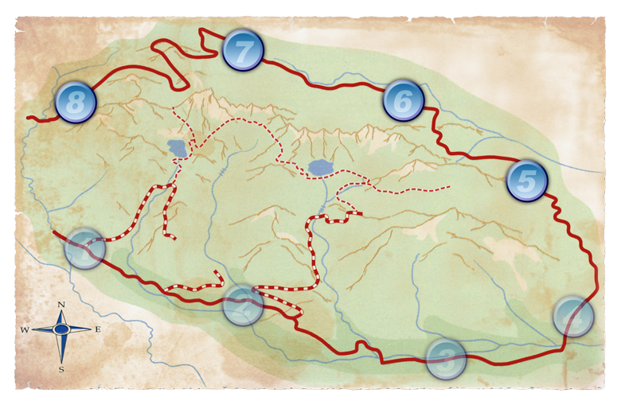
ROADMAP
Two Sessions - Others
Module 5: How I See Others
Module 6: Discover Style Needs
Module 7: Styles in Tension
Module 8: Flex to Create the Win-Win

Slide 8

BEHAVIOR VS. PERSONALITY
PERSONALITY is who you are.
BEHAVIOR is what you do.
PERSONALITY cannot be situationally, intentionally and temporarily modified by choice.
BEHAVIOR can be situationally, intentionally and temporarily modified by choice.

Slide 9
We call Patterns of Behavior Behavior Style
Behavior Style is NOT a label – everyone demonstrates all the Style behaviors at one time or another

Slide 10












WHAT’S THE PATTERN?
?
If you can identify the pattern you can make sense of it and know what comes next

Slide 11
“As I See Myself”
Profile

Slide 12
COMPLETING THE PROFILE
At the top of the form write WORK and complete it with that focus.
Go with your first hunch.
If no word seems to fit, pick the one that best
describes you.
1
2
3

Slide 13
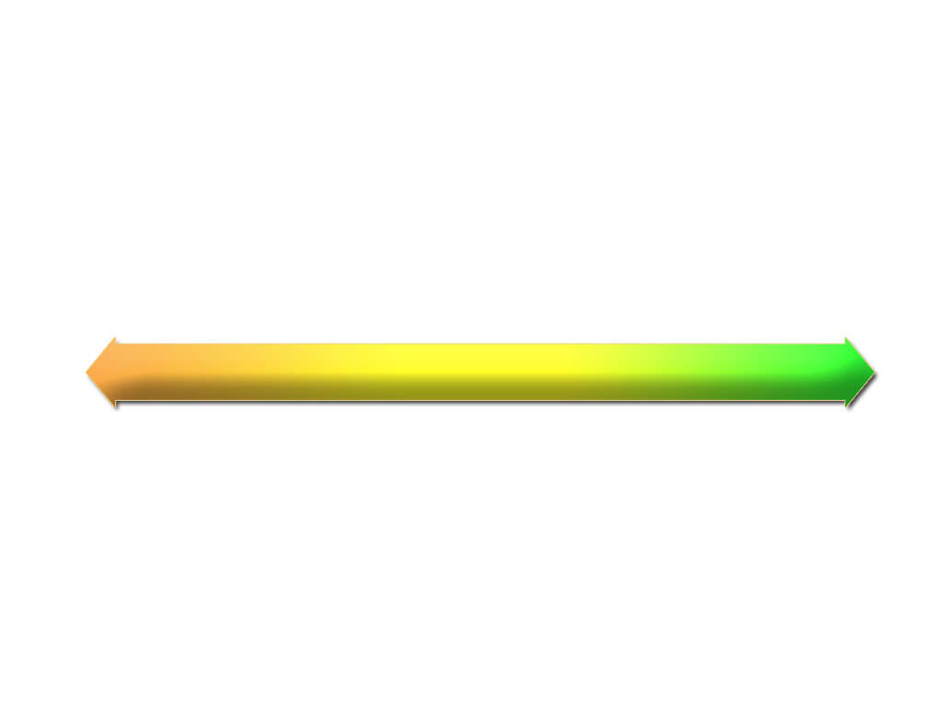
CSAP GRAPH
Tally Box
C O N T R O L L E R
C
10
0
1
2
3
4
5
6
7
8
9
10
11
12
14
16
18
2
S T A B I L I Z E R
S
2
0
1
2
3
4
5
6
7
8
9
10
12
14
16
A N A L Y Z E R
A
1
0
1
2
3
4
5
6
7
8
9
10
12
14
P E R S U A D E R
P
11
1
0
1
2
3
4
5
6
7
8
9
10
11
12
14
16
24
TOTAL - Must equal 24
Mid-line

Slide 14
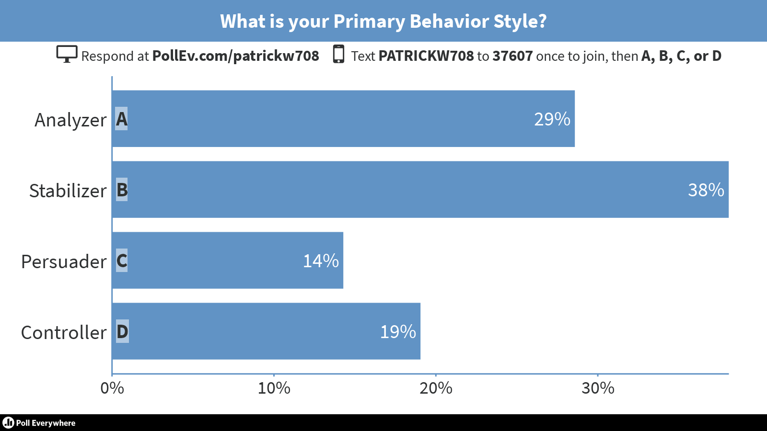

Slide 15
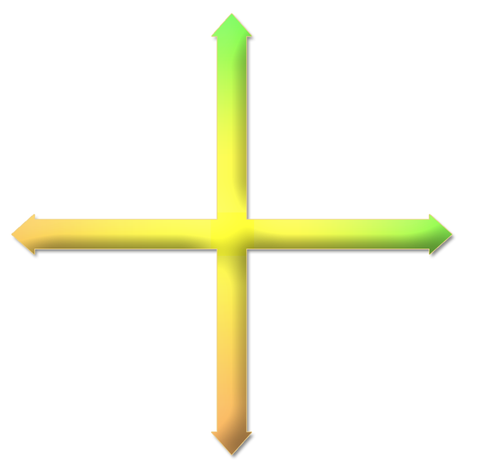
BEHAVIOR TENDENCIES
CONTROLLER
Results
To be in control
Uses conflict
Listening
Their objectives and results
Be efficient
Action
CONTROLLER
Results
To be in control
Uses conflict
Listening
Their objectives and results
Be efficient
Action
E
M
O
T
I
O
N
S
A
C
Analyzer
Controller
RESULTS
RESULTS
S
E
M
O
T
I
O
N
S
P
Stabilizer
Persuader

Slide 16
BEHAVIOR TENDENCIES
CONTROLLER
Results
To be in control
Uses conflict
Listening
Their objectives and results
Be efficient
Action
PERSUADER
People
To be liked
Uses verbal skills
Following systems
Their ability to take risks
Get acquainted, have fun
Approval and praise
E
M
O
T
I
O
N
S
A
Analyzer
RESULTS
RESULTS
PERSUADER
People
To be liked
Uses verbal skills
Following systems
Their ability to take risks
Get acquainted, have fun
Approval and praise
S
E
M
O
T
I
O
N
S
P
Stabilizer
Persuader

Slide 17
BEHAVIOR TENDENCIES
CONTROLLER
Results
To be in control
Uses conflict
Listening
Their objectives and results
Be efficient
Action
STABILIZER
Relationships
Security
Maintaining harmony
Initiating quickly
Them as a person
Understand their goals
Appreciation
E
M
O
T
I
O
N
S
A
Analyzer
RESULTS
RESULTS
STABILIZER
Relationships
Security
Maintaining harmony
Initiating quickly
Them as a person
Understand their goals
Appreciation
PERSUADER
People
To be liked
Uses verbal skills
Following systems
Their ability to take risks
Get acquainted, have fun
Approval and praise
S
E
M
O
T
I
O
N
S
Stabilizer

Slide 18
BEHAVIOR TENDENCIES
ANALYZER
Quality, accuracy and perfection
To get it right
Uses facts, data, history
Declaring a position
Their standards and principles
Be accurate
Facts and data
CONTROLLER
Results
To be in control
Uses conflict
Listening
Their objectives and results
Be efficient
Action
ANALYZER
Quality, accuracy and perfection
To get it right
Uses facts, data, history
Declaring a position
Their standards and principles
Be accurate
Facts and data
E
M
O
T
I
O
N
S
A
Analyzer
RESULTS
RESULTS
STABILIZER
Relationships
Security
Maintaining harmony
Initiating quickly
Them as a person
Understand their goals
Appreciation
PERSUADER
People
To be liked
Uses verbal skills
Following systems
Their ability to take risks
Get acquainted, have fun
Approval and praise
E
M
O
T
I
O
N
S

Slide 19
Questions?

Slide 20

Thank You!

