Slide 1

Pattern Libraries
Leveraging Atomic Design and Pattern Lab to Develop a Living Visual Style Guide
Jayson Jaynes, ITS Web Services
Web Developer
Mark Miller, IET Professional Services
Web Developer

Slide 2
We’re not designing pages, we’re designing systems of components.
Stephen Hay
Web Strategist Guru

Slide 3

Why a Pattern Library?
Quick mockups and iteration
Working with real code
Responsive interactions
Able to isolate components
Easy updating and extending
Documentation and annotation tools

Slide 4
We Need All the Changes for Everyone
Leadership wanted to see an inventory of components before we built
Wanted quick turnaround on design updates
Concerned about mobile and tablet
Needed a working example to show partners and stakeholders
Wanted documentation on design changes and decisions
Must be compliant and pass accessibility
Need to share final design with partners’ developers

Slide 5
Three-Week Design Challenge
Redesigning the www.ucdavis.edu website
Allowed 3 weeks to present a functional site
  …but it doesn’t work that way!
  Especially in a complex CMS like Drupal
We didn’t want to take 3 weeks making HTML mockups only to throw that work away later
We also knew that we would need to brand other sites with the same design

Slide 6
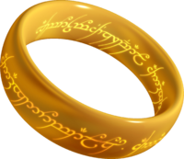
Our Universal Pattern Library Goal
If you're looking to build a fully customized website or application, our easy-to-use Pattern Library will allow you to build a unique look and feel without designing common elements from scratch. Developers across our university can borrow and contribute patterns, making it easier to forge functional, beautiful websites and applications with less effort.

Slide 7

Enter Pattern Lab!
An atomic framework that helps us build thoughtful, pattern-driven user interfaces using atomic design principles.
Produces final Pattern Library site
Creates navigation of components
Utilizes a built-in viewport resizer
Develops comprehensive documentation

Slide 8
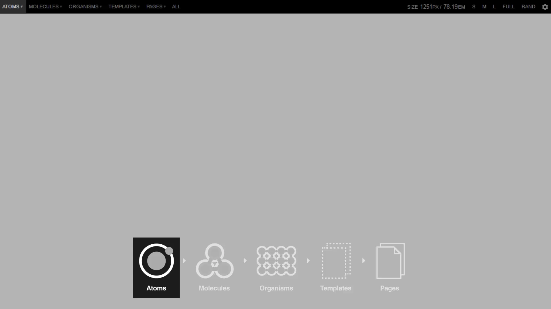
Atomic Design Principles

Slide 9

Atoms
Base Components
Smallest a component can be broken down
  Fonts, colors
  Inputs, buttons
  Paragraphs, section headers, lists

Slide 10
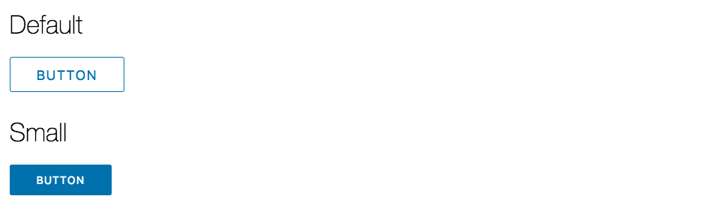
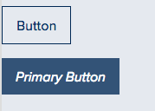
Atoms
Text Input
Buttons

Slide 11
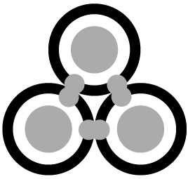
Molecules
Building Complexity
Two or more Atoms that come together to create a new component
  Search: Label, Input, Button
  Cards: Image, Heading, Paragraph, Link

Slide 12


Molecules
Search Box
Label
Input
Button
Label
Input
Button

Slide 13
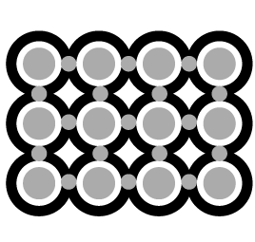
Organisms
Areas of Content & Functionality
Two or more Molecules and Atoms that build a piece of the interface
  Header
  Footer
  News Feed

Slide 14
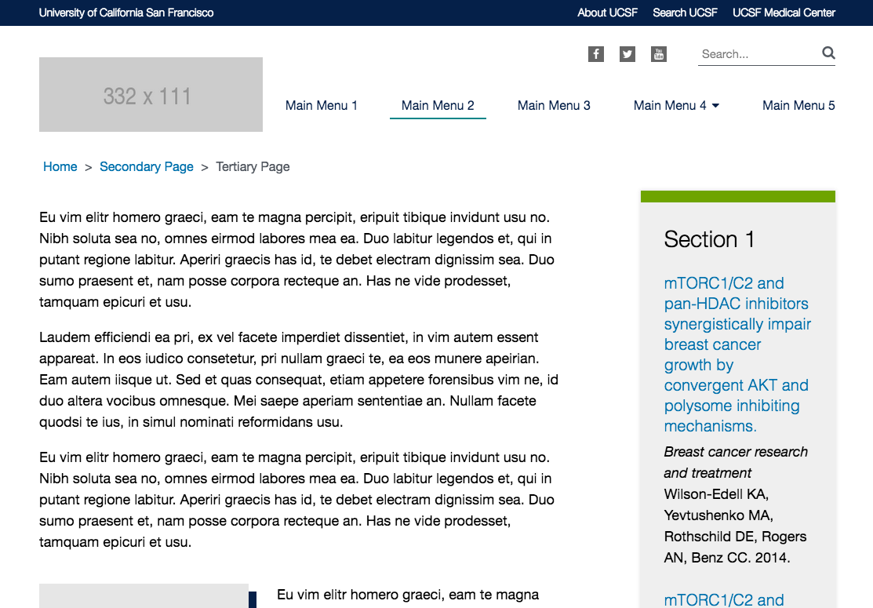
Organisms
Header
Site Top Menu Molecule
Social Media Links Molecule
Search Molecule
Logo Atom
Header Menu Molecule

Slide 15
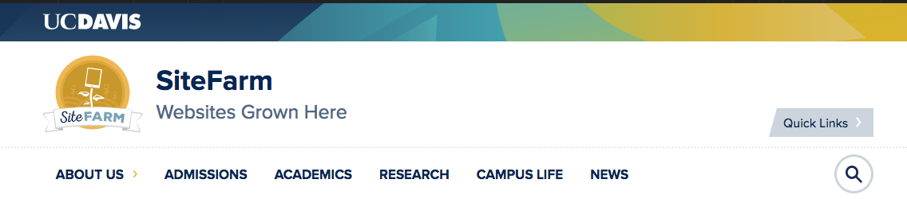
Organisms
Header
Site Logo Atom
Primary Nav Molecule
Search Popup Molecule

Slide 16

Templates
Page-Level Layout and Interactions
Using Organisms to build a wireframed template for a type of page
  Homepage
  Basic Page
  News & Event Listings

Slide 17
Templates
Basic Page
Header Organism
Content Organisms
Sidebar Organism

Slide 18
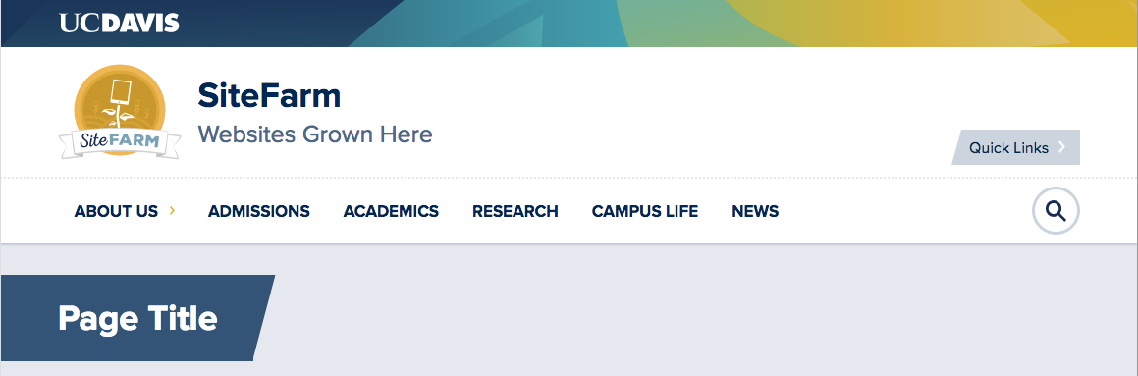
Templates
Basic Page
Header Organism
Content Organisms
Sidebar Organism
Trust us, it’s there.

Slide 19

Pages
Inserting Real Content
Final page layout and functionality using real content
  Homepage
  Basic page
  News & Events Listings

Slide 20
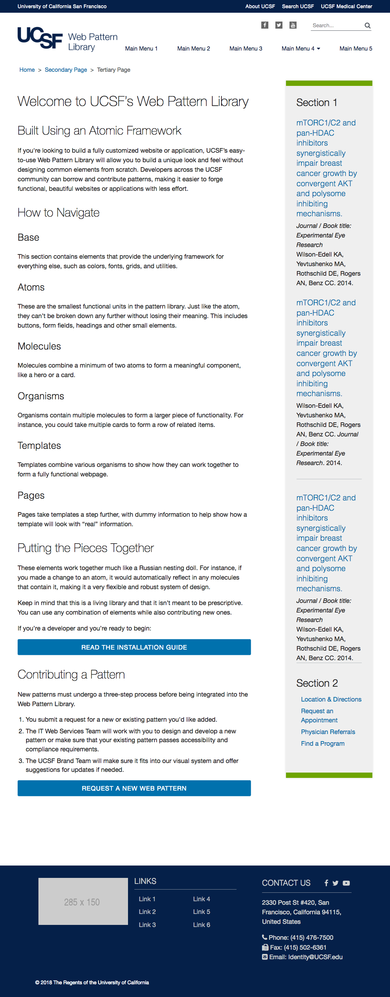
Pages
Introduction Page

Slide 21
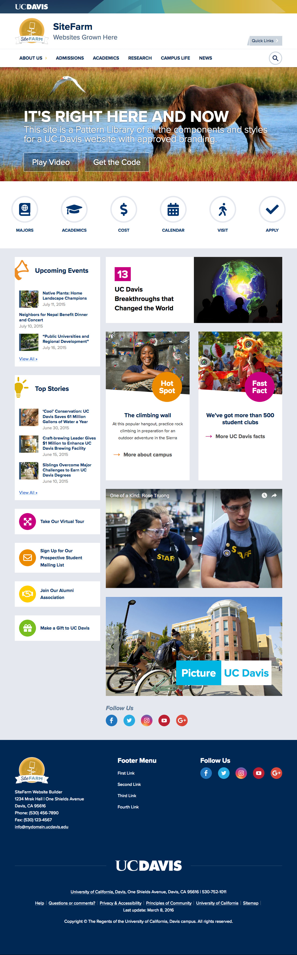
Pages
Homepage Page

Slide 22

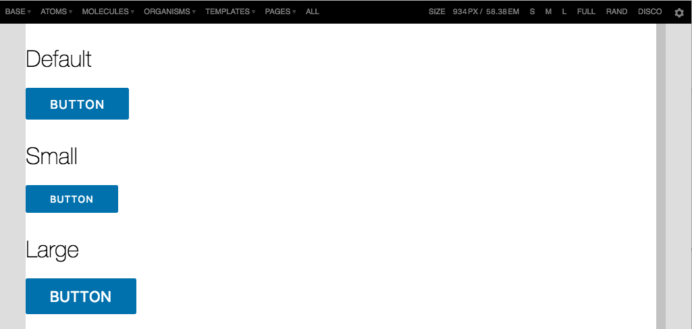
Documentation Tool
Accessing the Documentation
Gear Button

Slide 23
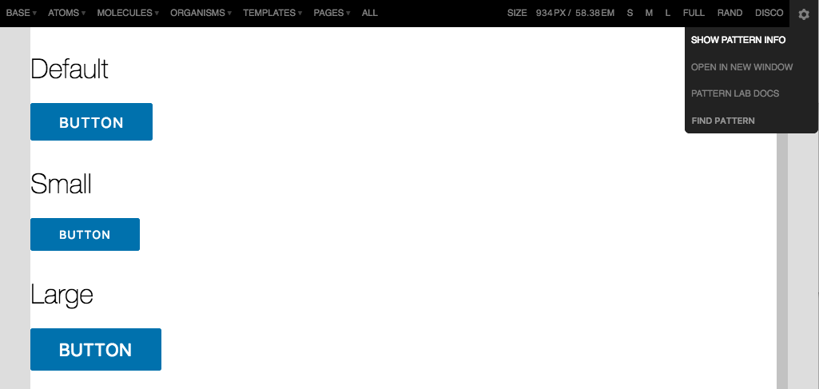
Documentation Tool
Accessing the Documentation
Show Pattern
Info

Slide 24
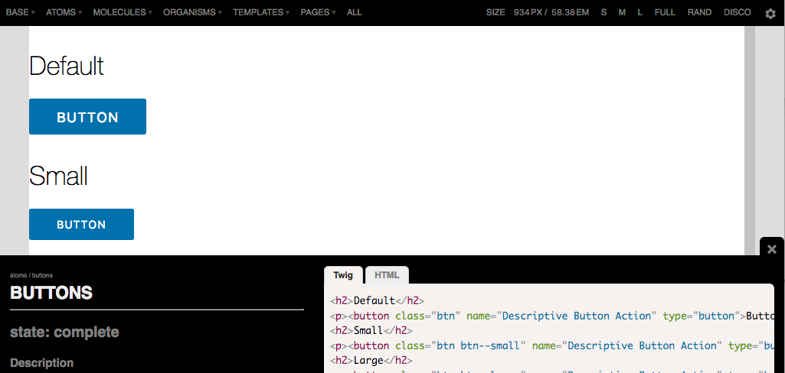
Documentation Tool
Accessing the Documentation
State, Description,
Usage, Code,
Dependencies

Slide 25

Flavors of Pattern Lab
Node Versions
Vanilla Edition
Gulp Edition
Grunt Edition
Webpack Edition
PHP Editions
Mustache Edition
Twig Edition
Drupal Edition
Thin Edition

Slide 26
Technology Requirements
Build requires PHP and Node.js
NPM to manage development assets
Bower to manage browser assets
Gulp/Grunt to run tasks and builds
Sass to write CSS

Slide 27
Incorporating Into My Project
Option 1: Place directly inside a website
Pros
  Everything in one place
  Access styles directly from main website
Cons
  Styles are not easily used outside the main website
Option 2: Keep it
separate and sync styles
Pros
  Everything can be reused across multiple websites
  Pure beautiful markup
Cons
  Integrating into websites is more complex

Slide 28
Syncing Into My External Website
Gulp task: newsite
  Copies necessary config out of a “starterkit” into an external website/CMS
  Copies initial styles over
Gulp task: themesync
  Sync styles into an external website/CMS
  Only copies sass/css, javascript, and images
  Markup is up to each external website to manage
* Thank you, Mark!

Slide 29
How Can This Help All of UC?
Sharing the Workload by Reusing Code!
Boilerplate Pattern Library
Build on development knowledge base
Reduce accessibility concerns
Increase scalability
Share new and better patterns
Hugs and PUPPIES!

Slide 30

Proposed Improvements
We’re Striving to Make Things Better!
Better code documentation
Mobile tables and tabbed data
Documentation on incorporating with Drupal CMS
New, and improved, patterns
More advance automations

Slide 31
Get the Code
UCSF Pattern Library
github.com/ucsf-web-services/ucsf_pattern_library
UCD Pattern Library
bitbucket.org/ietwebdev/sitefarm-pattern-lab-one

Slide 32
Using the Code
The Library is Open!
Online demo of patterns with code and documentation:
UCSF’s Pattern Library Website (webpatterns.ucsf.edu)
UCD’s Pattern Library Website (ucd-one-patternlab.s3-website-us-west-1.amazonaws.com)

Slide 33
Other Documentation & Support
Pattern Lab (patternlab.io)
UC Tech Slack, #pattern-library (uctech.slack.com)

Slide 34

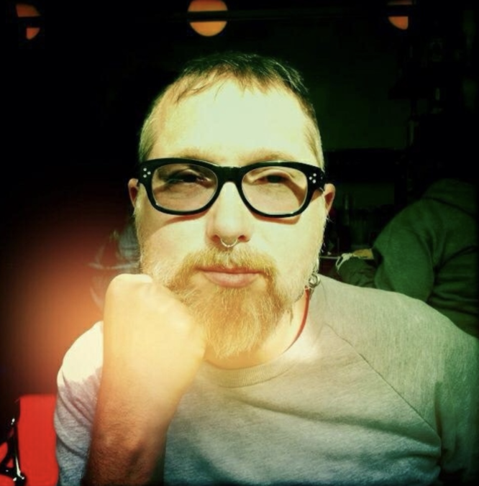

Q&A, Slack channel: #pattern-library
Jayson Jaynes
Web Developer
ITS Web Services
Contact: Jason.Jaynes@UCSF.edu
Slack: @jaysonjaynes-ucsf
Mark Miller
Web Developer
IET Professional Services
Contact: MrkMiller@UCDavis.edu
Slack: @markmill

Slide 35

Thank you!

