Slide 1

Making
Web Accessibility Work at Your Campus
Anna Gazdowicz and Lucy Greco
UC Berkeley
IST Web Platform Services
UCCSC 2018

Slide 2

Our Team:
Web Platform Services
at UC Berkeley
Notes:
Image: A team of sled dogs working together.
We are just as happy and productive as this jubilant team of sled dogs working together!

Slide 3
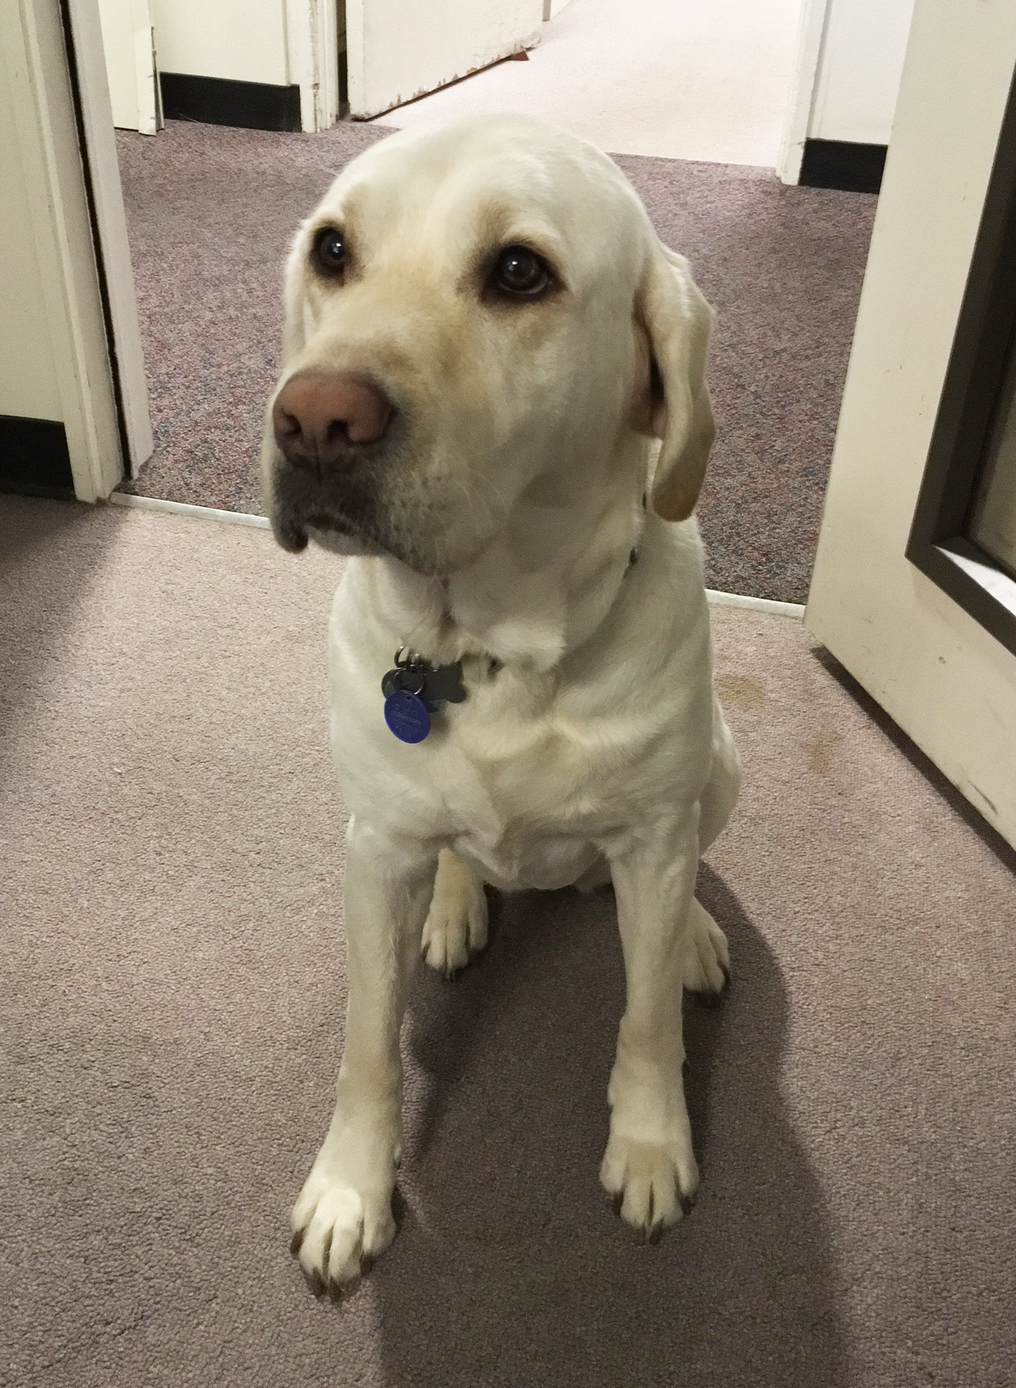
And Frances
Notes:
Image: Frances the guide dog in Lucy’s office.

Slide 4
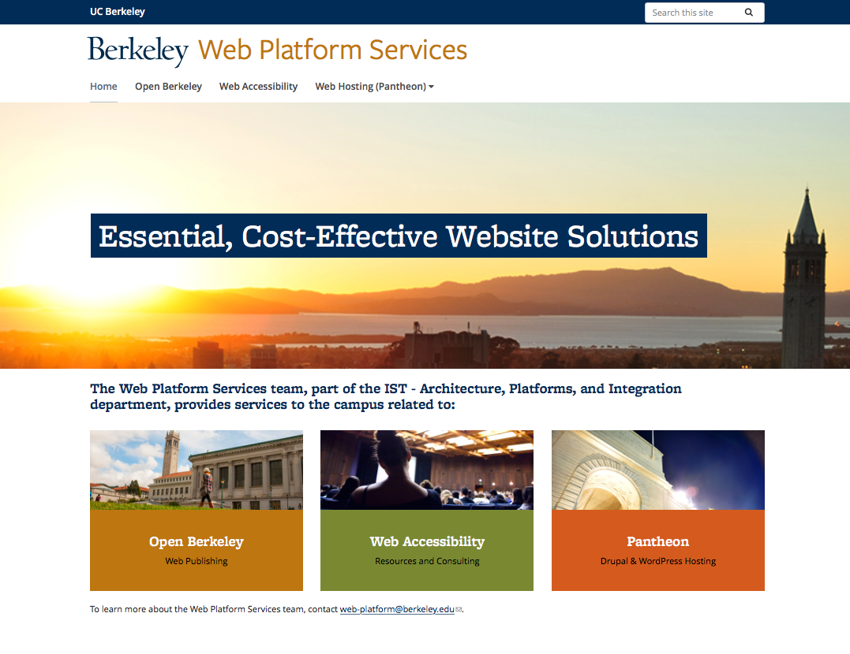
Notes:
Image: Screenshot of the Web Platform Services website home page.
UC Berkeley Web Platform Services: https://web.berkeley.edu
Essential, cost-effective solutions for your web presence at UC Berkeley, including:
Managed web publishing platform (Open Berkeley)
Coordination of web hosting services for Do-It-Yourself Drupal and Wordpress websites (Pantheon – the campus partner for DIY sites)
Web accessibility consulting and review services (the Web Access team)

Slide 5
Today’s Presentation (thanks for being here!)
Our IT community (probably) knows about the UC web accessibility policy. But what about everyone else at the UC?
About our team at Berkeley
What are other campuses doing in regards to promoting web accessibility? (let’s discuss!)
Notes:
If you’re here, you’re probably aware that the UC has an accessibility. But does everyone else know?
We’ll talk about our team at Berkeley and what we do, what we’ve done in the past, and what we want to do moving forward
And I’d love to also hear from others as to what they do at other UC campuses, so maybe we can all learn from one another

Slide 6
Where else can I learn about web accessibility at the UC?
UCOP Electronic Accessibility: https://www.ucop.edu/electronic-accessibility/
Other UCCSC presentations:
  2016: Jenn Dandle (UCSD), “Practical Web Accessibility”
  2017: Lucy Greco and Caroline Boyden, “How to Implement Accessible Purchasing at Your Campus”
  2017: Kristian McManus, “We Can Do It! Accessibility Testing”
  2018: Three different Siteimprove presentations

Slide 7

Why are we here?

Slide 8
Food for Thought
The UC population is huge! Students/staff/faculty/etc.! The list goes on.
How many people are we truly reaching with our efforts? How many people are being left out?
How can we all best promote web accessibility at our campuses, in order to:
  Uphold the UC policy; and
  Make our websites and web-based products better for everyone?
Notes:
Obviously, the entire UC population is quite large, and quite varied. Students/faculty/staff/etc.
Even with our current efforts, how many people are we truly reaching? How many people are potentially being left out?
So, in general, what can we all do to best promote web accessibility at our campuses, to ultimately uphold the policy, and make our websites better for everyone?

Slide 9

At UC Berkeley, it started with a passion for accessibility
Notes:
So, to provide some background, I’m going to hand the reins over the Lucy, with this slide, and then I’ll read the next slide. At UC Berkeley, it all started with a passion for accessibility, and Lucy was there from the get-go.

Slide 10
In the Beginning
Before there was a policy, there was a Berkeley working group
A community born from interest
100% volunteer effort
Weekly Web Access “clinics” (Fridays at 8:00am!)

Slide 11

So What
Happened Next?
Notes:
So what happened after all of these hard-working volunteer efforts? Inquisitive emoji with a monocle.

Slide 12
From “Volunteer” to “Official”
After the policy was implemented, everything changed
Our IT leadership recognized the need for a central team dedicated to helping campus departments adhere to the policy
The Web Access team (a part of Web Platform Services) became official
Notes:
After the policy became official, everything changed.
There was a period of time where there wasn’t any sort of organized effort at our campus, either volunteer or otherwise, in regards to web accessibility, and our IT leadership recognized a need for a central team
And Web Access became official. And this was the point at which I joined the team.

Slide 13
Web Access Team at UC Berkeley
Standardized Web Access clinics:
  Bi-weekly
  Anyone on campus can attend
  Post-clinic reports
Resources (https://webaccess.berkeley.edu/)
Consulting
Notes:
So what came with an “official” centralized team?
Standardized Web Access clinics
Resources
Consulting

Slide 14
About Web Access clinics
Free, common-good service
1.5 hour sessions with our team and the people who work on the website or application
We do screen reader testing and keyboard testing, and look at color contrast
We explain issues and provide recommendations for fixes
All issues, notes, and recommendations are captured in a report
We regularly receive very positive feedback, and have frequent repeat customers
Notes:
We held a clinic a couple of months ago for a third-party product that included a woman in an IT leadership role, and she was blown away by the fact that this was an available service and how much she learned. She kept saying how unusual it was for either a department or a third-party vendor to get this sort of in-depth user testing, for free.

Slide 15
What Do People Learn at a Web Access Clinic?
An introduction to web accessibility and why it’s important
Real-life user testing
Best practices from other developers
Where to go for more help and information
Notes:
So, on that note, what do people learn at a Web Access clinic? And this can vary, obviously, depending on how technical the clinic attendees are, and how much experience that they may or may not already have with the concept of web accessibility. We meet with some folks who are advanced web developers and are already quite familiar with many of the processes, and other folks are a little less technical, and maybe they just make simple updates to an existing website and are new to web accessibility altogether. And everybody learns something.

Slide 16
Procurement
Partnered with Supply Chain department to develop procurement documents:
  Language and checklists for RFPs
  Guidance for buyers
Our team reviews and advises on RFPs regularly
These documents were borrowed heavily from CSU, and were also adapted for use UC-wide (UCOP website)
Notes:
Another project that developed with the onset of our official service was a partnership with our Supply Chain department, the procurement side of things. So, Lucy and our coworker Caroline, as mentioned, did a whole presentation at last year’s UCCSC about this exact topic, so I’m not going to go into much detail, but here are the basics. Essentially, this is an attempt at a pragmatic approach to addressing the concept of web accessibility before third-party vendors and products can get “through the door” at the UC.

Slide 17
Key Partners
Many campus departments now include web accessibility in their processes, which has a wide impact:
  Office of Communications & Public Affairs
  Research, Teaching, and Learning
    Educational Technology Services
    Berkeley Resource Center for Online Education (BRCOE)
Notes:
We’ve also made some really key partnerships in the past few years, all of which have a solid impact on the rest of the campus. We could not do what we do without our valued partners.
The Office of Communications & Public Affairs is the unit responsible for the main UC Berkeley gateway site and other high-profile website projects, like the News site. They are also the stewards of the Berkeley Brand, the look and feel of both website and print materials. We meet with them regularly to test their websites and their templates, which can help ensure that the wide audience of folks visiting their websites can benefit, and other campus department are adapting accessible materials as a result.
Research, Teaching, and Learning, is a relatively new conglomerate of units and departments. ETS, within RTL, is a huge departmenti in and of itself, and is responsible for the technical services for faculty, students, etc. They obviously are responsible for a lot of websites and web-based products, including our campus LMS, so partnering with them to ensure that web accessibility is a part of their processes is essential.
And the Berkeley Resource Center for Online Education (BRCOE) is a part of RTL as well, and they caught the accessibility bug early on. They are responsible for lots and lots of online curriculum, so as you can imagine, web accessibility plays a very important part in the equation, and thankfully, they consider accessibility to be a top priority, and they come and work with us often and do their own accessibility trainings well.

Slide 18

Open Berkeley
Notes:
So, that’s what the Web Access team focuses on in particular. Another big part of our Web Platform Services team is the Open Berkeley platform, which is a website platform for the campus that we manage, and that keeps us quite busy. So, I’ll go more into detail now as to why this platform is important in regards to promoting web accessibility at our campus.

Slide 19
About Open Berkeley
Turnkey web platform solution for campus websites
Over 140 websites on the platform (both live and in-progress)
Accessibility is built into the platform
Accessibility best practices are covered in Site Builder trainings, as well as in how-to online documentation, and general support and operations
Notes:
Some additional information on Open Berkeley:
It’s a turnkey solution, meaning we provide the platform itself, and site owners are just responsible for their content and site structure, and we take care of security, accessibility, and maintenance
We’ve taken care of all the “heavy lifting” in regards to accessibility, meaning we’ve taken great care to make sure the code base and functionality are accessible
We cover accessibility best practices in training, documentation, etc. And it’s little things, like when we have Site Builders write to us and ask, “hey, can I have all of my website’s links open automatically in a new tab,” we write back and explain why we don’t allow that by default.

Slide 20
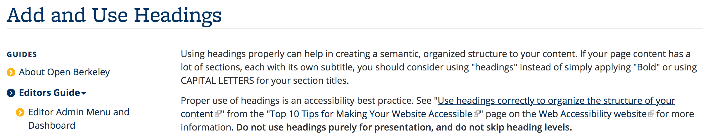
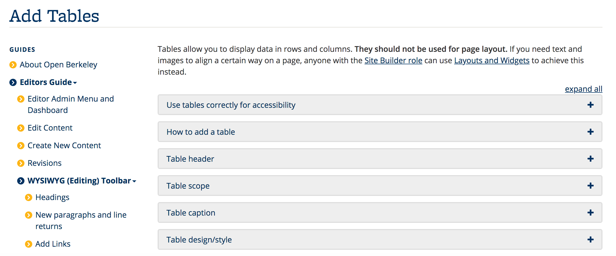
Accessibility Instructions are Embedded Within Open Berkeley Documentation
Notes:
Rather than collect accessibility best practices in regards to creating content, which is easy to forget or gloss over, we’ve included these best practices and guidelines within the actual context of how to use the website functionality. So, when someone is consulting our pages on either how to Add a Heading or how to Add a Table to their websites, they’re presented with the information on how to add these elements in an accessible way within the same context.

Slide 21
Feature Development and Maintenance
The platform is tested regularly for accessibility
Automated testing checks for keyboard accessibility
  In other words, Behat saves our bacon
Notes:
We test the entire platform regularly, and any new feature or functionality in the platform is vetted for accessibility before deploying.
In regards to automated testing: Continuous integration testing can help prevent regressions. As a bonus, it also performs low-rent accessibility testing! Our tests step through real site functions, such as editing a page, using real browsers with Javascript enabled. Our test setup doesn’t emulate any mouse behaviors, so if it can’t be operated with the keyboard, it can’t be tested. Keyboard accessibility is a good proxy for accessibility overall, because many assistive technologies rely on keyboard emulation.

Slide 22

We Now Have Siteimprove!
Notes:
So, moving on - we also now have Siteimprove, which is opening up all sorts of new opportunities!

Slide 23
Siteimprove at the UC
Available to the UC system, thanks to the Electronic Accessibility Committee (EAC)
Provides robust reporting of accessibility issues, as well as other QA reports
Should not replace real user testing!
Notes:
So, as mentioned, there were additional presentations on how to use Siteimprove at this conference. And there’s lots of how-to documentation on how to use the tool, and overall, I would say that the UC having access to this tool is really going to help in regards to encouraging more web accessibility across the board.
But, we want to note that just because your site scores high on Siteimprove does not mean that it’s fully accessible, it just means that it passes at an automated level.
So, for instance, Siteimprove actually can’t test for basic keyboard accessibility. So, maybe the site will check a lot of the boxes in terms of what Siteimprove can check for, but someone who, say, has limited mobility in their hands and can’t use a keyboard, may still not be able to navigate your website.
So, we still encourage real user testing - testing your site with just a keyboard, and actually testing with a screen reader user or something along those lines.

Slide 24

Current Challenges

Slide 25
This May all Sound Great, But . . .
There are still some challenges:
Attendance at open Web Access clinics
The same issues found in clinics, over and over again
Procurement system isn’t foolproof
Content creators on Open Berkeley websites sometimes make ... interesting choices
Departments may choose the “DIY” website approach
Limited resources
Notes:
I just outlined all these great things, right? Well, it’s far from perfect, and here are the challenges that we’re running into.
We have these great “open” clinics, but it’s quite rare for any folks aside from the people directly involved with the website actually attend the clinic, so our clinic model might not be having this beautiful, wide impact that we originally envisioned.
We encounter the same issues in clinics, over and over again. It’s a bit like a broken record. Abuse of ARIA, like using ARIA instead of the native HTML element that does the exact same thing, misuse of headings, ignoring basic keyboard functionality, etc. So it starts to feel like we’re reciting from a script after awhile. Which is not necessarily a bad thing, but we do wonder if there’s a better way to do this.
The procurement system is far from perfect. Plenty of vendors fill out the questionnaire and just say “yes” to everything, when they actually don’t really know what anything means. Or, the department purchasing the product pushes back on the questionnaire and says that it’s not applicable to them when it actually is (one department tried to claim that their product was an “application that ran through a browser,” and therefore the requirements didn’t apply to them; so, just think about that one for a second).
While the Open Berkeley platform itself is accessible, the website builders, the ones who are the actual content creators, despite all of our training and documentation, still sometimes do things like misuse headings, use “click here” (non-distinctive) links, put the entire content of a page in an image and don’t use any alt text . . . that sort of thing. We do what we can to point these out to Builders when we encounter them.
The Open Berkeley platform uses the Berkeley Brand for the look and feel, and some departments want to use their own branding, for example. We can’t force them to use the platform, but if they don’t, they might end up building a website that doesn’t incorporate web accessibility during the development process.
And, I’m sure this sounds familiar - we still have limited resources and time at the end of the day, we’re a small team, and the list of tasks continues to grow, so juggling all these priorities continues to be a challenge.

Slide 26
What Do We Want to do Next?
DIY Accessibility Checklists
Expand website resources
Re-think Web Access clinic model
Continue to increase usage of Siteimprove, and participation in trainings offered through the platform
Notes:
The DIY Accessibility Checklists (I’ll cover this in more detail in subsequent slides): We hope that these checklists with help with the issue of us seeing the exact same problems over and over again. The idea with the checklists is that we will ask departments to consult the checklist and address all of the applicable items (for example, use the native HTML elements when possible, do keyboard testing, etc.), and then come and see us for a clinic.
Regarding the clinic model: We might think about, you know, how to get the word out more about the benefits of attending more clinics, or maybe we need to look at a different day and time, that sort of thing.

Slide 27
DIY Accessibility Checklists
Master spreadsheet (Google Sheets) that anyone will be free to copy, adapt, etc.
5 checklists:
  WCAG Review
  Developer Code Review
  Keyboard Testing
  Automated Code Inspection
  Test with Real People

Slide 28
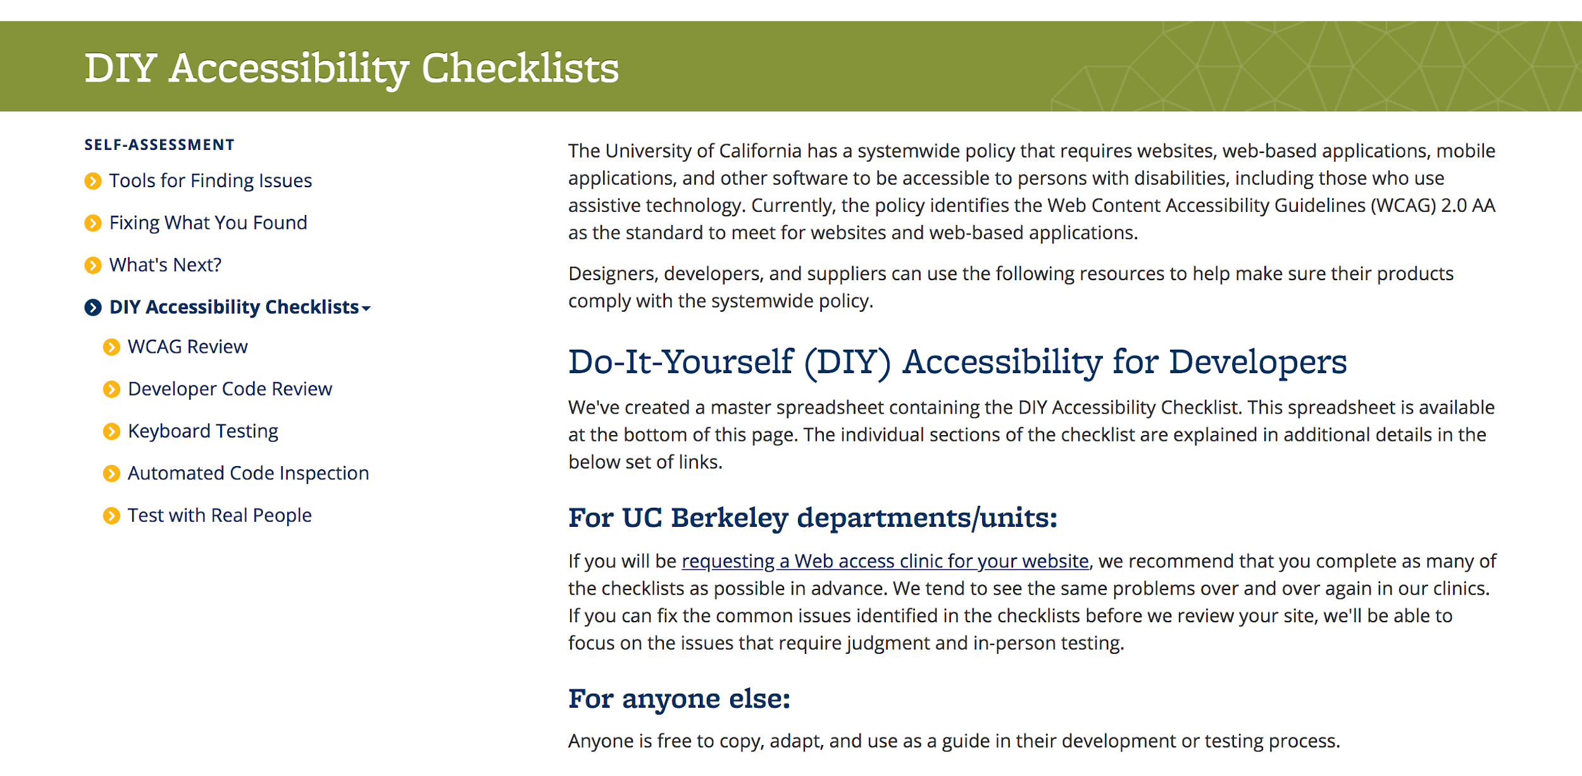
DIY Accessibility Checklists Landing Page (screenshot)
Notes:
This isn’t the whole page, just a piece of it. It provides some up-front information and then points folks to the individual checklists within the spreadsheet, and then more information about each checklist.

Slide 29
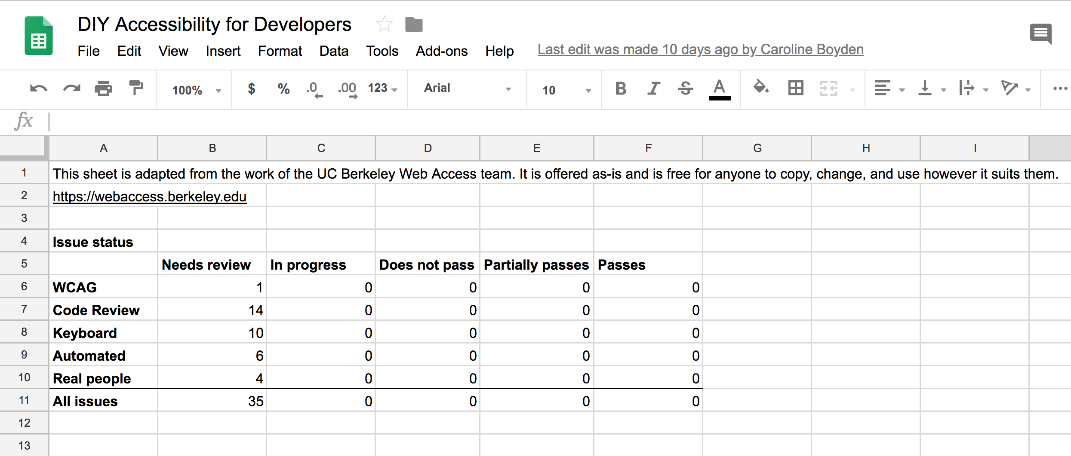
DIY Checklist Spreadsheet: Overview (screenshot)
Notes:
This is of the “Overview” page, which will populate accordingly as the developer goes through and uses each of the individual checklists. So, the “in progress” column will populate as the developer marks an item as “in progress,” same with “does not pass,” etc.

Slide 30
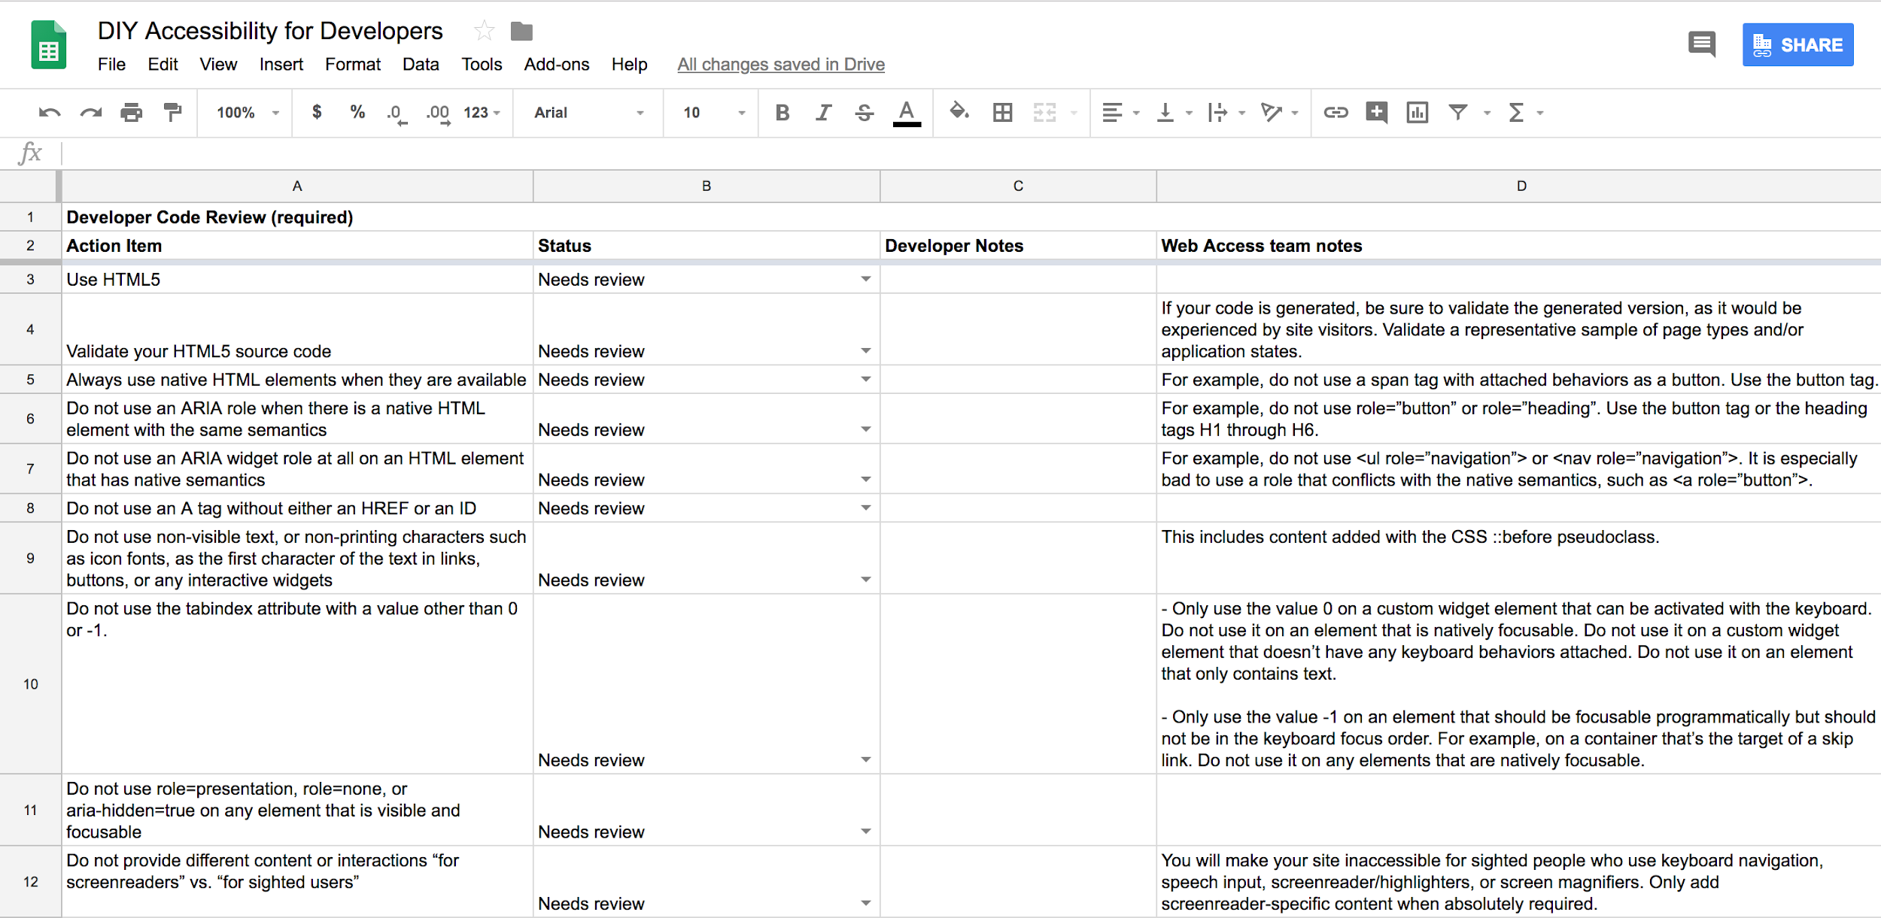
DIY Checklist Spreadsheet: Developer Code Review (screenshot)
Notes:
And then this is a screenshot of the “Developer Code Review,” one of the checklists. As you can see, there are the “action items,” then the “status column” (the status column items are collected back in that “Overview” page that I showed just before this), then a column to add your own developer notes, and then our own notes and tips from our team.
So, the overall status of these checklists is that we’re planning on getting some additional feedback first, because this was just our own first pass at what we think is important, but we would like to make sure that we haven’t missed anything that should be included.
But when these are ready, we can certainly post them in the UC Tech Slack accessibility channel

Slide 31

So, in summary ...

Slide 32
Conclusion
There is a web accessibility policy at the UC, and we’re all working hard to uphold it
There are myriad efforts at each campus to support and promote accessible websites and web-based products
But are we reaching as far as we can go? What else can we do?
Notes:
The conclusion I want to leave you all with is that, you know, we all know there’s a policy, we’re all working to uphold it, or we all want to, and there are probably lots of efforts to do so across our campuses. But, are we reaching as far as we can go? What else can we do? Which leads to essentially, our call to action, which is:

Slide 33
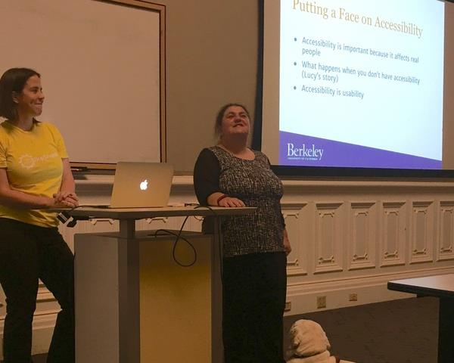
Be Impactful
Notes:
This is a photo of Lucy and I back in 2015. We were scheduled to present about how to implement an accessibility at an institution at Educause, and this photo was from our dry run at a Bay Area accessibility Meetup group event. I like this photo a lot, for a number of reasons:
Lucy is the main speaker, the main focus
When we’ve presented at conferences together where we talk about web accessibility on a higher level, I’m there to help out on a few points, but Lucy’s story and experience is at the forefront
Frances is with her
The slide in the shot is all about why accessibility is important, because it affects real people, and Lucy is telling her own personal story
More than likely, the next slide in the presentation is Lucy moving on to do her screen reader demo
Which leads into arguably the most important slide . . .

Slide 34
The Importance of Working with People with Disabilities
Web accessibility may remain abstract without real-life examples
Automated testing (such as Siteimprove) does not catch everything
Websites and products are incomplete without real user testing, and that includes users with disabilities
Make it happen!
Notes:
I don’t personally identify as someone with a disability, and that’s my choice to disclose that information, and I would argue that I probably don’t necessarily look or sound like someone with a disability. I obviously think it’s important to advocate for people with disabilities, and to help as much as I can.
If I’m going to go to present to a campus department or group and try to impart to them why web accessibility is important, people might listen, they might nod along and think, “wow, that’s interesting,” but, at the end of the day, are they truly going to remember what was discussed after the fact? Is this information going to stick with them when they go back to their desk and resume with juggling all of their competing priorities? Probably not . . .
But when Lucy presents to that same department or group, with or without me, it is significantly more impactful. Her screen reader demo, her explanation of her own experiences, this sticks with people, it truly has an impact. When I came in to interview with Lucy and the rest of our team for the job I have now, I went into that interview remembering when I attended one of Lucy’s screen reader demos from years earlier.
That’s what I mean by “be impactful,” and is what I mean by emphasizing the importance of working with people with disabilities. So, make it happen.

Slide 35

Discussion and Questions

