Slide 1
Multifactor Authentication (MFA)
At UCOP and Beyond!

Slide 2
Presenters
David Rusting
  UC system-wide CISO
Eric Goodman
  Identity and Access Management Lead
  Enterprise Architecture Team

Slide 3
MFA at UCOP (and Beyond!)
The value of MFA
MFA deployment planning
  Scoping, constraints and general considerations
MFA deployment at UCOP
  Overview
  Challenges, issues and lessons learned
  Comparison of campus MFA programs
MFA across UC
  MFA and system-wide applications
  How system-wide application requirements (may) differ

Slide 4
The Value of MFA
Half of UC breaches are via credential compromise
  MFA reduces that risk substantially
  Has become “table stakes” for security
First factor is usually “Something you know”
Passwords, Security Questions
  Can be intercepted, guessed, phished.
  Once stolen, can be used and reused to do bad stuff.
Strengthen with a second factor
  “Something you have”
    A phone, a phone number, a key, etc.
  “Something you are”
    Biometrics

Slide 5
Multifactor Authentication
General Deployment Considerations

Slide 6
Foundational Choices
Who will use MFA?
  Opt-in vs. Required
  If required, what the criteria? How will you track/audit?
  Pilots are frequently run as Opt-In
  UC trend: Required for employees, optional for others
Which applications will challenge for MFA?
  Commonly: Web SSO systems, VPNs
Product and supported factors
  Duo is very common at UC and in higher ed in general
  App Push, App OTP, SMS text are very common
  Voice, OTP token and U2F tokens are moderately common
  Other forms (device or personal certificate) less common

Slide 7
Factor-specific concerns
Factor | Pros | Cons
Password | Easy to use | Easy to steal Can be easy to guess
Voice call | Easy to use Ubiquitous | May be shared (landlines) VOIP not really something you have Users can defeat in novel ways Per authentication fees ($0.04)
OTP via SMS | Easy to use Common | Iffy security (SS7, # reassignment) Per authentication fees ($0.02)
OTP via Software | Easy-ish to use | Requires app install (cellphone) Sync issues (sequence)
OTP via Token | Doesn’t require personal device | Requires extra keychain item Sync issues (time or sequence)
Duo Push | Challenge itself is MITM-proof | Requires app install (cellphone) Real-time MITM phish still a threat
U2F/FIDO Token | Strongest security | Can be complicated to use Cannot use for all applications
Bypass Codes | Great for Service Desks | Can morph into another "just another password"

Slide 8
MFA deployment decisions
Where and how often are challenges presented?
  Often more “coordination and explanation” than “decision”
    “Remember Me” can reduce challenges for web-based logins
  Non-web apps often manage their login sessions uniquely
  Can still be effectively unpredictable for most users
How will onboarding be managed?
  Self-service: User driven
  In-line: Forced at login
  Ramp-up: Separate registration and challenge processes

Slide 9
MFA security considerations
"Trusted Networks"
  Do I need MFA if I'm onsite (or virtually onsite via VPN)?
    Threats: Open networks, lateral attacks, password sharing
  Implementation approach varies
Non-"second factor" factors
  Backup codes (esp. long lived and/or reusable)
    Limited use/short term are common for service desks
  “Bypass mode”
    Most locations avoid use
  VOIP phones, Google Voice, etc.
Fail Open vs. Fail Closed
  What do to if the MFA service itself is non-responsive?

Slide 10
Multifactor Authentication
Deployment at UCOP

Slide 11
MFA at UCOP: Overview
UCOP user population
  2000 employees and contractors with UCOP accounts
    All local users are “employee-like”
  Over 1000 non-UCOP UC employees with UCOP accounts
MFA Product
  Selected Duo as the vendor
  Allowed factors evolved over the course of deployment
Deployed in two phases
  Pilot deployment
  Full population deployment

Slide 12
MFA at UCOP: Pilot
2016 Pilot project targeted specific apps and users
Applications integrated
  Citrix/"Cloud Desktop"
  Outlook Web App (web mail)
Users
  ITS only
  Largely deployed as “self service” (train yourself)
  Users self-registered (opt-in style)
  Some experimentation with factors
Technically complex integration
  Involved multiple authentication technologies
Fairly low user impact
  Many users never saw MFA challenge

Slide 13
MFA at UCOP: Full deployment
2017/2018 Full rollout of MFA
Integrated MFA into SSO
  Effectively added MFA to dozens of applications
Users
  MFA requirement for all UCOP users
  Extensive training materials and training classes offered
  Users “phased in” per department (forced enrollment) over 3-months
Changes from Pilot
  Formalized MFA factor options
    Added Token support, removed voice and SMS options
  Formalized onboarding process
    Token distribution management
    Onboarding and offboarding workflow coordination with HR and Service Desk
  Extended SSO session length
  Enabled “Remember Me” for 12 hours

Slide 14
Rollout Issues and Concerns
Behavioral
  Employee resistance to using (or lack of) personal smart phone
  MFA seen as "extra complexity", "getting in the way"
  Users sharing passwords
  User engagement in pre-rollout communications
Functional/Process
  Delivery of (organization owned) phones and tokens
    And token management generally
  Onboarding of non-“UCOP employee” users
  Maintaining/auditing user MFA status
Technical
  VOIP phones
  Application MFA integration/interface capabilities
  Managing (and explaining) frequency of challenges to user

Slide 15
Campus MFA Rollouts at a Glance (AFAIK)
Location | Who? | What? | When? (SSO) | Notes
LBNL | Key Emps+Opt In | A,T | All Apps | Non-Duo shop
UCB | All Emps+Opt In | A,S,V,T | All Apps | 30-day "remember me"
UCD | Key Emps | A,S,V,T | Key Apps
UCI | Key Emps+Opt In | A,T | Key Apps
UCLA | All Emps+Stu | A,S,V,T | All Apps
UCM | Key Emps* | A,S | Key Apps*
UCOP | All Accounts | A,T | All Apps
UCR | Opt In | A,S,T | Key Apps
UCSB | Key Emps | A,S,V | None | Specific non-SSO apps
UCSC | Key Emps | A,S,V, (T) | None | Specific non-SSO apps
UCSD | Key Emps |  | Pilot
UCSF | All Users | A, (S, V), T | Key Apps
A=Smartphone (A)pp Push and/or OTP
S=(S)MS Texted OTP
V=(V)oice call confirmation
T=Physical (T)oken OTP
Some Health Center deployments differ from campus configuration

Slide 16
Multifactor Authentication
As a System wide Service

Slide 17
Typical Site-level MFA integration
Login happens at SSO server
  App redirects user to SSO service
  SSO service "knows" who needs MFA
  SSO service challenges for MFA if required
    Potentially a per user/per app configuration
Applications trust that “correct” MFA rule was applied
  Hey, if the user got here…

Slide 18
“Silent” MFA and system wide apps
What if an application specifically requires MFA?
  App must coordinate user roles with location MFA rules
  Can be especially complicated for system wide apps
If that’s not tenable, app can’t rely on location’s MFA
  App needs its own MFA solution (cost, complexity)
  User must sign up for app-specific MFA service (complexity)
  User may get two MFA challenges per login (annoyance)
    One from the location SSO service, one from the application

Slide 19
Signaling MFA
Higher-ed has defined a fed authN “profile” for MFA
  Can be requested when a SAML login is initiated
  Can be verified as part of the SAML login response
  Likely to be extended to higher-ed OAuth/OIDC profiles
Provides visibility into when MFA is done
  Better auditing, esp across organizations
  More flexibility for apps
Requires support by both app and SSO service
  Open discussion about adopting within UCTrust

Slide 20
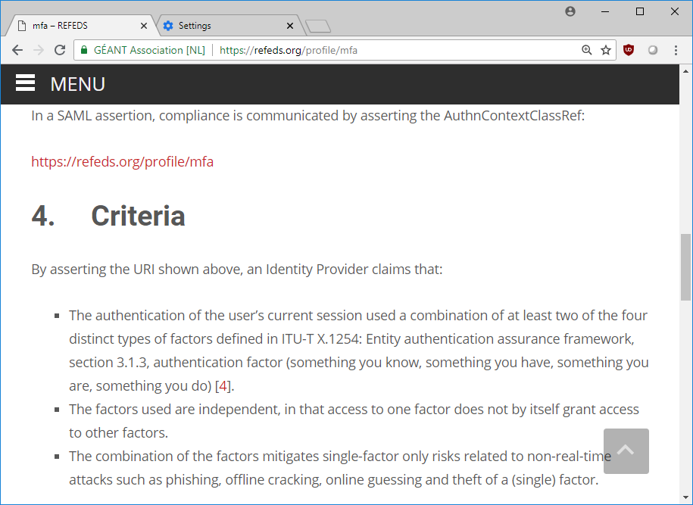
MFA Specification (Criteria)

