Slide 1

Leading in a Sea of Change
UCCSC, UC DAVIS
August 14, 2018

Slide 2

Kent Carpenter
IT Service Management (SMO)
Project Management Office
Service Desk Operations
Telephony/Software
Business Services
ServiceNow

Slide 3

Factors Affecting UC Merced
Budget Constraints
0% WFP
1.3M GSF of New Construction
New Sourcing Models – Leasing
Webcam

Slide 4
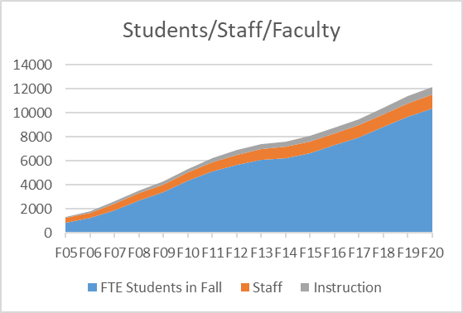
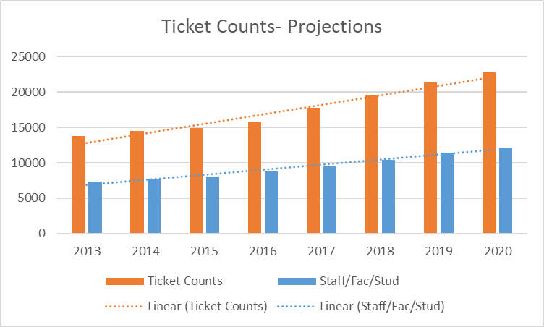
Growth

Slide 5

A Different Model
Campus WFP
Campus Shared Service
Small IT Footprint
Consolidated IT Services

Slide 6
Factors Affecting UC Merced
Budget Constraints
72 OIT Staff – 0% WFP
10% Increase YoY
New Sourcing Models – leasing
OIT Staff Increases are Organic

Slide 7
OIT - 4 Strategic Outcomes - What’s Different
Build Operational Capacity
Fix IT
Establish Value Creation and Communication
Sustainability and Scalability

Slide 8

Large Picture
1. Build Operational Capacity
Campus WFP
Campus Shared Service
Small IT Footprint
Consolidated IT Services

Slide 9
Large Picture
2. Fix IT
IT Service Management Processes (CRM)
Education the Campus
Improved OIT Reputation

Slide 10
Large Picture
3. Sustainability and Scalability
Resource stewardship
ServiceNow
Technology fee
Avoid duplication of systems
Campus wide solutions - Projects (Efficiencies) NGN/VOIP/DBS/Printing

Slide 11
Large Picture
4. Establish Value Creation and Communication
Educating Our Customers
Work Force Planning
Flexibility – Many Hats

Slide 12
Focus
Maturity (Agile)
Cloud First
  SaaS Solutions
  Off the Shelf
Culture of Collaboration
Project Execution

Slide 13
Focus
Know what is Important
ITSM – CRM Strategies
Service Ownership/Staff Empowerment
Goal Alignment

Slide 14





Thank You
Matthew Faulkner
Kent Carpenter
209 355 8715
mfaulkner@ucmerced.edu
It.ucmerced.edu
209 285 9617
kcarpenter4@ucmerced.edu
It.ucmerced.edu

