Slide 1
Break Things Better:
ERP to the Extreme
University of California San Diego

Slide 2

When Our Current Systems Came Online
People Dressed Like This…

Slide 3

Cellphones Looked Like This…

Slide 4
The University Looked Like This…
Half as many undergrads
(14k vs 28k)
20% of revenue
($1B vs $5B)
Smaller footprint

Slide 5
To Keep the University Running…

Slide 6

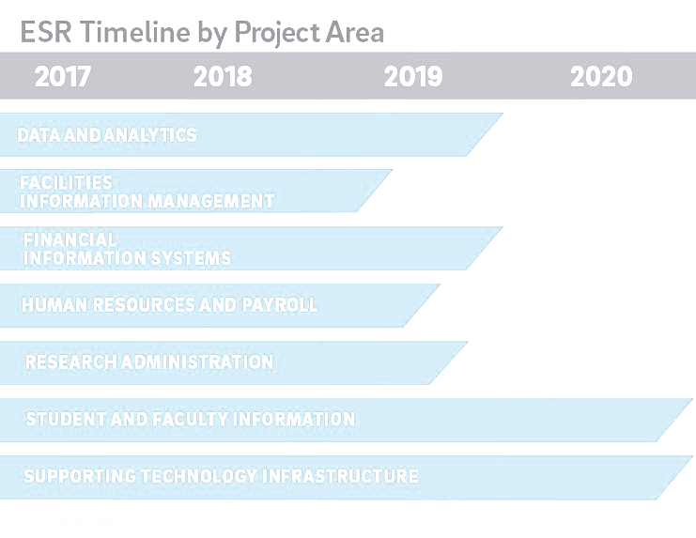

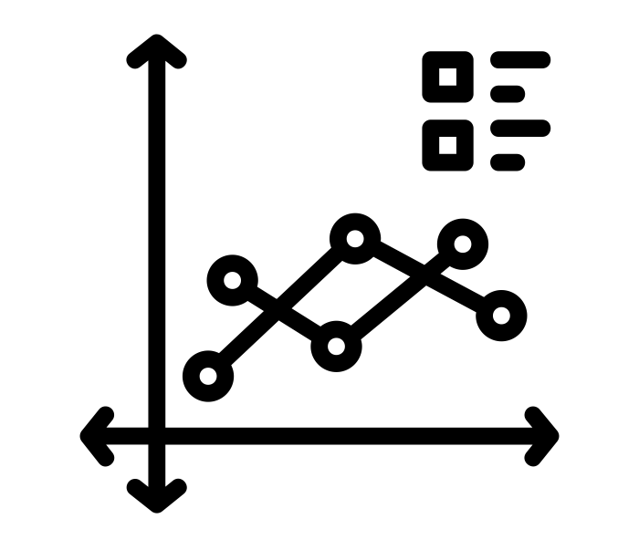









Enterprise Systems Renewal
Reshaping the Way
UC San Diego Does Business
Space Management
Financial
Document Management
Admissions
Identity Management
HR / Payroll
Faculty Review
Data & Analytics
Research Admin
Student Info
Degree Progress

Slide 7
How We’re Taking This On:
Expert Sourcing from World-Class Staff

Slide 8
Vendor “Bake Offs”
How We’re Taking This On:

Slide 9

How We’re Taking This On:
Architecture & Infrastructure Connections

Slide 10

How We’re Taking This On:
Lean Six Sigma Go Team
Business Process Improvement

Slide 11
How We’re Taking This On:
A Fresh Take on Organizational Change Management

Slide 12
Expert Sourcing

Slide 13
Why Not Just Hire Consultants?
Have to learn
our business
The Expense
Cookie
Cutter
Approach
Insufficient
Knowledge Sharing

Slide 14

Solution: Expert Sourcing with “Backfill”
FTE:
25% ESR
75% Staff
FTE:
100% Non-ESR
FTE:
75% ESR
25% Staff
100% Contract –backfill for FTEs

Slide 15
Benefits of Expert Sourcing
Learns and applies new skills
Job growth from new skills and experience
System knowledge stays on campus
Foot in the door, known entity for FTE hire

Slide 16
Some Expert Sourcing By the Numbers
200+ campus conference room pilot participants
600 staff briefed over 25 meetings
Financial
120 pilot participants from 60+ departments
14 SMEs
Faculty Review
14 members on RFP committee
25-30 vendor demo participants
45 SMEs for biz process review and improvement
21 change champions
Research Admin

Slide 17
Vendor Selection: “Bake Offs”

Slide 18
The RFP Process and Conference Room Pilot
Business Process Analysis
Jan-17 –
Jul-17
Friction Analysis
Jul-17 –
Aug-17
RFP
Sep-17 –
Nov-17
Scoring, Review & Approval
Aug-18
CRP
May-18 –
Jul-18
FIS Selection
Sep-18
GO!
Contract Negotiations
Jan-18 –
May-18
RFP
108 Function questions
29 Architecture Questions
9 Strategy Questions
RFP Scoring – multiple choice:
Not Supported
Customization – new functionality developed using SDK
Major Configuration – system configuration, standard tools, > 100 hours
Minor Configuration – system configuration, standard tools, < 100 hours
Out of the box – no configuration beyond basic setup
CRP
8 detailed scenarios: Procure to Pay (P2P), Budget,
Cash Management, Post Award, Med Center,
General Ledger (Campus & Central), and AR.
Each Scenario described a story, covering roughly
20 functions/process.
Does not exist
Does not meet, serious concerns
Partially meets, business process can be completed with workarounds
Meets all aspects
Clearly meets all aspects, very intuitive
Exceeds requirements
Notes:
Example RFP Functional Question: Does your solution support the ability to create reports that consolidate vendor/payee payments across multiple systems or multiple payment methods, create an aging report of unclaimed/stale-dated checks and unpaid invoices, retrieve payment information with status, and create exception reporting for duplicate payments/ invoices?
Example RFP Architecture Question: Does your solution support legacy canonical documents and messages (XML, EDI, industry standards and WSDL) and adapters for applications, databases, A2A and B2B protocols, cloud-to-on-premises application integration APIs, etc.

Slide 19
Architecture & Infrastructure

Slide 20
Enterprise Architecture
Cloud First Strategy
Infrastructure as a Service (IaaS) — Gives users automated and scalable environments with extreme flexibility
and control, without the need to manage local infrastructure
Platform as a Service(PaaS) — Provides a framework for quickly developing and deploying applications
by automating infrastructure provisioning and management
Software as a Service(SaaS) — Uniform, scalable applications, eliminating need to install and run
on-premise programs; focus is on configuration over application development
Modular Architecture
The monolithic approach to provisioning enterprise services is largely over
The proliferation of best of breed software stacks (on-premise, SaaS, mobile, etc.) requires a new integration model
API-Centric Design
Services expose a public API as their core channel for control, functionality, and sharing of information
The API is the integration layer; "application development" becomes the orchestration of services exposed via their APIs
APIs are created with cloud computing in mind; producers and consumers are machines and programs anywhere on the Internet

Slide 21
iPaaS – integration Platform-as-a-Service
Cloud integration platform – combines application and data integration
Enables development, execution and governance of integration workflows among on-premise and cloud-based applications as well as traditional and newer data protocols.
Uniform methods via API templates, integration connectors and platforms for:
IICS – Informatica cloud:
UCPath to Financial ERP
  Requirements & selection
  Gap analysis
  Incubation projects
Kafka – Streaming interface UCPath
and Financial data to campus
  Incubation projects (i.e. UCPath IAM interface)
API development & Manager –
data to campus
  Development
  Open API / Swagger
  WSO2 API Manager
  Incubation projects
AWS readiness for applications and API’s
  Setup Bamboo and Artifactory to build/store
  and deploy docker image
  Support for Java/.Net
  Support SSO

Slide 22
Activity Hubs
HANA – in memory database
The Student Activity Hub (SAH) combines information about all graduate and undergraduate students into a single repository. Academic analysts, advisors, and faculty can access the curated data through supported reporting and visualization tools: Tableau and Cognos.
Other Activity Hubs in design & development
  Academic
  Research
  Advancement & Alumni
  Employee (UCPath)
  Financial
  Facilities
  https://ucsdcloud-my.sharepoint.com/:p:/r/personal/maamini_ucsd_edu/_layouts/15/Doc.aspx?sourcedoc=%7B175BAA44-7DE9-4130-9816-7E009118D2F3%7D&file=ESR-CampusLISA-20180627.pptx&action=edit&mobileredirect=true

Slide 23
Improving Business Processes

Slide 24

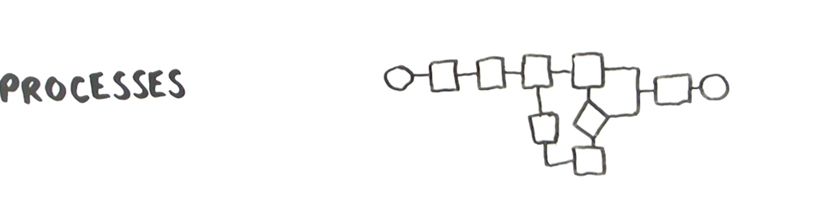
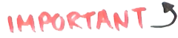
Lean Bench

Slide 25
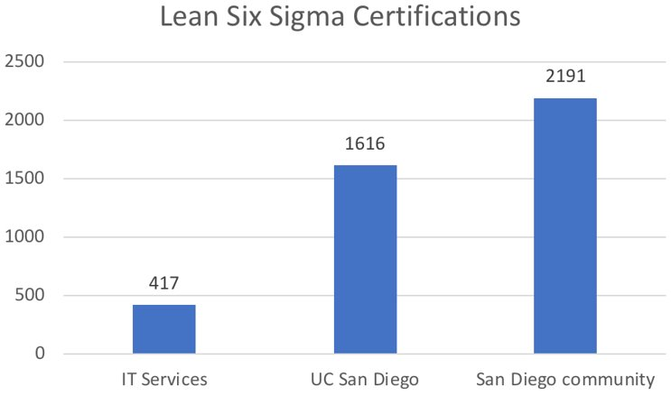
Lean Bench
Inclusive of Yellow, Green, Black Belts

Slide 26

Lean Bench
A select set of campus expert practitioners of Lean Six Sigma methodology who engage and lead crucial efforts around process improvement, operational excellence, and business efficiency.
Learn more: leanbench.ucsd.edu

Slide 27
Communication & Community

Slide 28
Communications & Community
Branded as a campus-wide effort,
Specifically not driven by IT
A real focus on people

Slide 29
ESR Signals a Lot of Change for a Lot of People
ESR:
Enormous Change!
Execs
Developers
End Users
Managers

Slide 30

“Everything Through People”
Powers Organizational Change Management
New systems are only as strong as the people using them
Timelines account for processing and reactions
Employees empowered
to talk to management
Communication defined
as two-way; goal is information sharing

Slide 31

Prosci ADKAR: Building Blocks of Change
Awareness (I understand why…)
Desire (I have decided to…)
Knowledge (I know how to…)
Ability (I am able to…)
Reinforcement (I will continue to…)

Slide 32
Change Teams Support Each Project
Change Leads set the tone. They establish a vision
and strategy for change and act as primary project spokespeople.
Change Practitioners
make change happen
via a complex master change plan.

Slide 33
ESR Roles and Responsibilities (Program Level)
PROCUREMENT | PROGRAM MANAGEMENT | BUSINESS PROCESS IMPROVEMENT |  | ENTERPRISE ARCHITECTURE
 |  | LEAN BENCH MANAGERS | LEAN BENCH MEMBERS
ROLE Establishes and leads overall procurement strategy for all ESR acquisitions RESPONSIBILITIES Manages processes and technology platforms for all procurement activities Liaises to partners for input, devil’s advocacy, consultation and negotiations support | ROLE Establishes the methodology, framework and technologies to drive program and project management RESPONSIBILITIES Establishes program and project dashboards and metrics Reviews and curates project updates Anticipates and manages possible risk/issues/collisions across projects that affect stakeholders | ROLE Establishes the framework and defines the process to drive process improvements using Lean Six Sigma (LSS) methodology and community RESPONSIBILITIES Consults with Process Lead to prioritize and plan for process improvement workshops Manages the roundtrip lifecycle of Lean accreditation, including exception case management Recruits, train and resource load projects with Lean Bench Member(s) Applies Lean accreditation and determine which steps (Define, Measure, Analyze, Improve, Control) to complete to those projects Maintains library of current state process opportunities and dispositions | ROLE Facilitates process improvement by measuring and capturing current state opportunities RESPONSIBILITIES 15-30% of their time is dedicated to Lean Bench. Rotates through projects. Members rotate annually. Defines and measures process current state, and progressively decomposes process views by adding details Identifies process opportunities and performs deep dives at a level of detail necessary to identify organizational responsibility and role interactions, and variations Analyzes and documents current state opportunities In partnership with the Project Manager, Process Lead and Configuration Lead, facilitates process improvement workshops | ROLE Leads overall enterprise architecture RESPONSIBILITIES Researches, determines and drafts architecture design documents Reviews technical architecture design and engages Architecture Review Board for feedback and approval Designs and implements target technology standards, solutions development lifecycle processes, and enabling toolsets. Provides guidance to technical leads to design and implement systems integration, user experience, identity management infrastructure and data warehouse

Slide 34
ESR Roles and Responsibilities (Program Level)
STRATEGIC ORGANIZATIONAL CHANGE MANAGEMENT | PROGRAM COMMUNICATIONS | EXPERT SOURCING FACILITATION | PROGRAM SPONSORSHIP | PROGRAM GOVERNANCE
ROLE Establishes the overall change management methodology and strategy RESPONSIBILITIES Defines change management framework, tools, dashboards and metrics In partnership with CL/CPs, designs and executes project OCM In partnership with Program Manager and CL/CPs, manages risks/issues/collisions across projects that affect the campus community Identifies and escalates issues to Programand Project Governance and Sponsors Serves as primary spokesperson, establishes and oversees the execution of OCM strategy for specific audiences by applying methodologies | ROLE Establishes and executes a program communication strategy and plan RESPONSIBILITIES Distributes campus-wide and executive-level communications Ensures the project communication needs are supported adequately. Ensures appropriate alignment across project communication plans Designs and implements metrics for measuring marketing channel efficacy Creates digital and traditional communications artifacts | ROLE Oversees expert sourcing strategy and implementation RESPONSIBILITIES Provides and refines review rubric and guidelines Consults people managers and unit heads on expert sourcing strategy Reviews and approves timely allocation of backfill/overload funding requests | ROLE Initiates, charters, and authorizes the program RESPONSIBILITIES Delivers major program announcements Is visible and accessible; communicates the changes Proactively learns about and socializes the program Responds to escalated program and project conflicts Provides executive decision-making Engages with employees outside scheduled events | ROLE Endorses overall strategy RESPONSIBILITIES Make decisions regarding program scope, timeline, and budget Support the changes in words, behaviors and actions

Slide 35
ESR Roles and Responsibilities (Project Level)
BUSINESS PROCESS LEAD | CONFIGURATION LEAD | SUBJECT MATTER EXPERT (SME) | TECHNICAL LEAD
ROLE Leads process review, design, reengineering, oversees solution(s) implementation RESPONSIBILITIES Provides and identifies appropriate subject matter expertise and stakeholders for process review, design and reengineering Reviews and approves functional requirements Participates in and endorses results of user acceptance testing Partners with Configuration Lead to develop product expertise of selected vended or custom developed solution(s) in preparation for process improvement workshops Partners with Change Leader and Practitioner to influence and approve changes to existing processes, policies and procedures | ROLE Leads out-of-the-box configuration and define implementation requirements RESPONSIBILITIES Develops product expertise of selected vended or custom developed solution(s) Develops functional and integration requirements, and provides configuration expertise to support systems integration Implements processes and functional requirements leveraging out-of-the box configuration functionality Participates in and endorses results of functional and integration testing | ROLE Serves as process and subject matter expert RESPONSIBILITIES Participates in and recommends the selection of solution(s) to address business needs Participates in the documentation, analysis, design and reengineering of current state business processes Participates in the gathering, reviewing and documenting of functional requirements Participates in the creation of content for project communication and end-user training Identifies and recommends strategy for closing end-user knowledge, skills and abilities gap(s) | ROLE Leads technical design and implementation of system solution(s) RESPONSIBILITIES Leads the design, analysis and execution of all systems integration and customizations in alignment with enterprise architecture standards Leads the review, analysis and testing of all technical deliverables from vendor(s), and provide sign off if applicable In partnership with the Project Manager, creates work breakdown structures (OTLs) and provides work estimates for all technical deliverables, and resource load if applicable Develops product expertise of selected vended or custom developed solution(s)

Slide 36
ESR Roles and Responsibilities (Project Level)
PROJECT MANAGER | CHANGE LEAD | CHANGE PRACTITIONER | CHANGE CHAMPION
ROLE Manages the overall project from initiation to completion RESPONSIBILITIES In partnership with project team members, develops project documentation, work breakdown structures (OTLs), tracks progress to completion and provides regular project updates Negotiates with supervisors and assigns tasks to project resources Mitigates risks and removes roadblocks, serving as the first point of escalation for project team In partnership with Change Leader and Practitioner, integrates OCM plans/activities into project plan In partnership with Lean Bench managers, and Process and Configuration Lead, integrates process review, design and reengineering into project plan as applicable | ROLE As the primary project spokesperson, establishes and oversees the execution of strategy for OCM RESPONSIBILITIES Identifies and partners with the Change Practitioner to establish vision and change management strategy In partnership with the Change Practitioner, develops and executes OCM plans in alignment with program strategy Proactively engages sponsors, project governance and the campus community to disseminate information and advocates for change Addresses organizational change resistance Escalates issues to SOCM | ROLE In partnership with the Change Lead and Project Manager, applies change management methodology RESPONSIBILITIES Develops and executes project OCM plans (communications, training, coaching, resistance management, etc.) In partnership with Program Communications and Change Lead, creates, refines and directly/indirectly delivers content to target audiences leveraging multiple channels of communication In partnership with Change Lead, identifies and addresses organizational change resistance In partnership with Change Lead, identifies and plans for end-user needs to inform change management and end-user training plans In partnership with Change Lead, escalate issues to SOCM and partner to engage audiences | ROLE Disseminates and advocates for positive change RESPONSIBILITIES Proactively learns about future change Attends periodic informational sessions Tailors and delivers project content and socializes change Establishes two-way communication and feedback loops with local networks In partnership with project Change Leads and Practitioners, escalates and de-escalates organizational change resistance and conflicts

Slide 37
Change Practitioner Resources
Phases | Segments | Deliverables
SOCM Orientation |  | Change Practitioner First Steps
Phase 0: Getting Started | Get the big picture Define your change situation | Change Definition Checklist
Phase 1: Preparing for Change | Define Your Change Management Strategy Prepare Your Change Management Team Develop Your Sponsorship Model | Prosci Impact IndexProsci Team Member Competency Assessment Update to the ESR Sponsor Model
Phase 2: Managing Change | Develop Change Management Plans Take Action and Implement Plans | Build out your Master OCM Plan: Communications Plan Sponsor Roadmap Coaching Plan Resistance Management Training (End-user and OCM) Plan
Phase 3: Reinforcing Change | Collect and Analyze Feedback Diagnose Gaps and Manage Resistance Implement Corrective Action

Slide 38
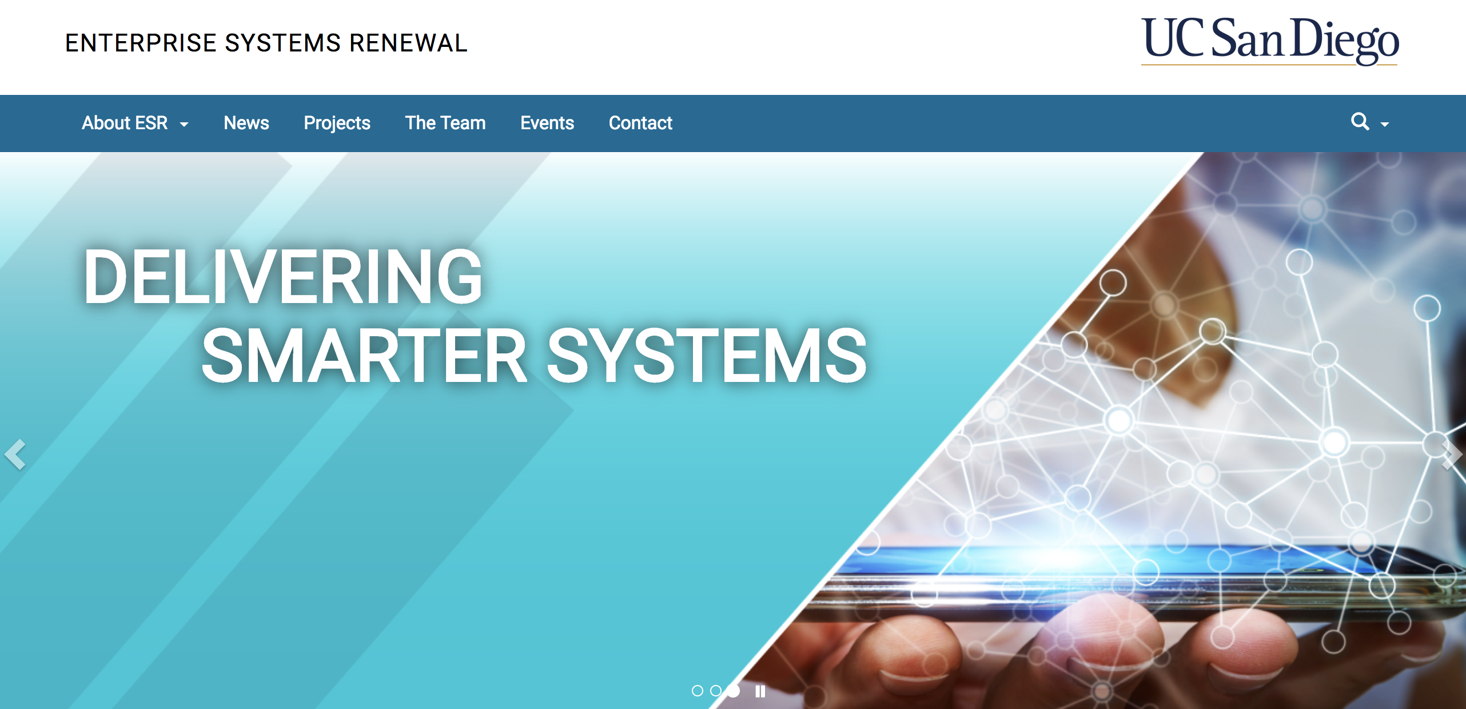
esr.ucsd.edu

