Slide 1
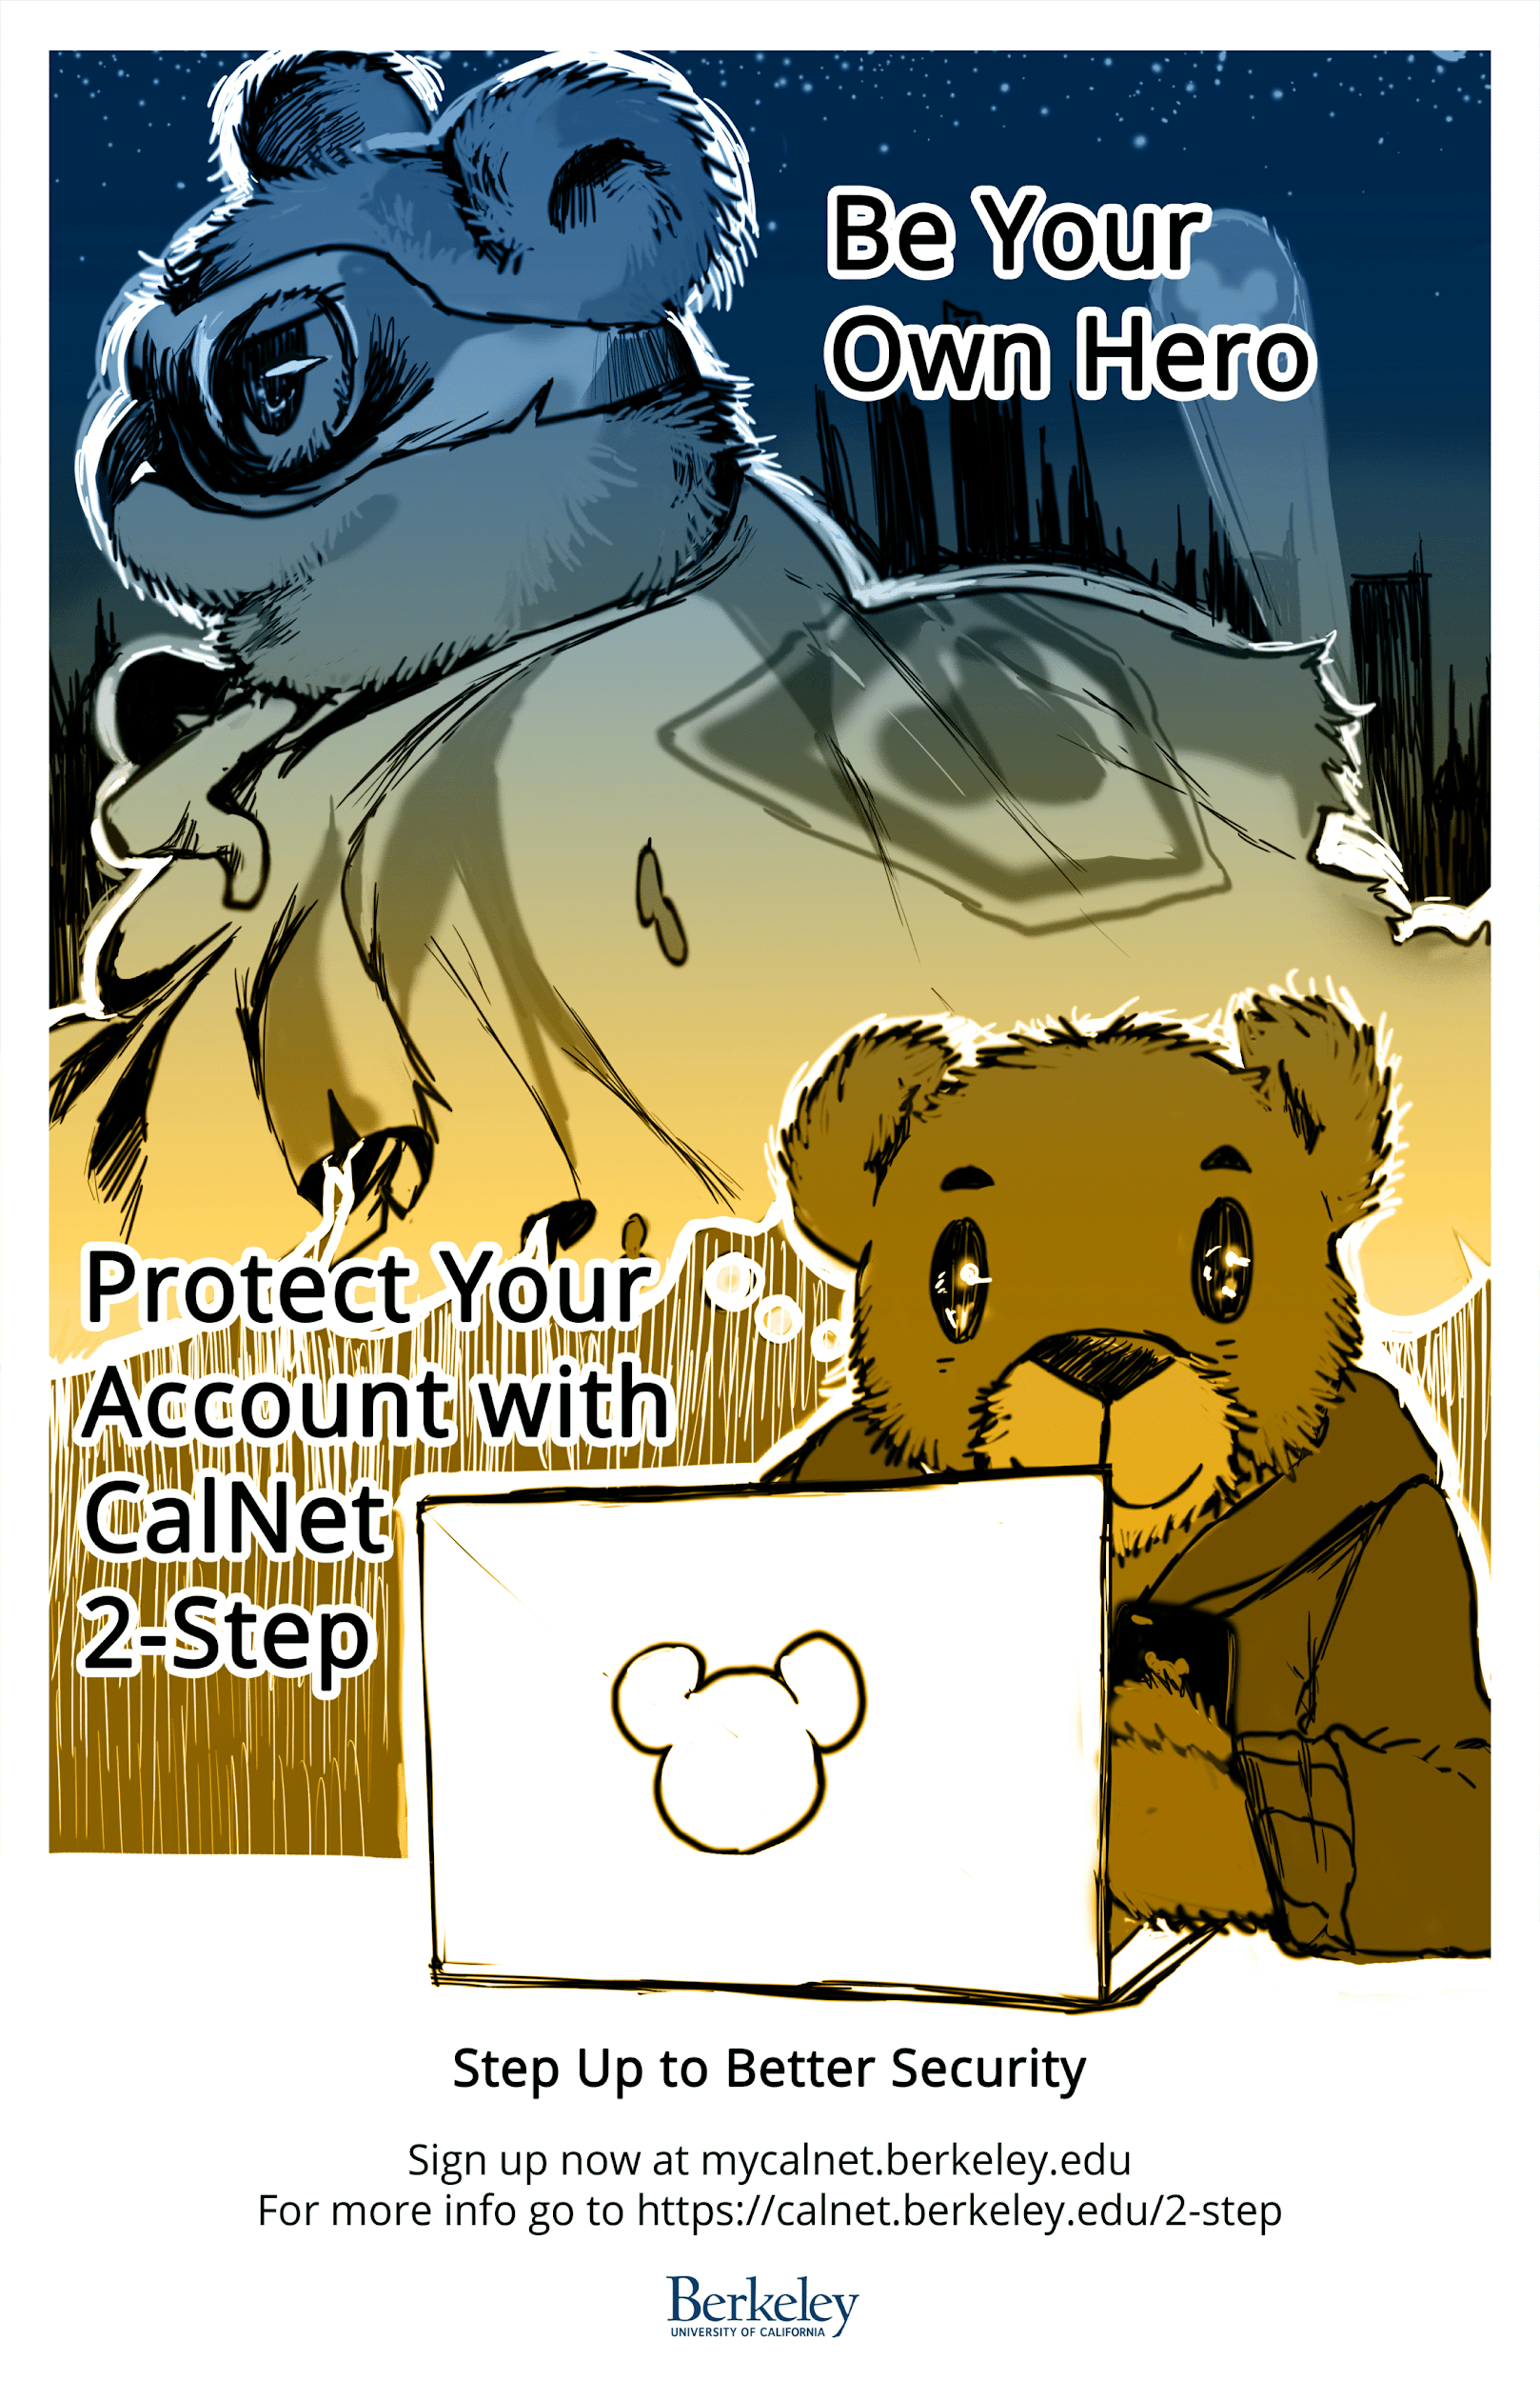
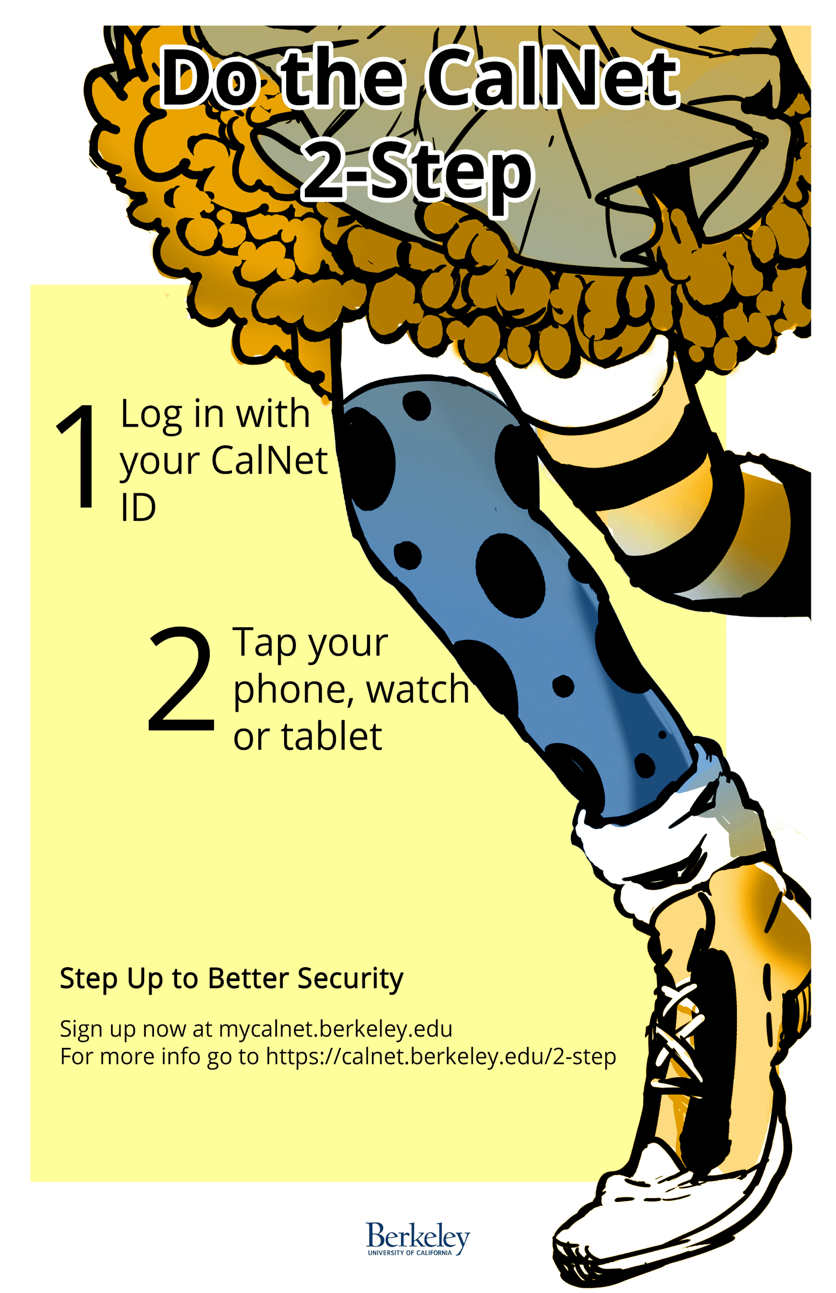

Slide 2

Doing the 2-Step at UC Berkeley
Notes:
Thank you all for coming to one of the last sessions of the last day! We’ll have a prize drawing at the very end and you have to be present to win so stick around! I’m Ronnie Ong, project manager for this project and this is Summer Scanlan, communications and support lead for this project.

Slide 3
Our Project
Implement 2-Step for 25,000 faculty and employees within 3 months.
Notes:
In January this year, our chancellor announced to all staff that they will be required to do 2-Step (or MFA or 2FA). We weren’t sure how we were going to get this done – we didn’t get additional staffing to do this and our team at the time had 4 technical staff in addtion to Summer and me. But by mid-April, we got all 25K faculty and staff on this service!

Slide 4
Proof of Success
Thank you notes from colleagues
Spontaneous shout-out from our EVCP
Achievement award
Metrics
Notes:
Unsolicited compliments from our IT colleagues, and they’re our toughest critics!
Spontaneous shout-out from our EVCP (Paul Alivisatos) during an all IT meeting
Our team won Achievement Award for this effort
Stats from CSS-IT, our Service Desk partner in this project:
Installed users = 31,000
Contacts for assistance = 2486
Contact rate 8% (10% is industry avg)
Avg contacts per week (past 3 months) = 187

Slide 5
Doing the 2-Step:
Our Approach
Notes:
This presentation is about sharing with you how we managed this feat. We’ll give you an overview of the program and share top 10 lessons we learned.

Slide 6
Strategy
Use Duo Service
Branding: CalNet 2-Step
Require at the CAS Level
Allow Opt-in Period
Set 2 Cohort Deadlines

Slide 7
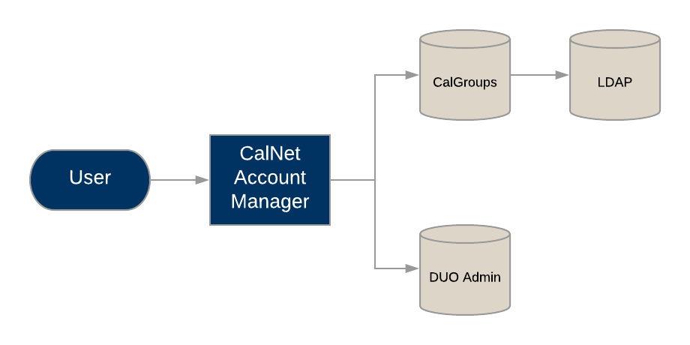
Systems Flow

Slide 8
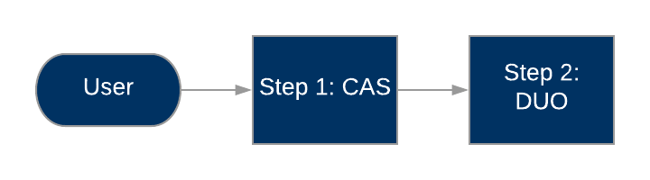
User Authentication

Slide 9
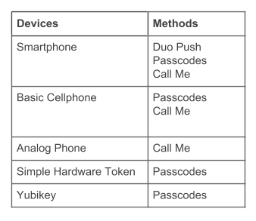
Service Offering

Slide 10
Service Options
Remember Me for 30 Days
Backup Passcodes
The Russian Option

Slide 11
Support
Employee Help Desk
Student Help Desk
Training and Materials
Continuous Feedback
Process Improvement
Notes:
Success, we needed good customer support
Get buy in from Service Desk - new arrangement
Also got the student help desk to help
Shared queue, escalate from student to service desk
Escalation path
Training - limited for students, used docs vetted by service desk
In person with service desk, listened to their comments and suggestions, updated support documentation according to their feedback
Comprehensive user facing materials and FAQ for every scenario we could think of
Continuous feedback - revieved every ticket during the pilot period to find where we can improve on documentation, process and system.

Slide 12
Support
Token Distribution Stations
Drop-in Sessions
FAQ’s
Notes:
How each was set up, what was hard, what worked.

Slide 13
Outreach Campaign
Posters
Website
Contest
Targeted Emails

Slide 14
Outreach Campaign
Reminder in CAS
Volunteers
Info Sessions
Tracking Tool

Slide 15

Doing the 2-Step:
Top 10 Lessons
Learned

Slide 16

10
Have a what-to-do-when-you-travel page.
Notes:
This is a big concern from the academic departments. Let them know what to do to make sure they can authenticate when they travel. Also let people know where 2-Step won’t work.

Slide 17

9
You meet the most interesting
people in drop-in sessions.
Notes:
They are effective for the most disgruntled user.

Slide 18

8
Use all devices and methods Duo offers.
Notes:
So no one can complain that you can’t accommodate them. Also, not everyone has a phone or want to use their phones.

Slide 19

7
Bribery works!
Notes:
We had fidget spinners, iPad contests. Got an increase in enrollment whenever we announce an iPad contest drawing.

Slide 20

6
You can’t count on just emails to get the word out.
Notes:
People don’t necessarily read their emails. Shocking! So we used different channels to get info to users. Also people get info from other sources - colleagues, sometimes their bosses. The most effective way we got attention? CAS warnings. We put those on 2 months before the deadline.

Slide 21

5
Documentation, documentation, documentation!
Notes:
Have documentation for end-users and Help Desk and keep them up-to-date

Slide 22

4
Help departments help themselves.
Notes:
In order to help departments help themselves on this effort, we gave them a tracking tool to see who’s enrolled and who’s not so they can harass the right people

Slide 23

3
Get students to help.
Notes:
We worked with Student Tech Services to have them offer support. We also hired student assistants to help with this project. We love our students! They ended up designing our posters and this slide deck. ☺

Slide 24

2
Work with your partners from the get-go.
Notes:
Worked with CSS-IT from the beginning of the project to plan, etc.

Slide 25

1
It takes a village!
Notes:
Get your colleagues to own this effort with you. Get them into the loop on what you’re doing, problems, progress - the good, bad and ugly. And listen to their feedback and take action. They appreciate being helpful and being heard. Because it takes a village to get everyone on 2-Step

Slide 26
Questions?

Slide 27
Resources and Contacts
2-Step Website:
https://calnetweb.berkeley.edu/calnet-2-step
Project Manager: Ronnie Ong
ronnieo@berkeley.edu
Communications and Support Lead: Summer Scanlan
sscanlan@berkeley.edu

