Slide 1
Research Data Services Summary
Aug 14^{th, 2018}
Martha Michel, Ph.D., MS UCSF
UCCSC Conference, UC Davis
Notes:
Brief bio of me

Slide 2
Outline
Brief exercise plus intro
Our data sources
Old process
Change
Where are we going
Notes:
Our intake process was that we met with the client, wrote some notes in service now, and delivered

Slide 3
Exercise

Slide 4
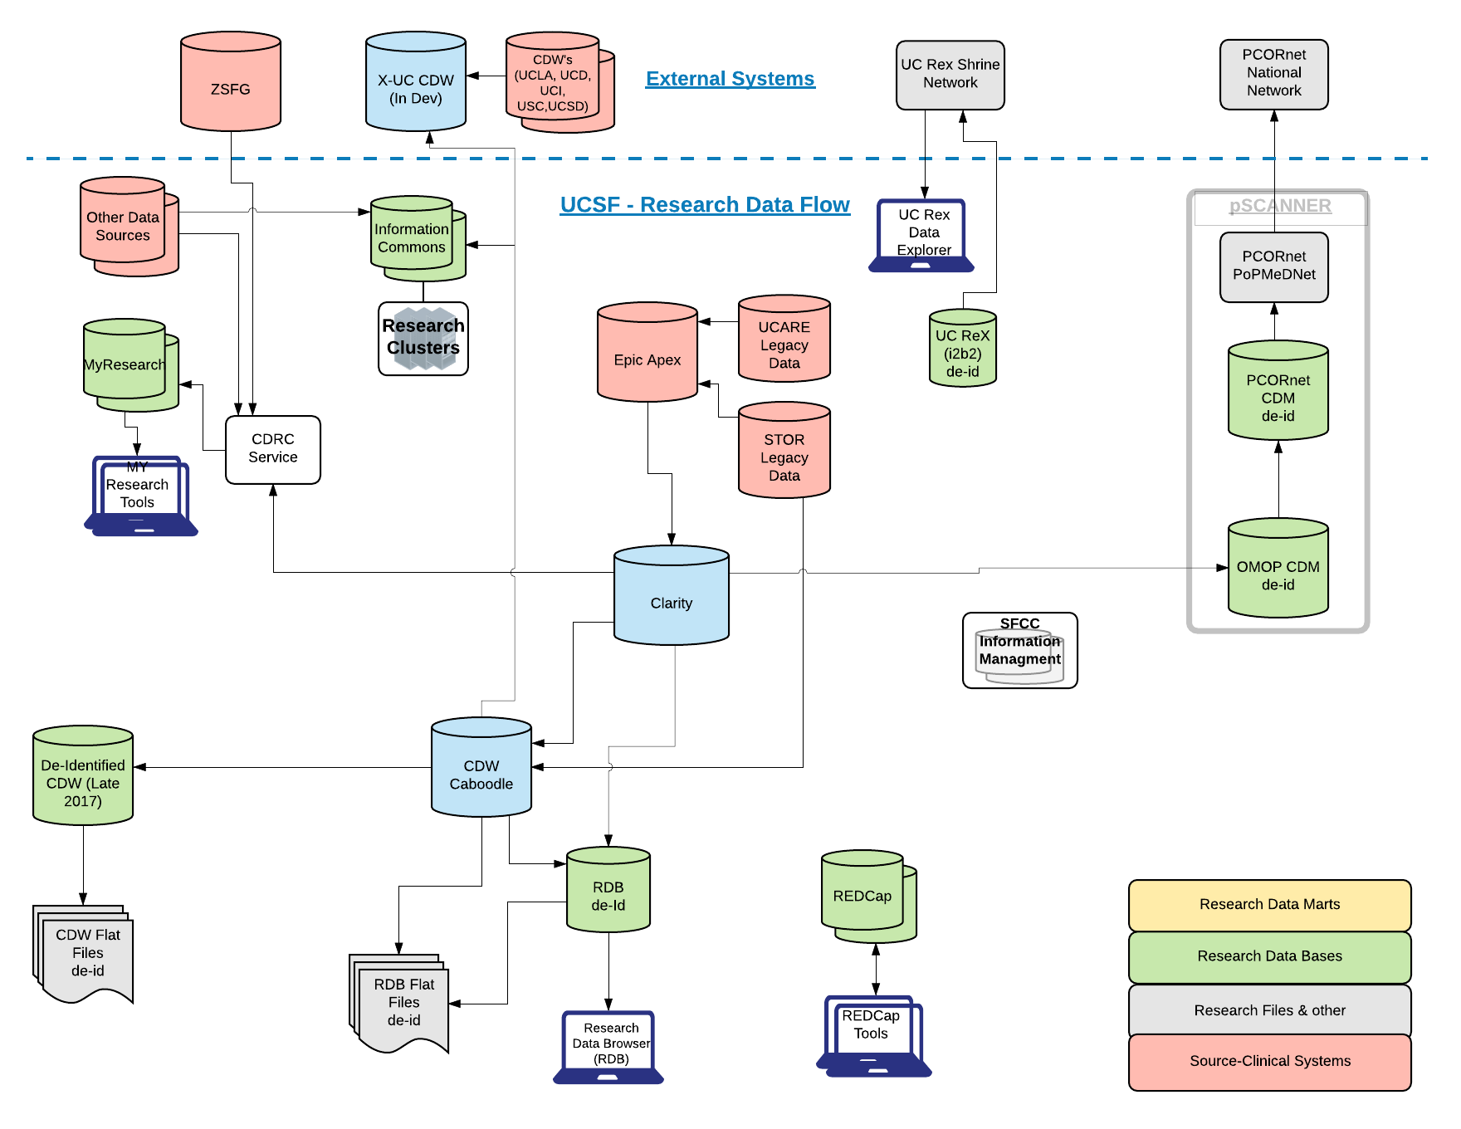
Data Sources: UCSF and ZSFG

Slide 5
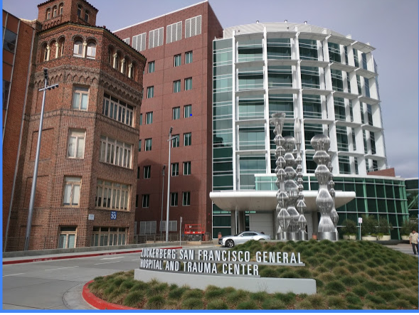

Slide 6
ZSFG Data Sources Available for Research
Invision (procedures, diagnoses, visits, demographics ) 1990 ->
LCR on Cerner – Lifetime Clinical Record (labs, notes, meds) 1997 ->
eCW – OP charting system (clinics – provides meds, notes, some labs) 2011 ->
Jail Health- for SF inmate population
Community Behavioral Health- includes the Avatar charting system
Laguna Honda – long term stay facility
…

Slide 7
Data Sources: ZSFG
Scenario | Self-serve (Free) | Consult Required (May have recharge) | IRB needed | Requires MyResearch account or other secure environment | Includes clinical notes
Counts | No | Yes | No | No | No
De-ided data | No | Yes | No | No | No
Limited data | No | Yes | Yes | Yes | No
Id’ed data | No | Yes | Yes* | Yes | Sometimes
* Process requires separate IRB approval
clinicaldata.ucsf.edu

Slide 8
Data Sources: UCSF
Scenario | Self-serve (Free) | Consult Required (May have recharge) | IRB needed | Requires MyResearch account or other secure environment | Includes clinical notes | UC Health data available in addition to UCSF data
Counts | Yes | Yes | No | No | No | Yes
De-ided data | Yes | Yes | No | No | No | Yes *
Limited data | No | Yes | Yes | Yes | No | Yes *
Id’ed data | No | Yes | Yes | Yes | Yes | Yes *
* Process to obtain data from UC Health sites can be very lengthy
clinicaldata.ucsf.edu

Slide 9
Time Frame | UCSF Count | UCSF Average Days Open | ZSFGH Count | ZSFGH Avg Days Open
Closed 2017 June-Dec | 70 | 50 | 12 | 194
Closed 2018 Jan - Feb 19th | 17 | 50 | 4 | 78
Current Open Tickets as of 02/19/18 | 29 | 48 | 8 | 57

Slide 10
Streamlining our processes
Intake process
Ticket meeting
Peer review
Quick disclosure
Intake
Intake
SOW
Begin Work
Peer Review
Data Delivery
Quick disclosure and Closure!
Notes:
Our intake process was that we met with the client, wrote some notes in service now, and delivered

Slide 11
Streamlining our processes- Intake
Client used to be able to submit tickets
Analyst would self assign and we had no limit on number of free hours we worked on tickets
Current intake by Center for Translational Science Institute at UCSF (except for ZSFG which ARS (Academic Research Systems in IT) does
Review brief power point with client
Pick list of procedures and ICD 9/10 codes for clients
Notes:
Our intake process was that we met with the client, wrote some notes in service now, and delivered. Covers the expectations SOW process, and iterative nature of our work

Slide 12
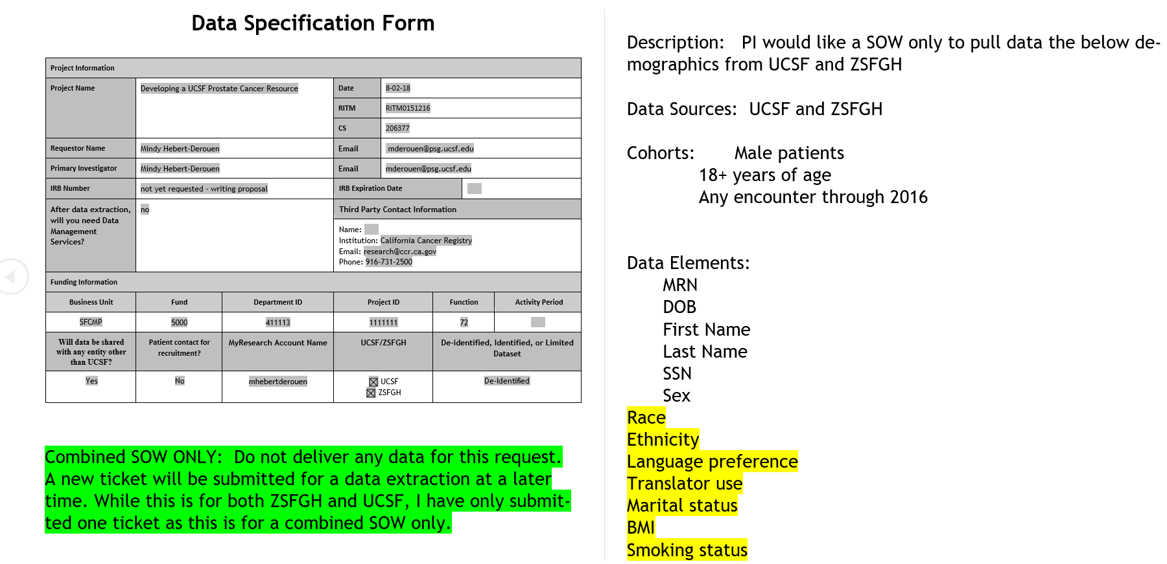
Data specification form

Slide 13
Streamlining our processes – Ticket meeting
Review status of all open tickets
Review blockers
Review iterations with clients
Assign new tickets
Notes:
Our intake process was that we met with the client, wrote some notes in service now, and delivered

Slide 14
Streamlining our processes – Peer Review
Double check the IRB
Check who gets the data and the type of data
Double check data elements and request as well as code
(true positives, false positives and positive predictive value)
Notes:
Our intake process was that we met with the client, wrote some notes in service now, and delivered

Slide 15
Streamlining our processes- Data delivery and quick disclosure
Data is delivered into HIPPA compliant environment
We, as part of our honest broker function submit all the MRNs we disclosed to the researcher into a table, which is bulk imported back into Epic frontend.
Notes:
Our intake process was that we met with the client, wrote some notes in service now, and delivered

Slide 16
Summary
Bringing on a dedicated resource, expanded access to key systems and process improvements have improved key metrics around data request turn-around times and backlog.
  As a historical reference in 2016 UCSF and ZSFGH’s average time to close tickets was over 130 days
From June 2017-Feb 2018 we delivered data to 15 different requestors for ZSFG
In the mid-term ZSFGH will continue to be more challenging based on the fact that the data spans across multiple legacy systems
Days spent on tickets decreased as a result of these policies and processes.
Researchers need analysts to work with them and investigate new sources of data but
have learned to work within the new structure.
Notes:
The collaboration with the ZSFG team is going well
With the upcoming ZSFGH Epic migration the UCSF CDRC team could be very helpful given they are all Epic certified

Slide 17
New Directions!
Streamlined RDD process
Quick disclosure for campus analysts
Continual improvement with respect to security and privacy with an eye toward HIPPA. IE what about datasets that expire, what about data refreshes that have an expired IRB?

Slide 18

Stress Free UC

