Slide 1
A Tale of Two Factor
Going BIG with two-factor authentication at UCSF
Kevin Dale, John von Eichhorn, Erik Wieland
Notes:
John
John von Eichhorn, Associate Director, IT Service Desk

Slide 2



The Threat
It was the worst of times…
Phishing was up 41% in Q2 2017 compared to Q1
  1 in 131 emails contained malicious content
  1 in 10 people were falling for a phishing message
Health organizations are high value targets
  Medical records valued up to $1000
Known instances of our users giving up credentials
Notes:
John
Introduction
Initial deployment was targeting email threats primarily.
We rolled out to OWA off network and VPN to cover all email access with 2FA
Stats on value vary widely over time. At all times Med records more valuable. Some estimates in 100s of dollars per.
SSN: $1, Drivers Lic.: $20, Medical record: $1000 -

Slide 3
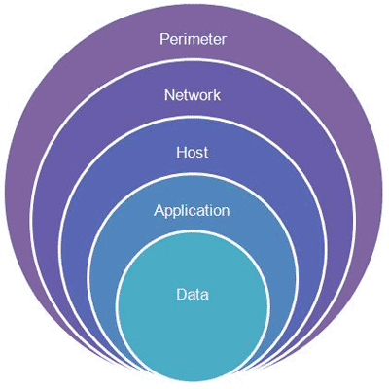
What UCSF was Already Doing
It was the spring of hope…
Two layers of spam filtering
  >85% of emails sent to UCSF addresses are
  blocked before they hit client spam folders
Web filtering that blocks UCSF visits to known malicious sites
Simulated phishing tests to raise user awareness
Incident response to reports of suspect messages from users to IT Service Desk
Filter to test whether links in email are safe
Notes:
John
UCSF was already doing quite a bit to combat the phishing threat

Slide 4

Our Ability to Respond
It was the season of Darkness…
Move to Exchange Online reduced UCSF visibility into credential use/abuse
HIPAA reporting requirements: guilty until proven innocent – no safe harbor
Notes:
John
A couple areas were still vulnerabilities.

Slide 5
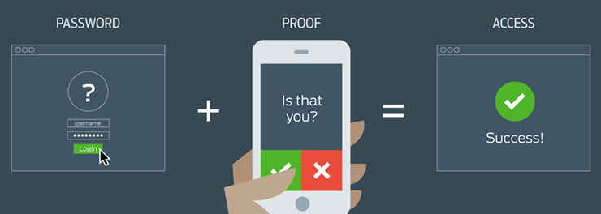
Why Two Factor?
It was the age of wisdom…
Effective against credential compromise via phishing
IT was already using two factor internally
HIPAA notification requirements mitigated if PHI involved
Notes:
John
Industry standard
UCOP recommendation
IT was using Duo for VPN access
If email compromised, but Duo authentication not logged we have confidence that no breach has occurred and do not have to report via HIPAA.

Slide 6

Why Duo
Selection
Contractual obligation, was just for 100 hundred or so users
Minimal Cost - not enough to do a full RFP
Duo selected based on
  Internet2 (Cheaper)
  Gartner magic quadrant
Infrastructure
Duo was attractive as it could be easily implemented,
  Use existing AD credentials
  Supported the applications UCSF needed out of the box
Notes:
Kevin
Kevin Dale, Manager, Identity & Access Management

Slide 7
Duo Implementation
Only using out of the box features
  UCSF uses Active Directory (AD) for authentication
  Users provisioned, deprovisioned in Duo by AD groups
UCSF does not use Duo API…yet
  Adding self-service features in future
Version
  Started with MFA Edition
  Currently using Access Edition
Notes:
Kevin
We need provide self service features for users
Adding, removing an alias
Updating email address

Slide 8

Duo Rollouts
started very small, now very big
2015 Small, initially 100 or so users
  Users were provisioned manually
  during initial rollout ~6 months
2016 Security 2.0 added for all IT as users, up to 3k users
  For VPN, Server Access (Windows and Linux)
  Added AD Sync (3 main AD Domains) for automated pro & de-provisioning
2017 Rolled out to all UCSF, Now > 34k users
  All users for VPN, Outlook Web Access (OWA)
Notes:
Kevin

Slide 9
Duo Usage
Duo Statistics August 24, 2015
 | Count | Provisioned | % | Authenticated | %
Invited | 895 | 894 | 100% | 697 | 78%
Admin | 454 | 454 | 100% | 103 | 23%
Vendor | 38 | 38 | 100% | 10 | 26%
Consultants | 33 | 32 | 97% | 21 | 66%
Others | 103 | 103 | 100% | 84 | 82%
Total | 1523 | 1521 | ~100% | 915 | 60%
Notes:
Kevin

Slide 10
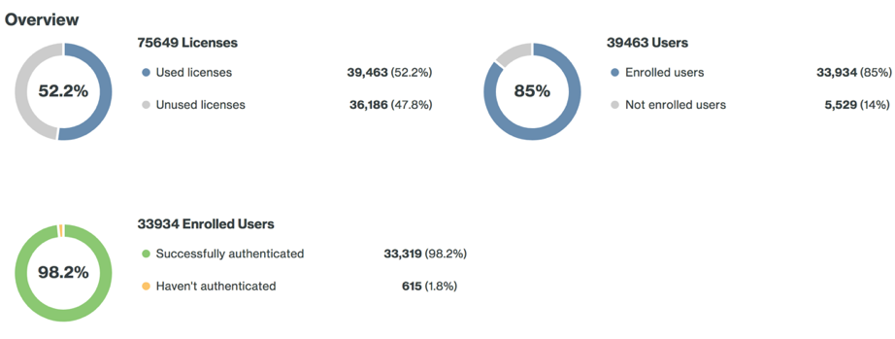
Duo Usage
Duo Statistics August 3, 2018
Notes:
Kevin

Slide 11

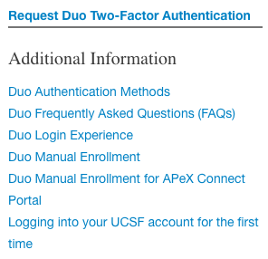
Preparation
Pilot
  Self-service tools: MyID, manual enrollment
  Test all situations
Capture
  Accept all feedback
  Categorize and share
Notes:
Erik
Erik Wieland, Manager of Communications, Content Services & Cloud Apps; IT project Customer Champion
Created self-service tools
MyID: show me all about my AD accounts
Self-enrollment in Duo: no need to have that QR code
Test all situations
Travelers in Vietnam (poor connectivity), Kenya (blocked IP space), Mozambique (flooding and power outages)?
People without smartphones, or not allowed to use smartphones (nurses)?
People in flight on a plane, and can only connect one device at a time?
Feedback comes from engaged people, who want us to be successful
General information for all users: how do I enroll? How does it work with common applications?
Targeted information for specific users: new faculty, staff, students; clinical users

Slide 12
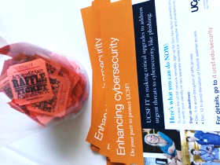
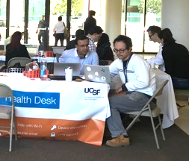
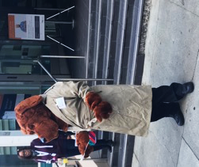
Community Engagement
Consistent language explaining risk, benefits
Target Trust, Community, Responsibility
Signs, newsletters, websites/portals, emails, webinars, meetings, pop-up messages, handouts
Town Halls, Health Desk events, Staff Appreciation events
Notes:
Erik
Risks are real and we have to act, this will make things better, we’re all in this together, we have your back
Use the industry’s language and relevant analogies: something you know, something you have (when someone else knows what you know, we’re still protected)

Slide 13

Support Concerns
Big Bang approach – Anticipated large support burden for rollout
User Experience – How can we make this as easy as possible for the end-user while meeting our goals for rollout pace?
Escalations – Plan for addressing clinical operations, VIPs
Notes:
John
Significant pressure to get this done very quickly (Chancellor’s directive to ”move purposefully”)
With aggressive timeline, we were deploying Duo to a large population in a short time and needed to accommodate anticipated support needs.

Slide 14

Staffing
Internal
  Contractor ramp up at IT Service Desk
  Assistance from IT Field Services on phones
  Health Desks
External
  Partnership with
  established call center
  at external vendor
Notes:
John
We needed more than our dedicated staff could offer
Internal –
We held onto contract staff that would normally have been released in November due to seasonal volume trends.
Rapid onboarding of 5 additional agents for the project.
Prepped to use IT Field Services staff.
Identified resources
Provisioned access
Training
Process definition – Set expectations with Field Managers on how/when to pull in additional resources (3 tiers)
Health Desks – Walk up support was popular and took on considerable volume of users.
Yubi Key distribution was handled at Health Desks
Those with SmartPhone questions/issues benefited the considerably from the walk up experience.
EXTERNAL
HCL partnership – Established call center on East Coast. Pulled in 6 resources there, trained and prepped.

Slide 15

Staffing: Lessons Learned
Onboarding agents to full effect often takes longer than expected. Staff early!
Partnering with an external call center also took considerable time and effort. Lead time is key.
Notes:
John
External partners, while experienced Service Desk Agents, lacked familiarity with UCSF processes and policies. It took considerable effort to get them ready for calls. If there had been an ongoing relationship where we used the call center for seasonal spikes, this could be a good option for rapid expansion, but going from 0 to 60 took as long as recruiting and pulling in contractors directly.

Slide 16
Operational Approach
Custom phone queue – rapid entry for Duo questions
Agent skilling to accommodate Duo-related traffic while keeping other services open for business.
In-person events
Close eye on volume metrics to adjust resource use
Notes:
John, then Erik last 2
We set up a quick menu option in our phone line welcome message allowing users with Duo questions to get into that specific queue quickly
This allowed us to get new agents onboarded more quickly by focusing them on Duo and Password administration and skilling them only for the Duo and Password queues.
While Duo was an ”All hands on Deck” exercise, we kept specific agents away from the overflow queues to ensure critical services were supported.
Long wait times across the Service Desk, so keeping Clinical Agents in reserve for example was important to ensure patient impacting issues were addressed in a timely manner.
Erik: SOM Tech team led the heavy lifting on communications, webinars, surveys, events. In-Person events at the Health Desks and pop-ups helped to get significant numbers of users enrolled quickly and easily. Cookies, brownies and various baked goods, combined with coffee, helped! We were also supported by the local IT departments, who were (almost) universally behind our efforts.
Erik: Throughout the rollout we were regularly reporting on call and ticket volumes to inform adjustments to our queue skilling as well as triggering the call for additional help from IT Field Services. We tracked the uptick in enrollments from events, and added events as a result.

Slide 17
Go-Live
Big Bang
Notes:
Erik
The final enrollment looked like this. We added all remaining accounts tied to an email address to the AD group, synchronized with Duo, and Duo started sending out the enrollment emails. Open enrollment for 1 week, then big bang for VPN.
We’re going to look at the support response in two ways: targeted, and general. They supported and reinforced each other, but since I’m the one who’s talking right now I’m starting with the targeted response.

Slide 18
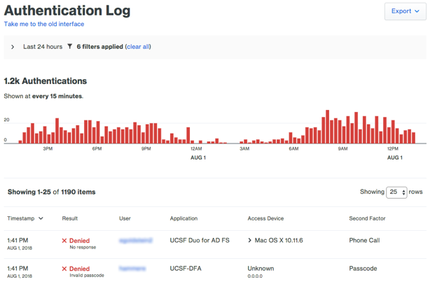
Proactive Support
Figure out who’s having trouble logging in
Notes:
Erik
A former Ford CEO said that a happy customer will tell 5 people, and an unhappy customer will tell everyone they know. It’s much easier to retain your customers’ trust that try to regain it after a bad experience. So our goal was to support every customer.
My role was Customer Champion. I used Duo’s excellent reporting to locate customers who were having trouble with the process.
Correlate enrollment status, device registration, login failures

Slide 19
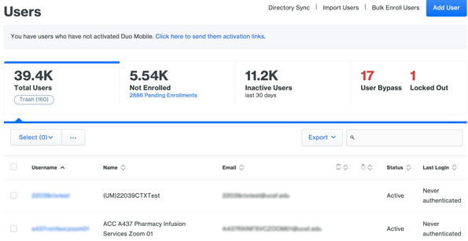
Proactive Support
Figure out who’s having trouble logging in
Compare to who’s never registered device or authenticated
Notes:
Erik
Finding the sticky wickets in the data
Correlate enrollment status, device registration, login failures

Slide 20

Proactive Support
Figure out who’s having trouble logging in
Compare to who’s never registered device or authenticated
Reach out and offer assistance
Notes:
Erik
Customers were delighted that we cared enough to do this. Each time we also made sure they knew about the Health Desks and the special Duo hotline at our IT Service Desk.
I tracked my outreach over time, to make sure the same customers were successfully enrolled and authenticating. It worked!

Slide 21
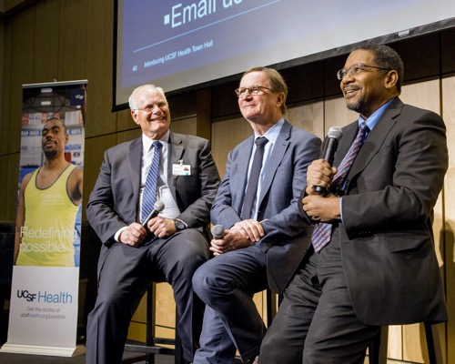
VIP Support
Centralized response to complaints, escalations to leadership
Consistent messaging, process
Respond with facts, help – not defensiveness
Notes:
Erik
Our leadership helped us communicate the importance of this effort…which meant they got a lot of direct feedback. I captured and responded to all of it. The fact that they got a response surprised most people. We found a LOT of people operating on the edges of the enterprise, including many volunteer clinical faculty. These are faculty who teach once a year, but otherwise don’t interact with IT. They were effusive in their praise for our efforts.
The takeaway was that the best response was genuine concern, and specific instructions on what customers needed to do to get back to work. The point of this exercise was to keep everyone working!

Slide 22



Results: Enrollments
55% of users enrolled in first 4 days
93% in first 3 weeks
“…one of the quietest go-lives I’ve witnessed.”
-Joe Bengfort, CIO
Dec. 2
Dec. 21
Today
Notes:
Erik
The yellow is the area where I focused my targeted efforts.
Our support staff were slammed, but most customers were patient. We expected it to be much worse.

Slide 23
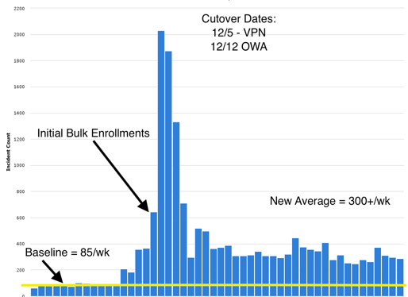
Results: Support Volume
Early adopters helped us hone response
Duo enrollment emails generated most traffic...
Followed closely by those surprised by cutover dates
Most issues related to RTFM
Notes:
John
This is a snapshot of weekly volumes for Duo/VPN – related contacts to the Service Desk - All on top of the usual day to day.
With the flood of communications we got some early adopters who helped us test our technology and response
Big Bang held true to its name, with the mass enrollment causing the biggest spike in traffic as users called in for help enrolling.
Our two cutover dates were the second largest volume generators as those who somehow missed all the communications were stuck needing to authenticate with Duo.
By far, we found most calls/contacts were due to users not reading the instructions sent to them.

Slide 24
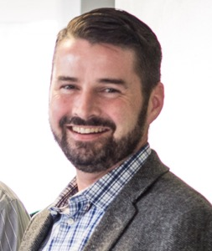
Did We Succeed?
Improved visibility on, response to compromised accounts
Better HIPAA safe harbor, simplified incident response
Better data on system access, usage
The Smilin’ CISO
Notes:
Erik
Proof that even if credentials are stolen, they weren’t used
Pat Phelan, the “Smilin’ CISO”

Slide 25

Lessons Learned
Stop shooting yourself in the foot
Collapse your domains today!
No amount of testing will make
everyone happy
Get your leadership to take point
Staff up early, and keep staffing
Test very early, and keep testing – eat your own dog food
Push for push – use the app to save time and money, better security
Ready for PATH? Duo now!
Notes:
Kevin and others
Better security: cf. Reddit SMS man in the middle compromise

Slide 26
Questions?
A Tale of Two Factor – UCCSC 2018

